Slide 1
Something To Tell the GrandCows
By: Elleen Spinelli

Slide 2
assortment: a group of different kinds of things

Slide 3
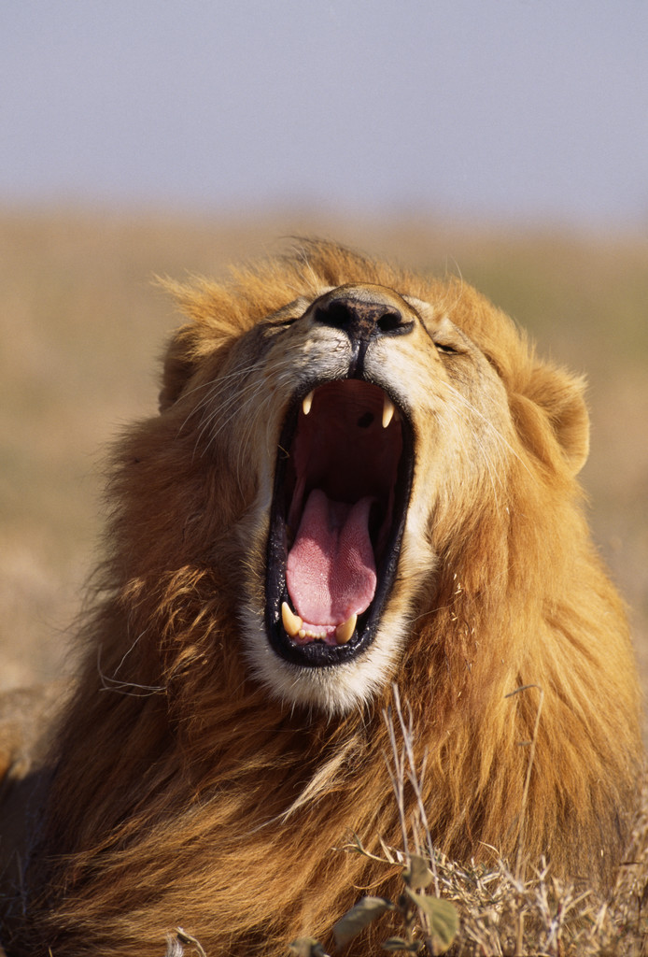
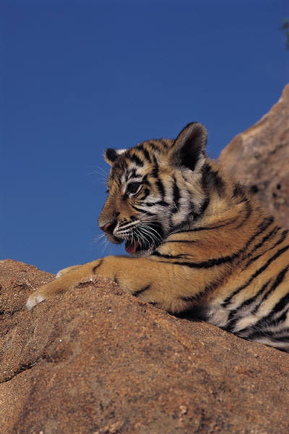
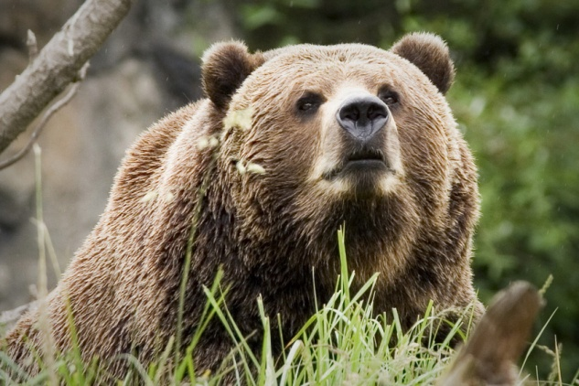
fierce: wild and dangerous

Slide 4
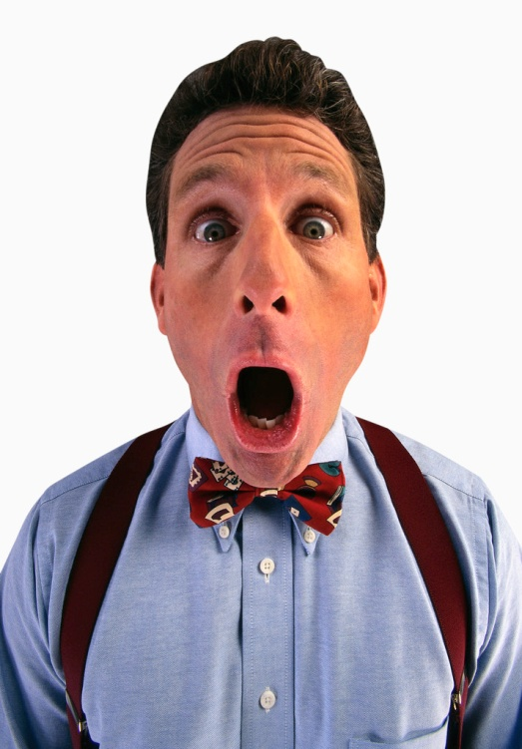
amazed: showing great surprise.

Slide 5
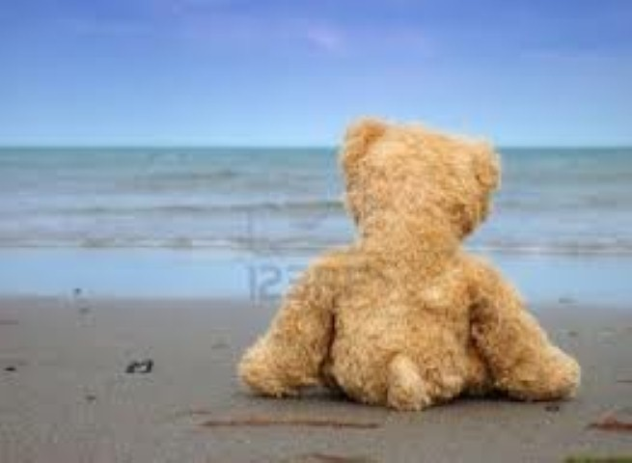
Which picture goes with assortment?

Slide 6
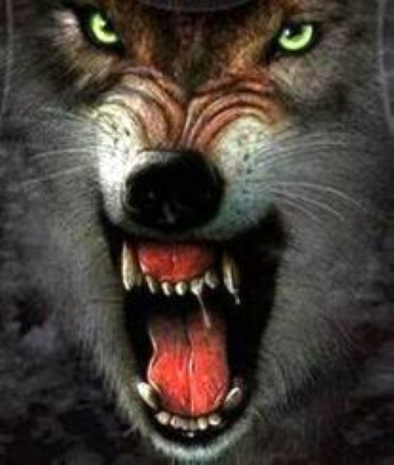
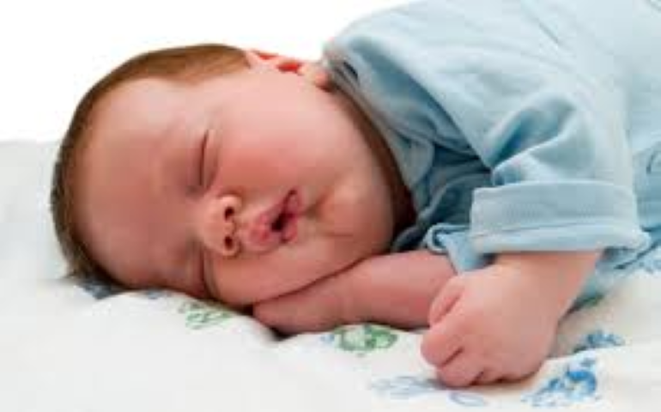
Which picture goes with fierce?

Slide 7
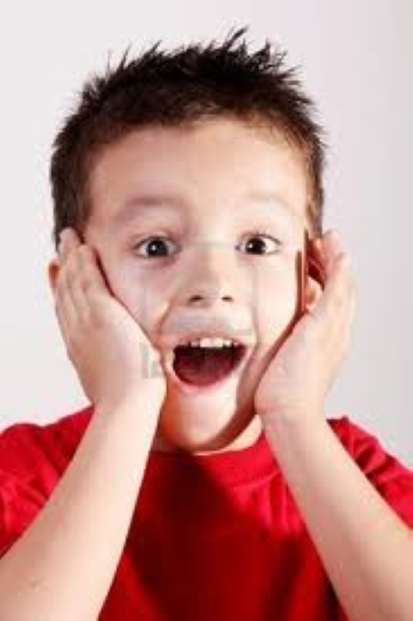
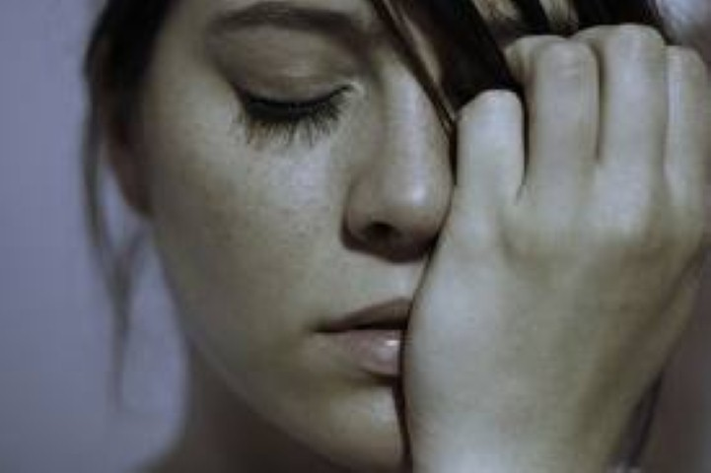
Which picture goes with amazed?

Slide 8
Does this picture show assortment, fierce, or amazed?

Slide 9
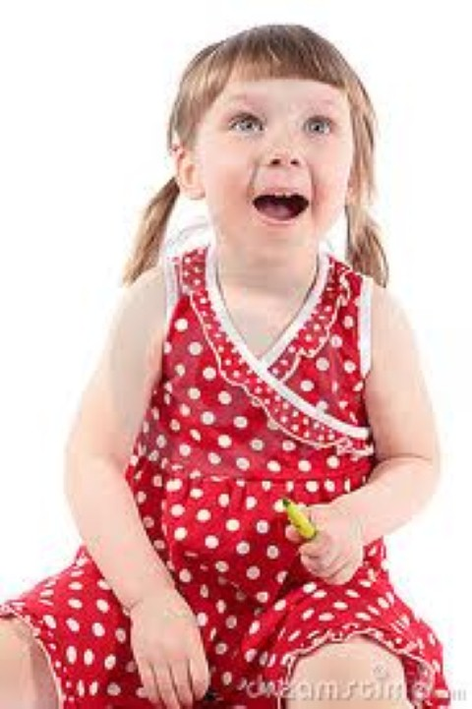
Does this picture show assortment, fierce, or amazed?

Slide 10
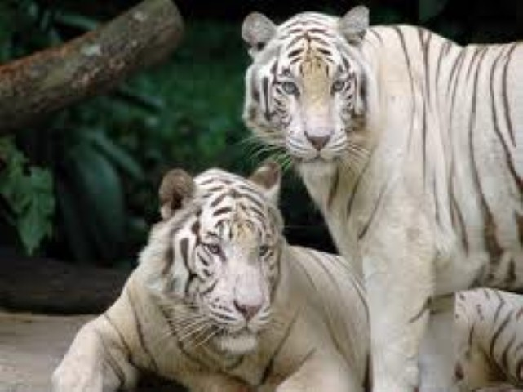
Does this picture show assortment, fierce, or amazed?

