Slide 1

Lon Po Po
By:
Ed Young
Kindergarten
Old Wire Road Elementary

Slide 2
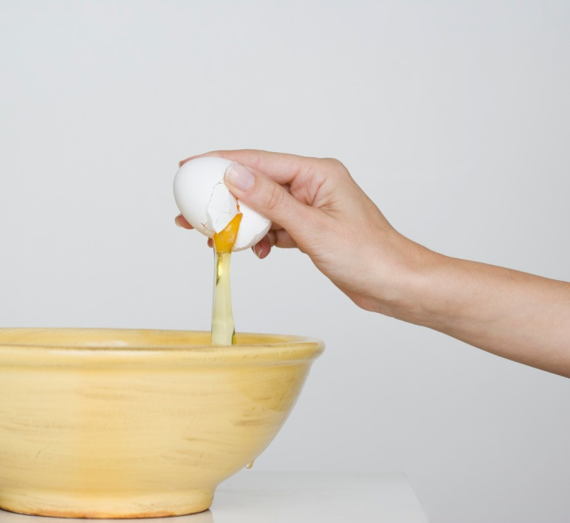
brittle:
easily broken

Slide 3
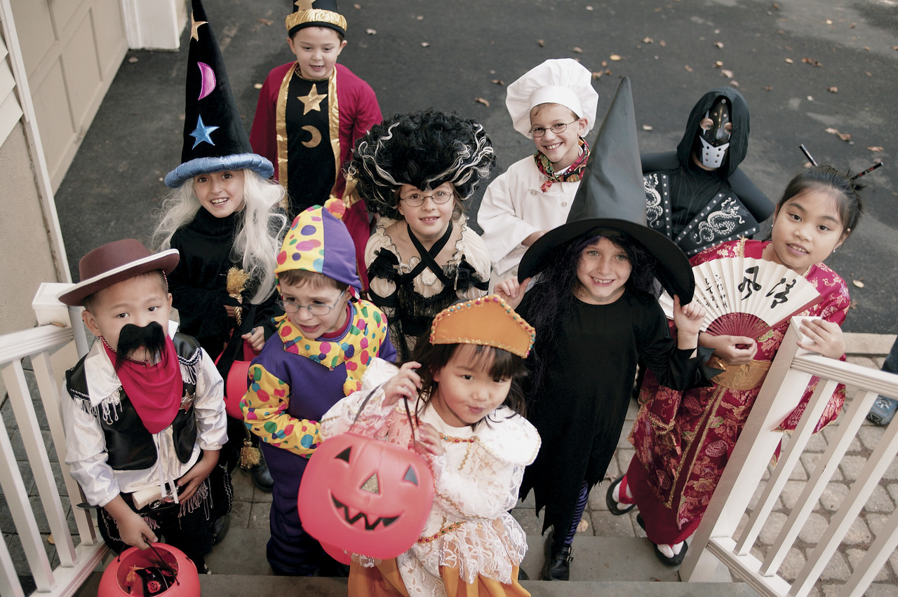
disguised:
Put on a costume to cover up who you really are

Slide 4
plucked:
pulled out quickly

Slide 5

Which picture goes with brittle?

Slide 6

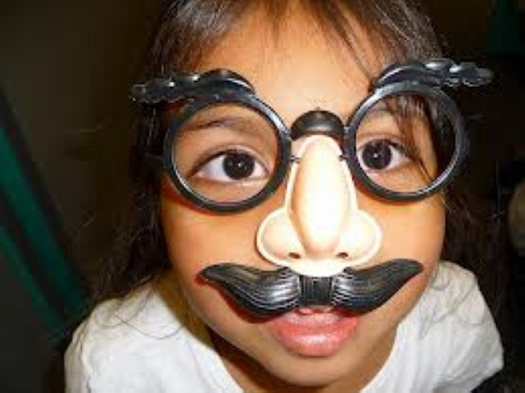
Which picture goes with disguised?

Slide 7

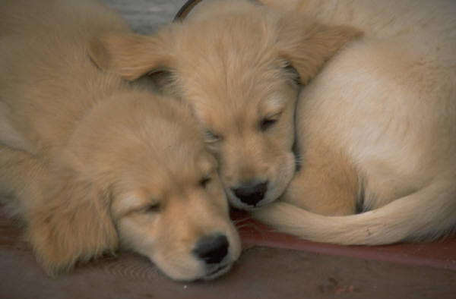
Which picture goes with plucked?

Slide 8
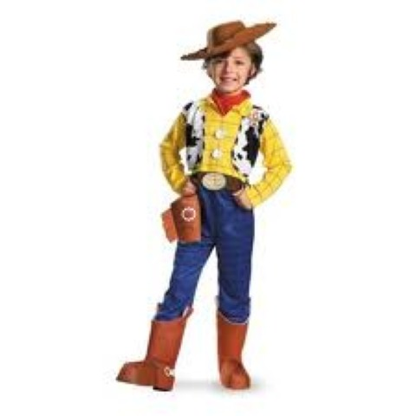
Which word goes with this picture: plucked, disguised, brittle

Slide 9
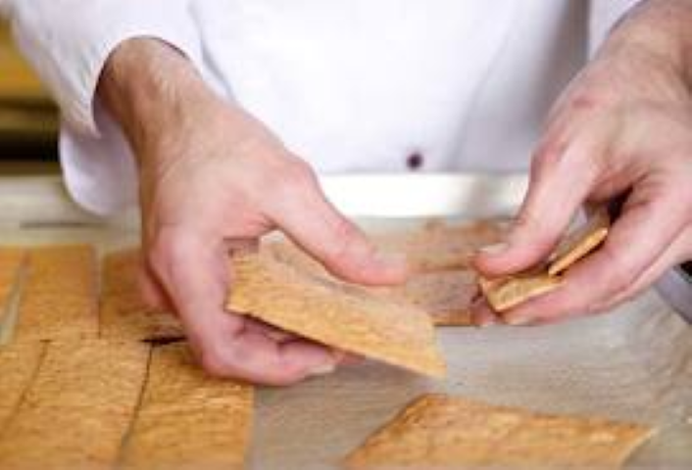
Which word goes with this picture: plucked, disguised, brittle

Slide 10

Which word goes with this picture: plucked, disguised, brittle

