Slide 1
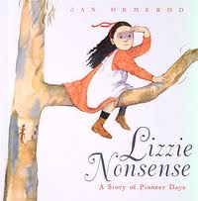
Lizzie Nonsense
By Jan Ormerod

Slide 2
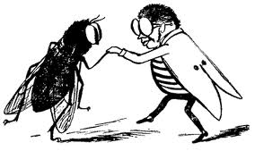
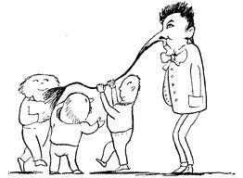
nonsense- silly or makes no sense

Slide 3
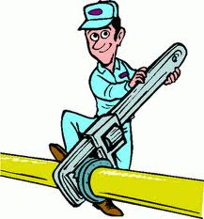
mending - fixing

Slide 4

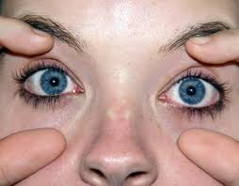
broad – wide and full of space

