Slide 1
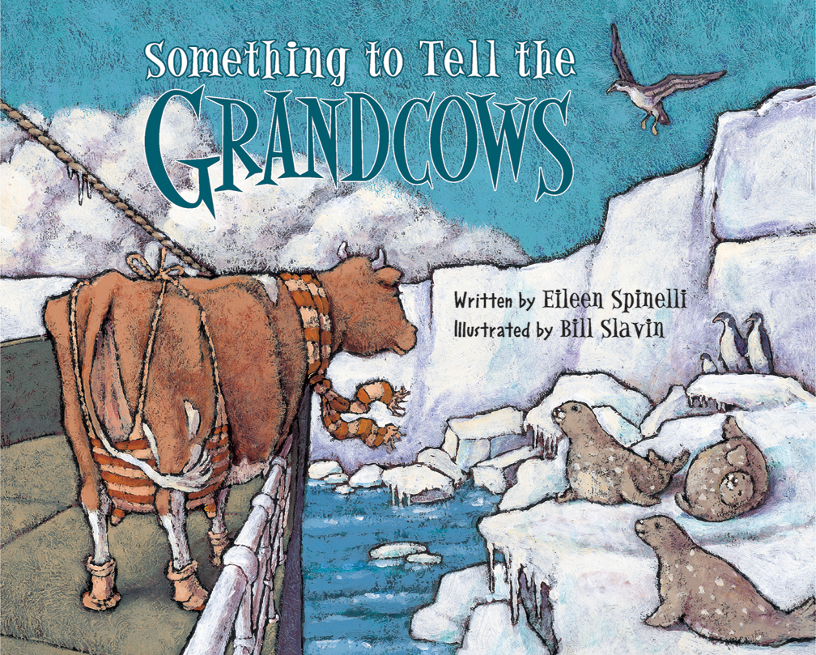
Something to Tell the Grandcows
by Eileen Spinelli and Bill Slavin

Slide 2
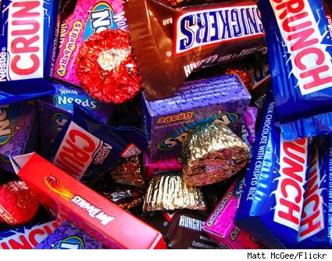
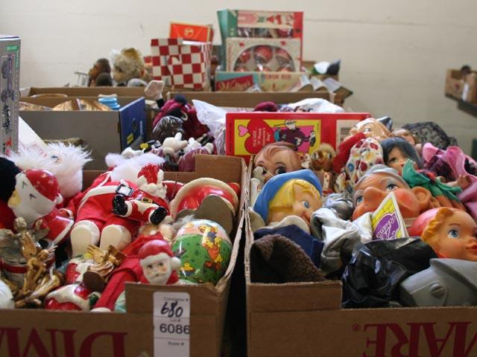
Assortment- a group of different kinds of things.
I can see an assortment of toys.

Slide 3
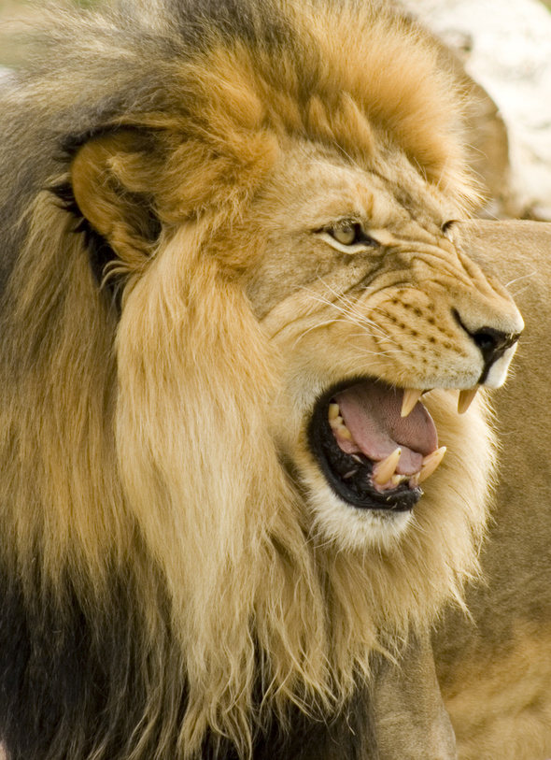
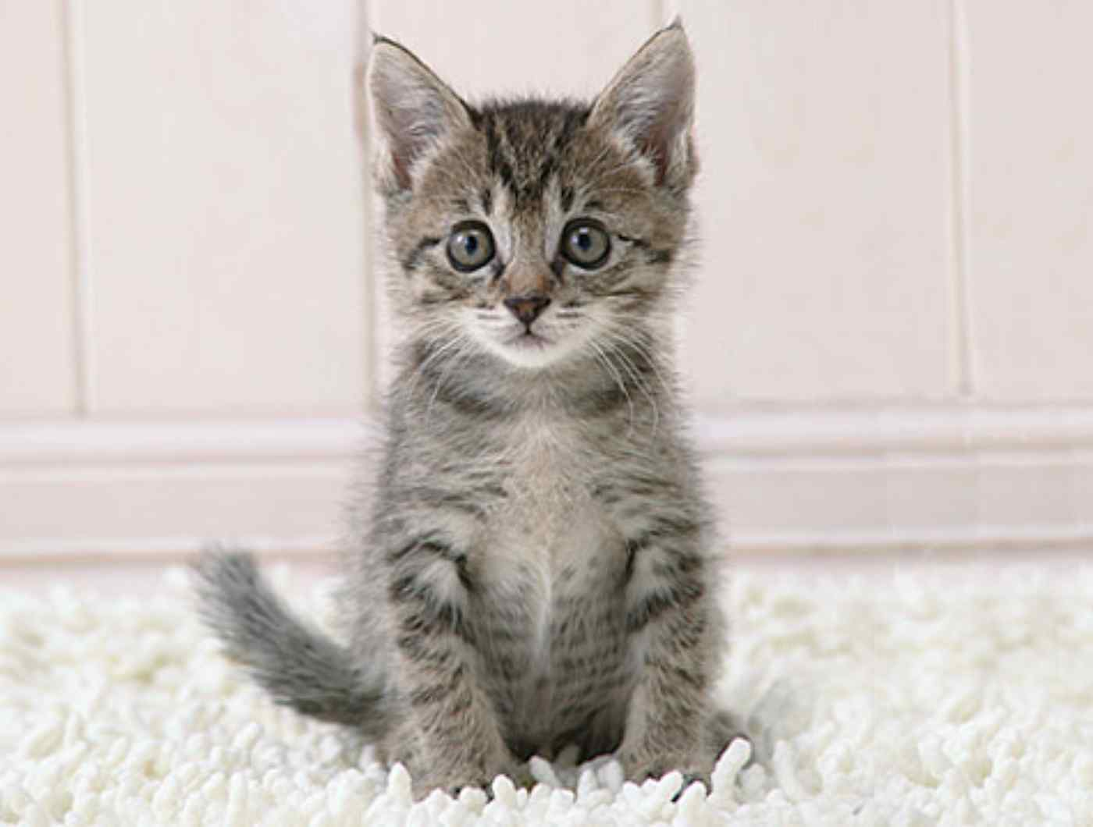
Fierce- wild and dangerous.
The lion is a fierce jungle cat.

Slide 4
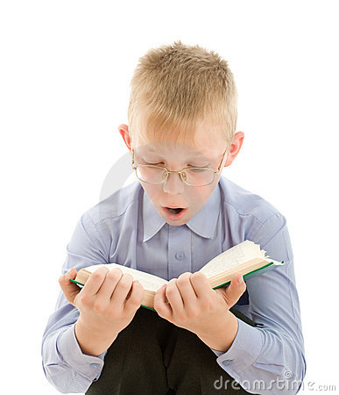
Amazed- showing great surprise.
The boy looked amazed by the characters in the story.

