Slide 1
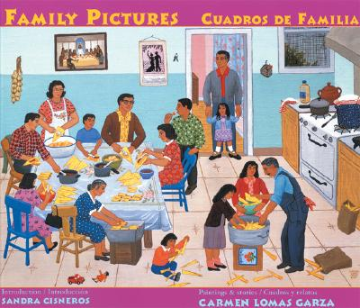
By Carmen Lomas Garza

Slide 2
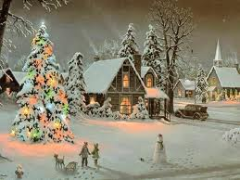
Scene- the setting and all that is in it.
What do you see in this Christmas scene?

Slide 3
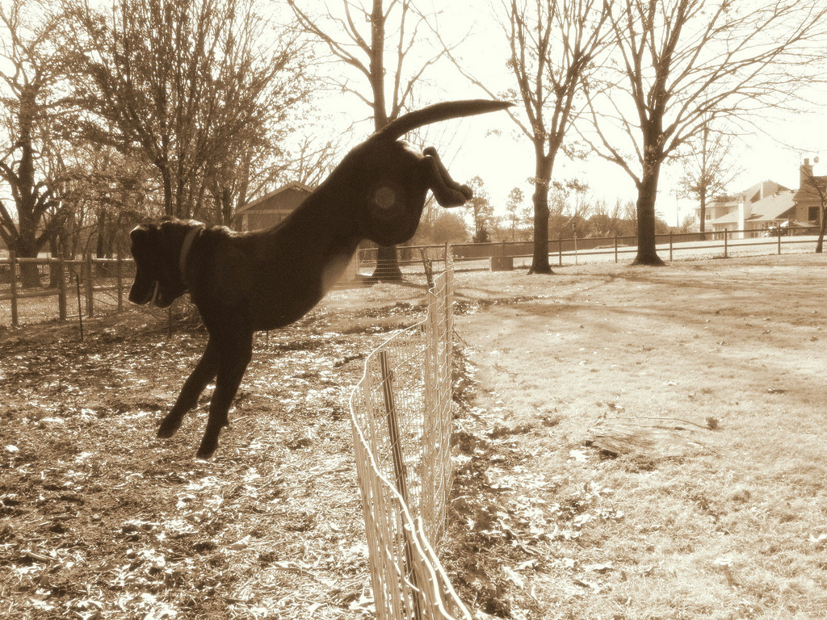
Beyond- outside of an area.
My dog went beyond the fence.

Slide 4
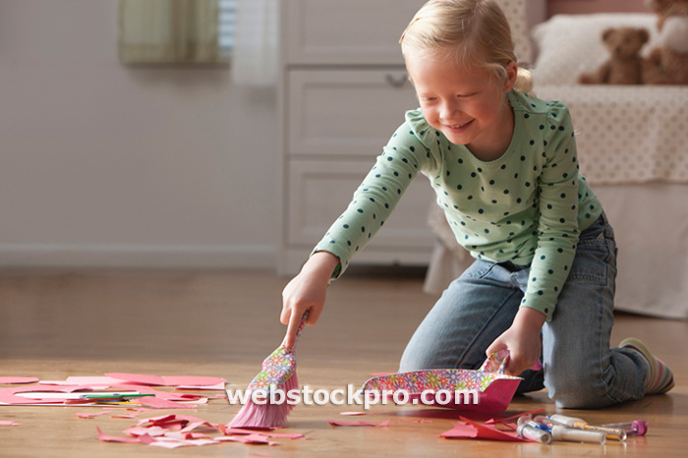
Inspired- to make someone work hard or create something.
The girl was inspired by her mom to help clean up.

