Slide 1
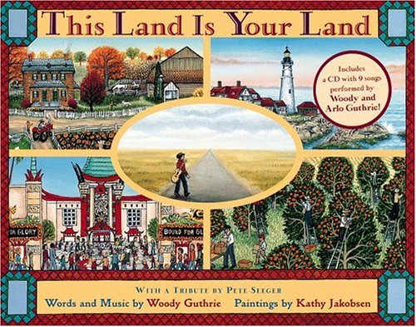
This Land Is Your Land
By Woody Guthrie

Slide 2
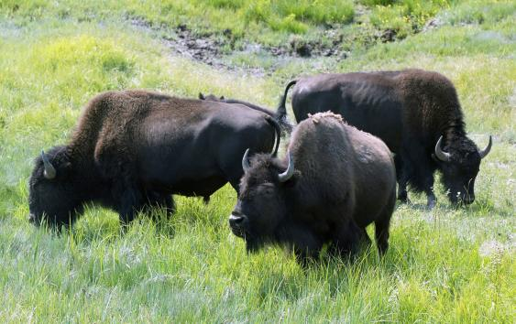
Roamed-to walk around without having a place to go
The buffalo roamed the field eating grass.

Slide 3
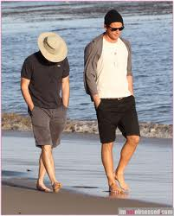
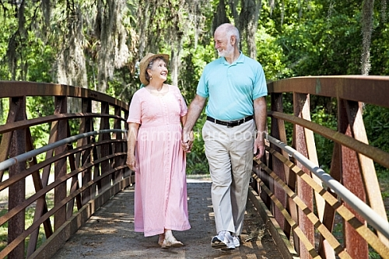
Strolling- a relaxed walk.
We will go strolling through the park.

Slide 4
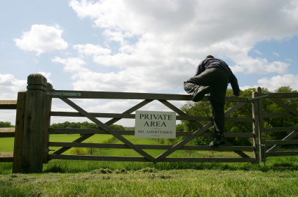
Trespassing- to go into a place
or space you are not allowed.
The boy was trespassing in his neighbors yard.

