Slide 1
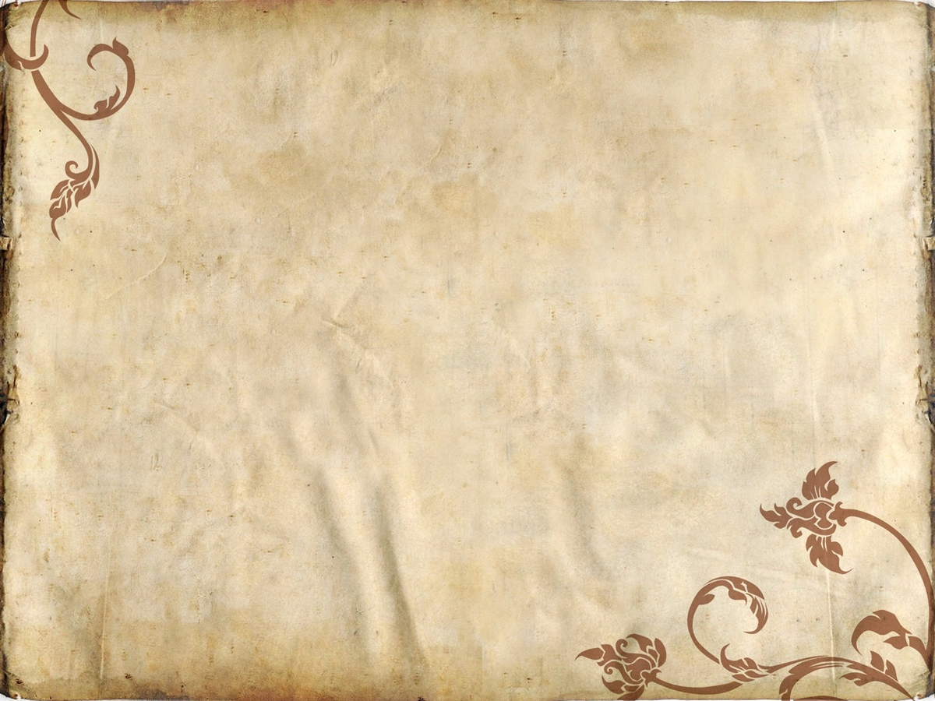
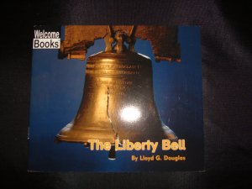
By Lloyd G. Douglas

Slide 2
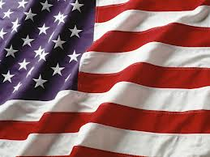
Symbol- a picture or object that makes people think of a country, or group of people.
The American flag is a United States symbol.

Slide 3
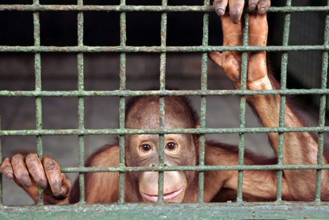
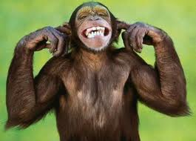
Freedom-having the power to make your own choices.
The monkey was excited about his new freedom.

Slide 4
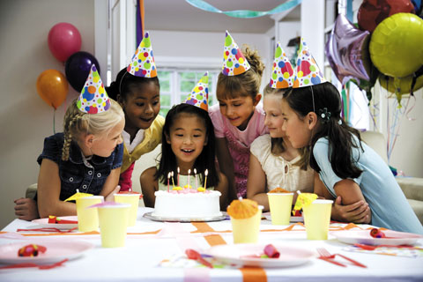
Celebrate- to make something special with gifts, parties, or activities.
The girls have cake to celebrate a friends birthday.

