Slide 1
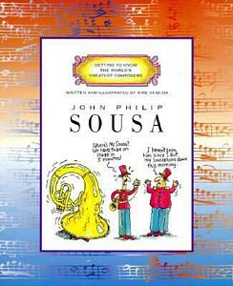
By Mike Venezia

Slide 2
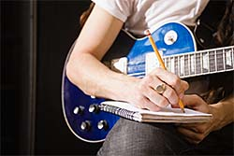
Composed- to write a song, piece of music, story or a poem
He used his guitar to help compose a song.

Slide 3
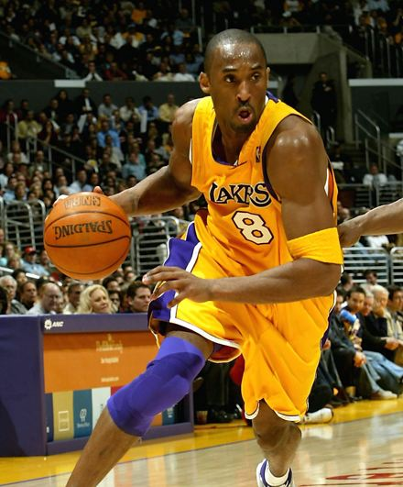
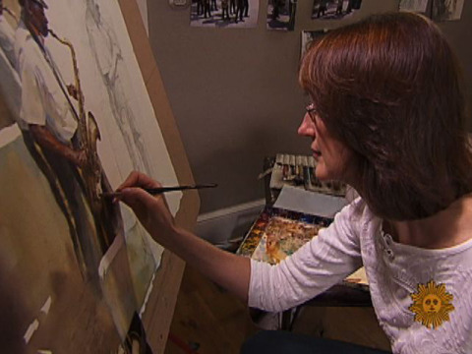
talent- to be very good at something like sports, singing, drawing….
The basketball player had talent.

Slide 4
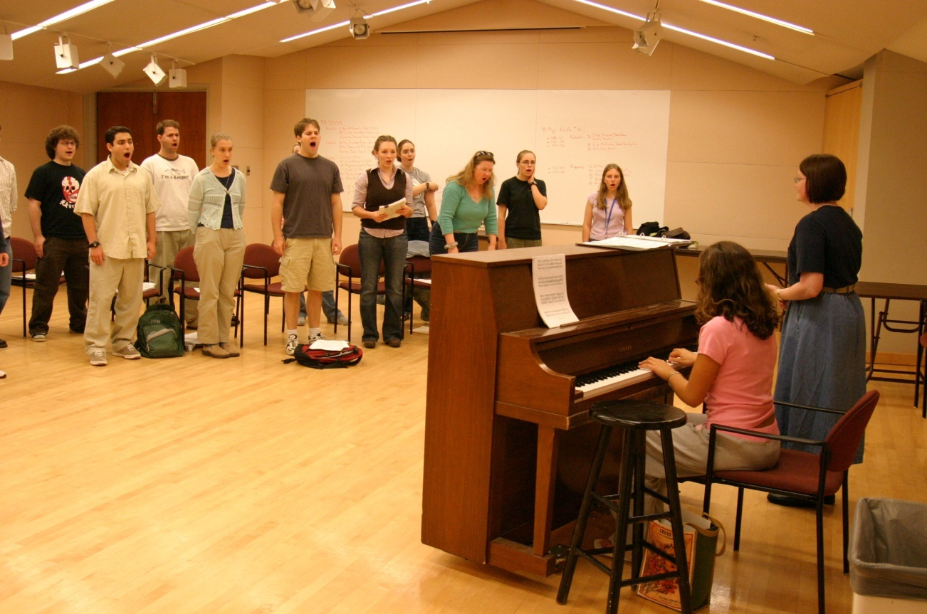
Rehearsing- practicing something before you have to perform it
The students were rehearsing for the musical.

