Slide 1
By Trudi Strain Trueit

Slide 2
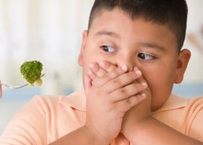
Refused- when you tell someone you will not do something; saying no.
The little boy refused to eat his broccoli.

Slide 3
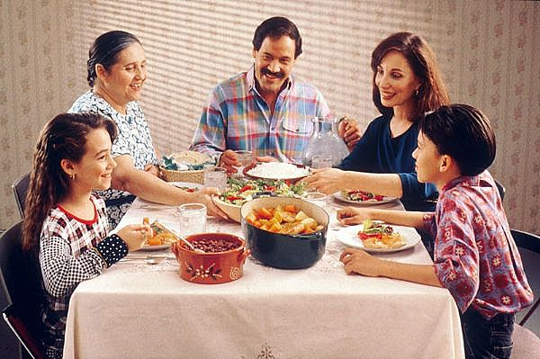
Custom- something a groups of people do every year like celebrating a holiday.
It is custom for this families to eat together at the table.

Slide 4
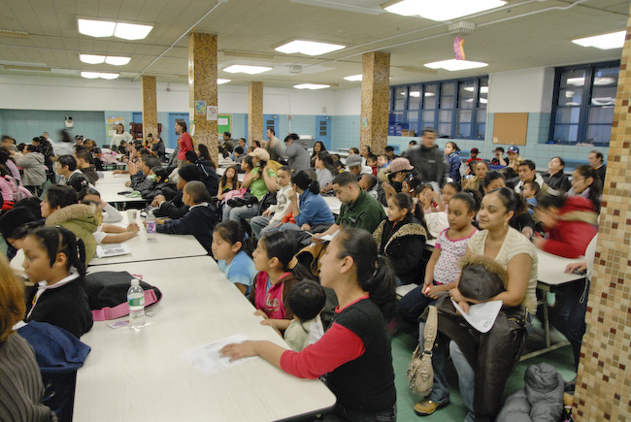
Gather- to come together.
We gather in the lunch room to eat.

