Slide 1
Duck for President
By Doreen Cronin

Slide 2
furious
Notes:
very mad or angry

Slide 3
In the text…
Notes:
The next morning Farmer Brown found a poster on his front door. VOTE DUCK! For a kinder, gentler farm. Farmer Brown was furious!

Slide 4
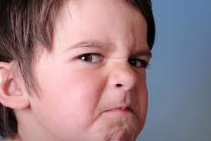
furious
The boy was furious when his mom told
him, “No candy.”

Slide 5
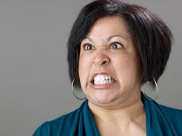
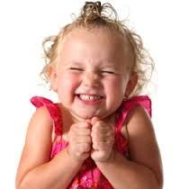
Which picture shows someone who is furious?
1
2
furious

Slide 6
Can you think of something that would make you furious?

Slide 7
demanded
Notes:
To ask with force- to order something to happen

Slide 8
In the text…
Notes:
The vote was counted and the results were posted on the barn wall: F. Brown 6, Duck 20. Farmer Brown demanded a recount.

Slide 9
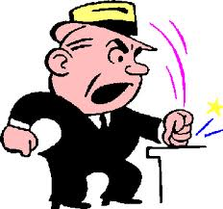
demanded
The man demanded that we give
him his money back.

Slide 10
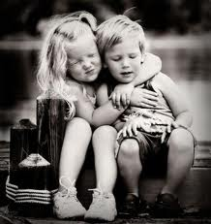
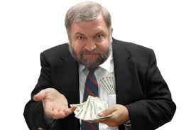
Which goes with demanded?
1
2
demanded

Slide 11
Name a person who might demand something. Explain your idea.
Notes:
Make a list of cozy places.

Slide 12
proud
Notes:
Feeling pleased because of something one has done

Slide 13
In the text…
Notes:
That night Duck and his staff started working on posters for the presidential election. They said: A Duck for Change, I LIKE DuCk! And DUCK- Making us proud again

Slide 14
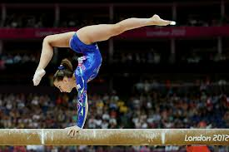
proud
I was so proud of her hard work
and dedication!

Slide 15
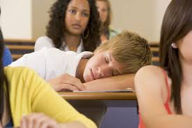
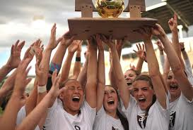
Which is something that would make you proud?
1
2
proud

Slide 16
One more time
furious
demanding
proud

