Slide 1

By Doreen Cronin

Slide 2
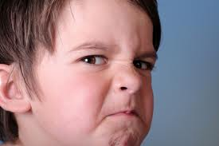
Furious- to be very mad
The boy was furious when he broke his toy.

Slide 3
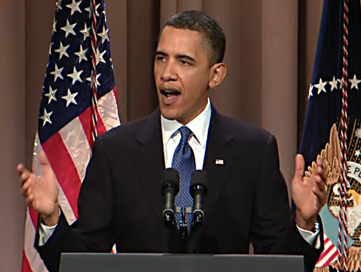
Announced- tell something publically
or out loud.
Barak Obama announced his plans to run for president.

Slide 4

Requirement- something that you have to do.
It is a requirement for kids to buckle up when.

