Slide 1
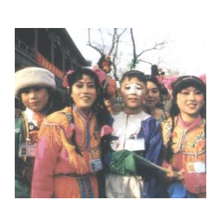
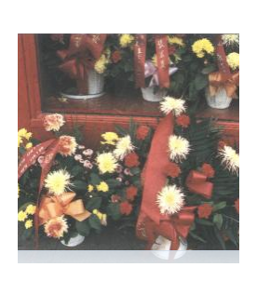
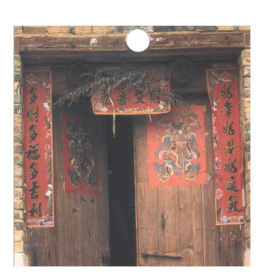
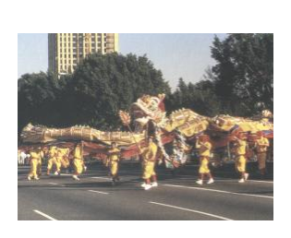
Name: RI.K.7

Slide 2
1
Open the doors and windows. It’s Chinese New Year!
2
Groups of people dress up in long dragon costumes and dance through the streets.
3
Families clean their houses before the new year. They decorate their homes with flowers.
4
On New Year’s Day, there are festivals in every Chinese community.
1
Open the doors and windows. It’s Chinese New Year!
2
Groups of people dress up in long dragon costumes and dance through the streets.
3
Families clean their houses before the new year. They decorate their homes with flowers.
4
On New Year’s Day, there are festivals in every Chinese community

