Slide 1
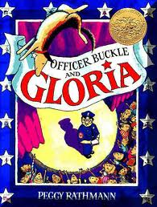
Officer Buckle and Gloria
Old Wire Road
Elementary
Kindergarten

Slide 2
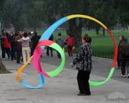
swiveled
Swiveled – to twist back and forth
The ribbon swiveled in the air.

Slide 3
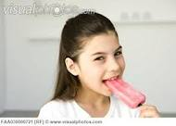
Which one goes with swiveled?

Slide 4
swiveled
Act it out! Can you show how your body would swivel?
What would happen if you swiveled for a really long time? (Turn and talk.)
Why is it a bad idea to stand on a swivel chair? (Turn and talk.)

Slide 5
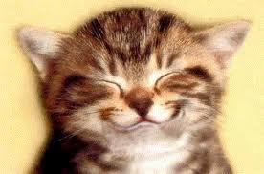
Grinned
Grinned – smiled really big.
He grinned from ear to ear.

Slide 6
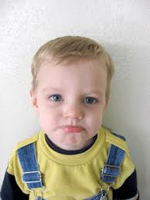
Which one goes with grinned?

Slide 7
grinned
Act it out!- Turn and show your partner a grin.
Which of these things would make you grin?
(Thumbs up/down)
Lots of candy
Ice cream
Cleaning your room
Getting in trouble
Popcorn
A special prize

Slide 8
Discovered
Discovered – to find or see before anyone else.
The little boy discovered the treasure.

Slide 9
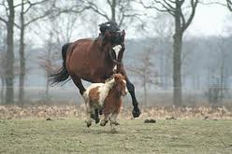
Which one goes with discovered?

Slide 10
discovered
If I could discover one of these things in our school garden, say “Bingo!”
Tiny bugs
TV
Computer
Flowers
Vegetables
Trees
Ice cream

