Slide 1
Text Talk

Slide 2
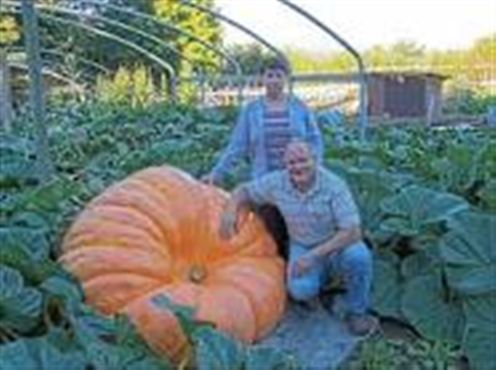
enormous – very large in size
The pumpkin was enormous.

Slide 3
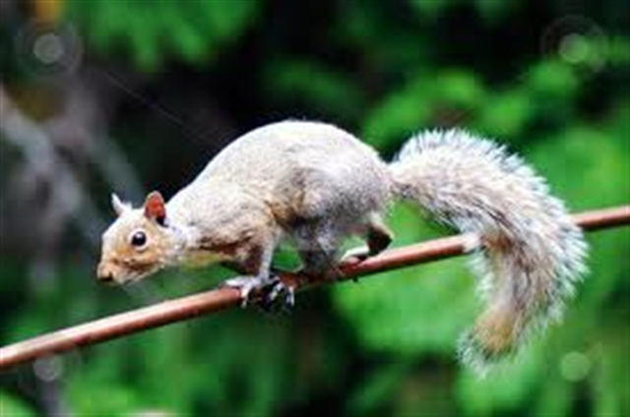
Which picture goes with enormous?

Slide 4
Enormous
Tell your partner something you have seen that was enormous. What did you say? What did your face look like?
If this is would be enormous, say “Wow!”
A whale
A kitten
A piece of candy
The world
A book
A letter

Slide 5
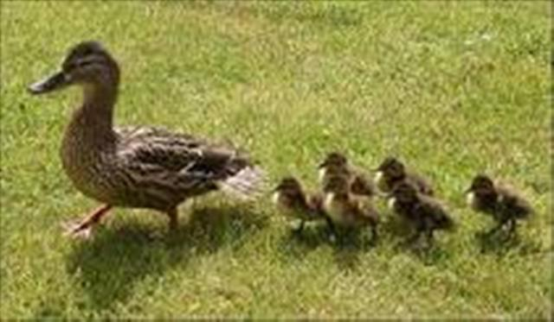
waddled – to walk with side to side steps
The duck and her babies waddled toward the pond.

Slide 6
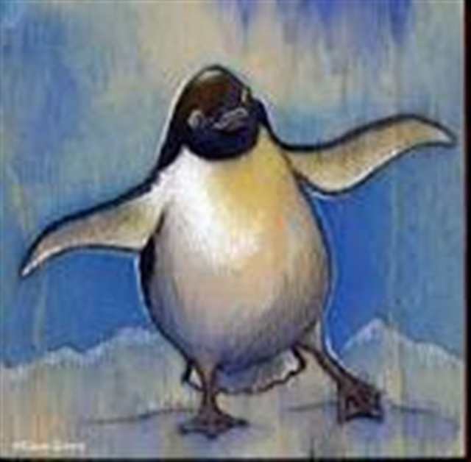
Which picture goes with waddled?

Slide 7
Waddled
Show what it looks like to waddle.
What kinds of animals waddle? (Turn and talk.)
If this animal would waddle, say “Waddle, waddle, waddle!”
A baby duck
A penguin
A dog

Slide 8
beckoned – to call or motion to come with your head or hand
My teacher beckoned us to come to the carpet.

Slide 9
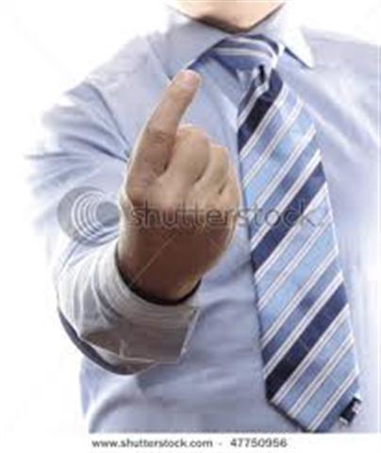
Which picture goes with beckoned?

Slide 10
Beckoned
What does it look like to beckon someone? (Show your partner.)
Let’s give some examples of what it means to beckon someone. Think of one reason you might beckon someone….share.
(Example: “I need help with my homework.”)

