Slide 1
By Mo Willems

Slide 2
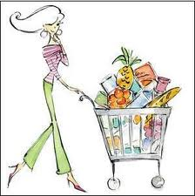
Errand- a short trip made for a reason

Slide 3
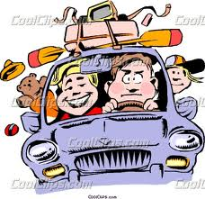
Which picture shows an errand?

Slide 4
Errand
Which of these is an errand that you have gone on with your parents? Thumbs up/down.
going to the grocery store
going to the bank
coloring a picture
shopping
going to the post office
cooking dinner

Slide 5
Realized- started to believe something is true

Slide 6
Which picture shows realized?

Slide 7
Realized
Examples:
When I tried to run away from my cat, I realized that he is really fast.
When my mom sang with the music, I realized that she is a great singer.
When I touched the cookies, I realized that they were still really hot.
Turn and Talk- Tell your partner something that you have realized today.

Slide 8
Fussy- cranky; difficult to please or make happy (picky)

Slide 9
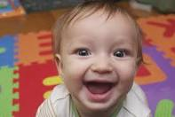
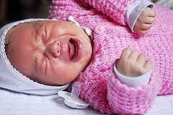
Which picture shows fussy?

Slide 10
Fussy
Show a face that makes you like fussy.
If this sounds like someone who is fussy, say “Wa, wa, wa!”
“Don’t play with me!”
“I don’t like that.”
“I love drawing pictures with you!”
“I never get to do what I want!”
“Thank you for helping me.”

