Slide 1
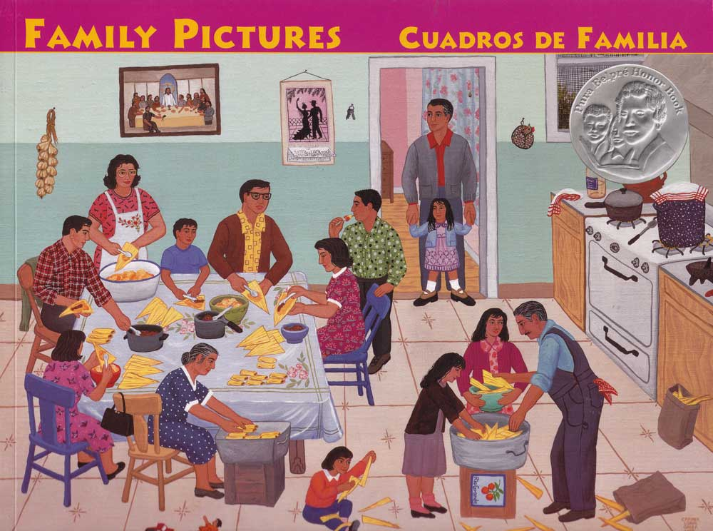
Kindergarten
Text Talk

Slide 2
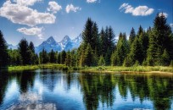
scene the setting and all that is in it
The students were amazed at the beautiful mountain scene.

Slide 3
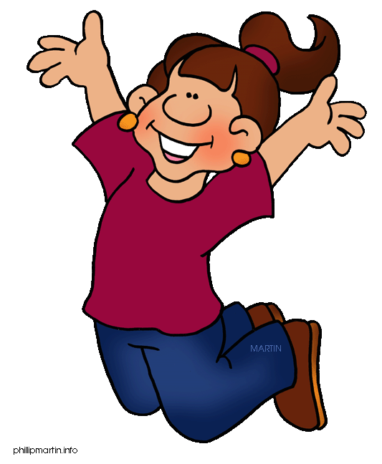
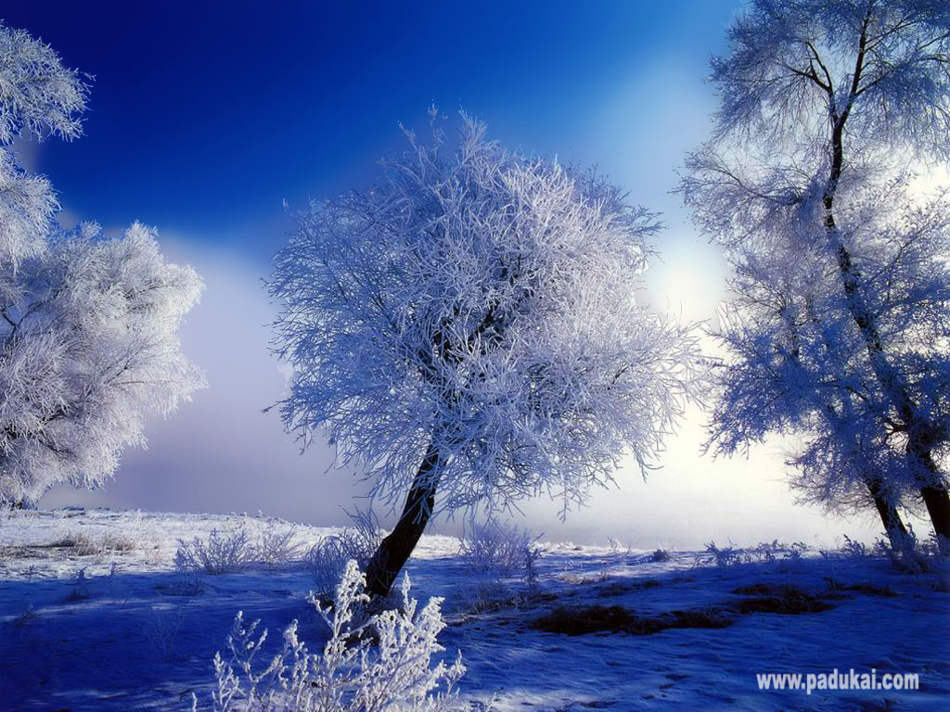
Which picture shows scene?

Slide 4
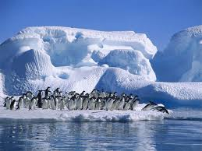
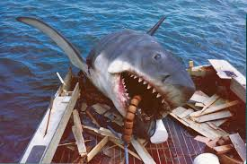
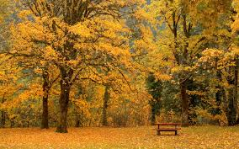
scene
What would you say about these scenes? Use the sentence frame: That scene is…

Slide 5
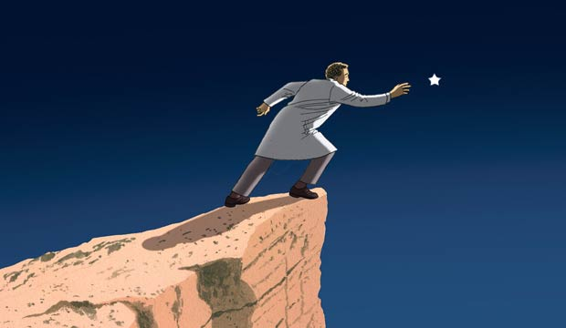
beyond outside of an area
The star was beyond the man’s reach.

Slide 6
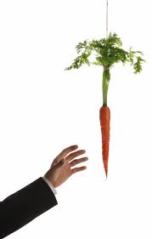
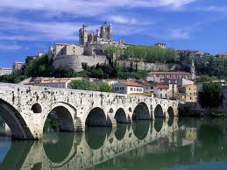
Which picture shows beyond?

Slide 7
beyond
Name something in the classroom that is beyond your reach.
If this would be beyond your reach, say “To infinity and beyond!”
The stars
The sun
A chair
The moon

Slide 8
inspired to make someone work hard or create something
This poster inspired men to join the military.

Slide 9
Which picture shows inspired?

Slide 10
inspired
Have you ever been inspired to do something? Why would you do it?
Would this inspire you? If it would, give me a “thumbs up.”
“You can do it!”
“You don’t know how!”
“Don’t worry, keep trying!”

