Slide 1
Curious George H.A. Rey

Slide 2
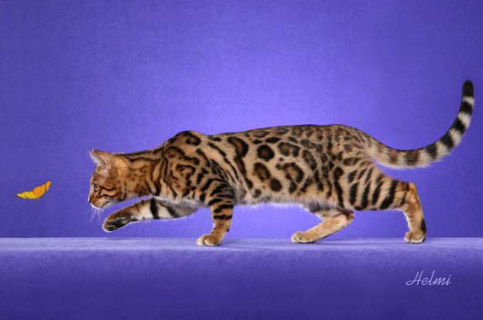
Curious
Interested in knowing about something
The cat was curious about the butterfly.

Slide 3
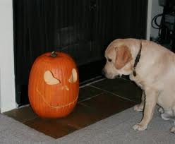
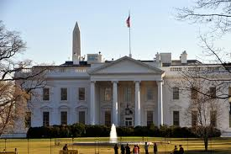
Which goes with curious?

Slide 4
Curious
What would a curious student say about some new tools in a work station?
Turn and Talk; share out
When we looked at our class pumpkin, you were curious. Think of some things you did that showed you were curious.

Slide 5
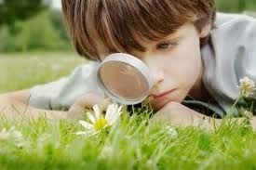
fascinated
Interested in something; holding someone’s attention
The boy was fascinated with the green grass.

Slide 6
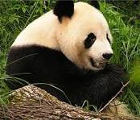
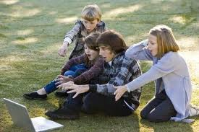
Which goes with fascinated?

Slide 7
Fascinated
If any of the things I say would fascinate you, say “Oooo, Ahh!”
A $100 dollars
A bird with 10 eyes
A pencil with an eraser
A teacher
A dog that could talk to you

Slide 8
whisked
To brush off; to move quickly
The girl was whisked away.

Slide 9
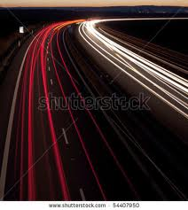
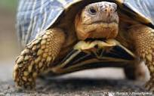
Which goes with whisked?

Slide 10
Whisked
Which could cause something to be whisked away? Thumbs up/down (yes/no)
A tornado
A race car
A turtle
A chair
An airplane

