Slide 2
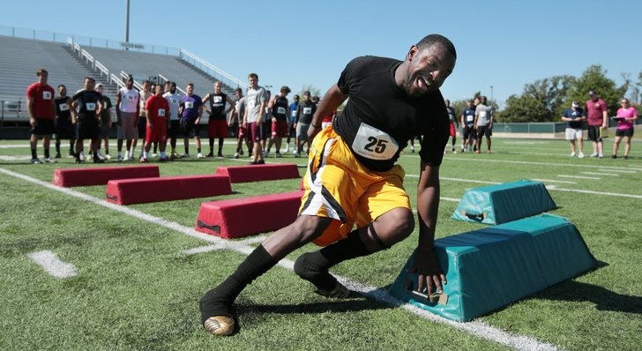
hustle- to hurry; work fast and energetically
The man hustled to finish to the race as quickly as he could.

Slide 3
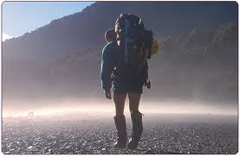
Which picture shows hustle?

Slide 4
Hustle
Show what it looks like to hustle.
If this would be a time when you would need to “hustle” say “Hurry, hurry!”
Your house is on fire
A bear is chasing you
You are watching TV
You are helping your sister
You want to win the race

Slide 5
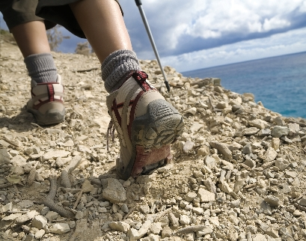
tramping- to walk with heavy feet
The lady was tramping up the side of the mountain.

Slide 6
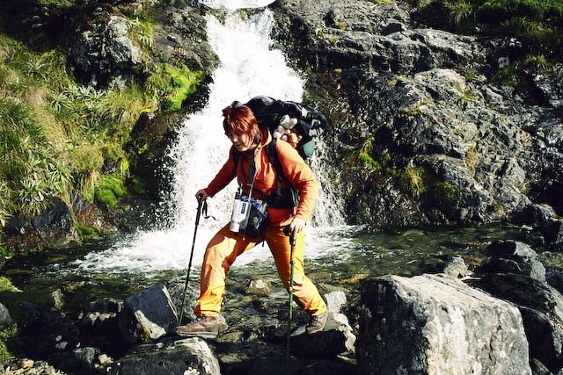
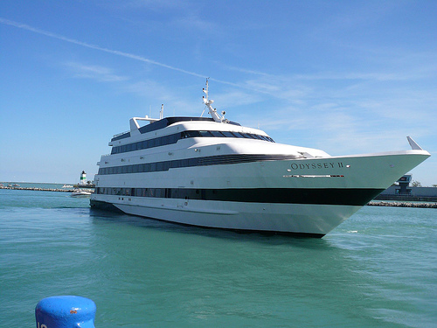
Which picture shows tramping?

Slide 7
Tramping
What would it sound like to be tramping?
Show what this looks like.
Why would you be tramping? (Turn and Talk)
What would a teacher say if you were tramping down the hallway?
What would your dad say if you were tramping up the hill carrying tons of stuff?

Slide 8
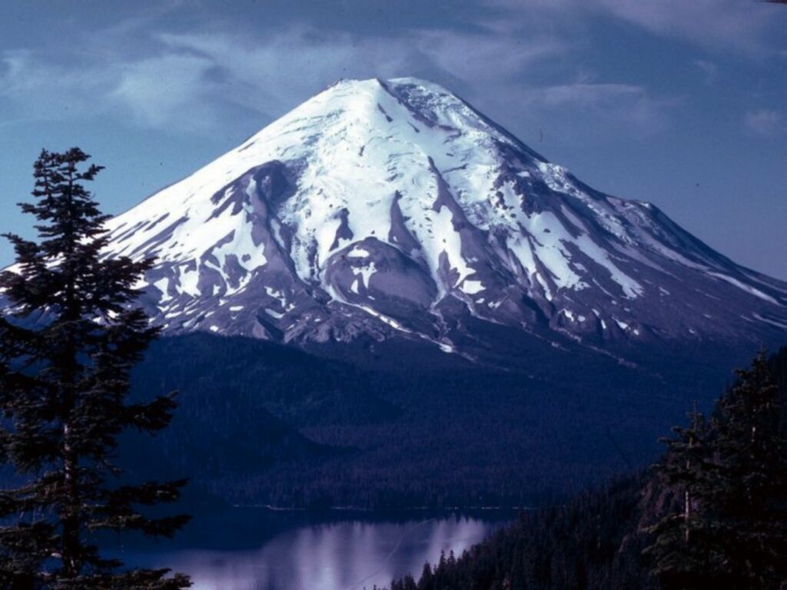
tremendous- really big, wonderful, fantastic (vast)
The mountain was absolutely tremendous.

Slide 9
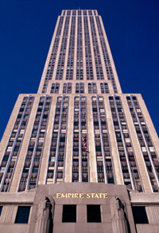
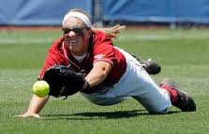
Which picture shows tremendous?

Slide 10
Tremendous
If this is something that would be tremendous, say “Awesome!!”
A cat
A pencil
A big snowman
Tons of cookies and candy
A new playground
A pillow

