Slide 1
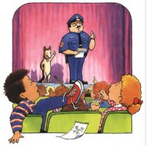
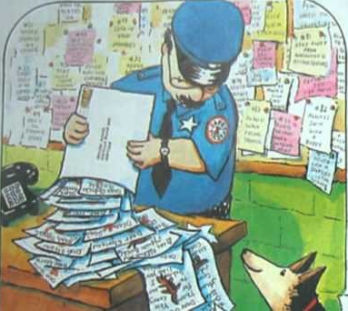
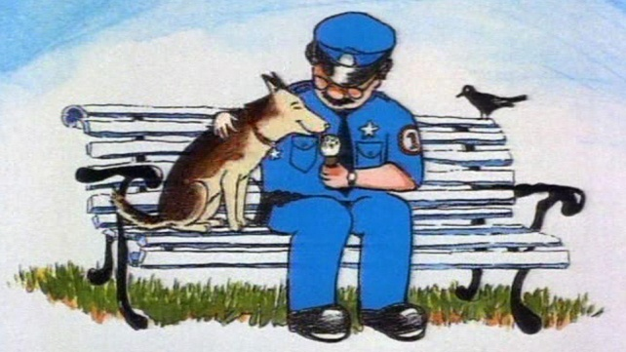
Name: RL.K.7

Slide 2
1
The next day, an enormous envelope arrived at the police station. It was stuffed with thank you letters from the students at Napville School.
2
After every speech, Officer Buckle took Gloria out for ice cream. Officer Buckle loved having a buddy.
3
Officer Buckle gave Safety Tip #1: Keep your shoelaces tied. The children sat up and stared.
4
“Children, this is Gloria”, announced Officer Buckle. “Gloria obeys my commands. Gloria, sit”. And Gloria sat.
1
The next day, an enormous envelope arrived at the police station. It was stuffed with thank you letters from the students at Napville School.
2
After every speech, Officer Buckle took Gloria out for ice cream. Officer Buckle loved having a buddy.
3
Officer Buckle gave Safety Tip #1: Keep your shoelaces tied. The children sat up and stared.
4
“Children, this is Gloria”, announced Officer Buckle. “Gloria obeys my commands. Gloria, sit”. And Gloria sat.

