Slide 1
What is Poetry?
“The Swing” by Robert Louis Stevenson
Anne Saullo
Mrs. Magarin’s Kindergarten
Grace Hill Elementary
December 2014

Slide 2
Goal I can listen to and illustrate a poem.
Students score their understanding of the goal.
Standards: RL.K.1, RL.K.5, SL.K.1, SL.K.5
Notes:
GOAL:
RL.K.1 Ask and answer questions about key details
RL.K.5 Recognize common types of texts.
SL.K.1 Participate in collaborative conversations.
SL.K.5 Add drawings to descriptions.
Our Goal: I can listen to and illustrate a poem.
Ask students to rate how well they can meet the goal (with whatever system the teacher uses) at the beginning of the lesson.

Slide 3
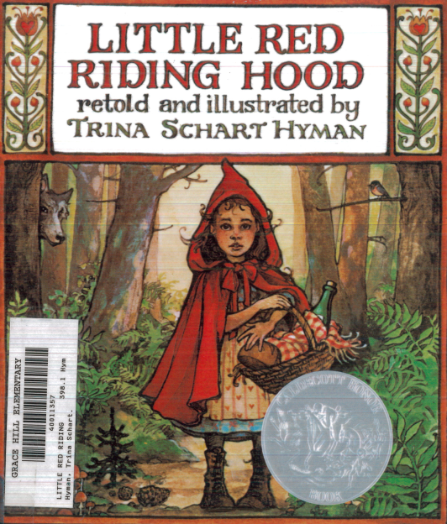
Access Prior Knowledge
Show students copies of books they are familiar with and review the features of a book.
Front Cover
Back Cover
Title Page
Notes:
Show students copies of storybooks they are familiar with.
Review the features of a book. (front cover, back cover, title page)

Slide 4
Notes:
This is the poem you are going to listen to today.
Poems are different from the storybooks you have been reading.
How does this poem look different than the storybooks you have been reading,
Like The 3 Pigs or The 3 Billy Goats Gruff (show books). Turn and Talk.

Slide 5
New Information
Read the poem,“The Swing” by Robert Louis Stevenson to students.
After reading, point out:
Lines
Stanzas
Rhyming Words
Notes:
Read the poem, “The Swing,” to students. Point out the lines and stanzas on the poem written on large chart paper.
Have students identify rhyming words and highlight on the chart paper.
Poems look different. They have stanzas. They have lines. They often have rhyming words.
Poems are sometimes short.
A storybook is usually one story.
A poetry books has many poems.

Slide 6
Use the illustrations and questions to help students visualize the poem. Explicitly model illustrating the first stanza of the poem.
Where?
Who?
How?
What?
Notes:
Explicitly model how to illustrate the poem using questions to help visualize the poem.
Who is in the poem? A child
What is the child doing?
Where is the child? What things are around him/her?
How does the child feel?

Slide 7
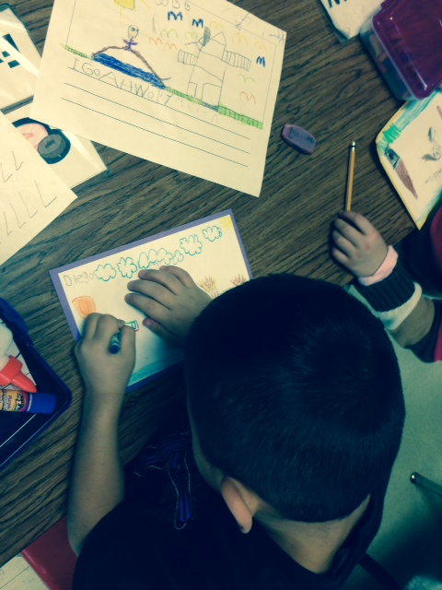
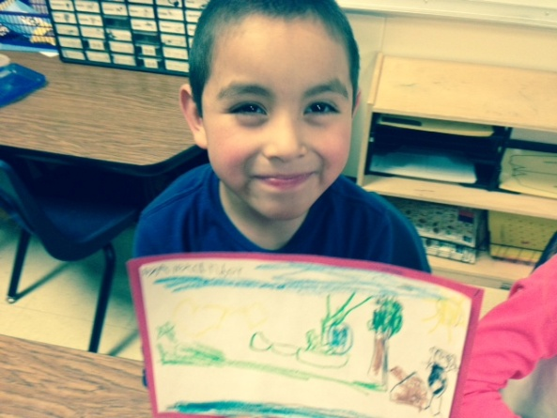
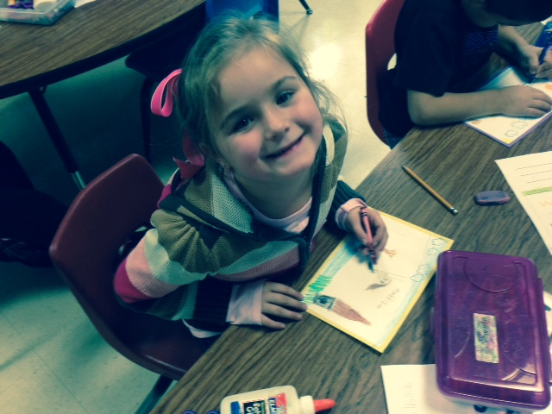
Application
Tell students that they will ask and answer questions in order to illustrate the poem, “The Swing,” so others can visualize or see the poem in their heads.
Notes:
Read each stanza and ask questions that illustrators need to ask to illustrate a poem.
Who? What? Where? How?
When students know what they are going to draw, they put their hands on their head.
They go to their table to draw their illustration.

Slide 8
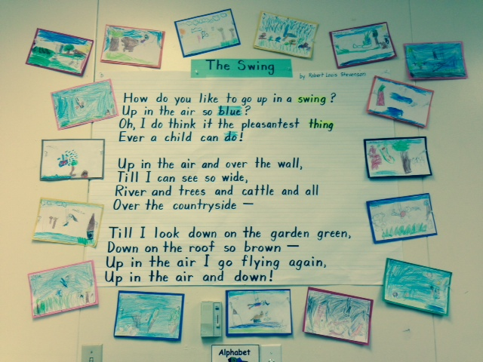
The poem now has illustrations!
Notes:
Ask the partners to match their illustration to the stanza it illustrates. You may need to read the poem again.

Slide 9
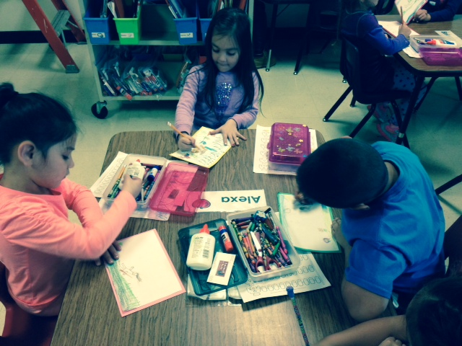
Once students complete their illustration for the wall, they can illustrate their own copy of “The Swing” to put in their poetry folder.
Notes:
Hand individual students a poem to illustrate.

Slide 10
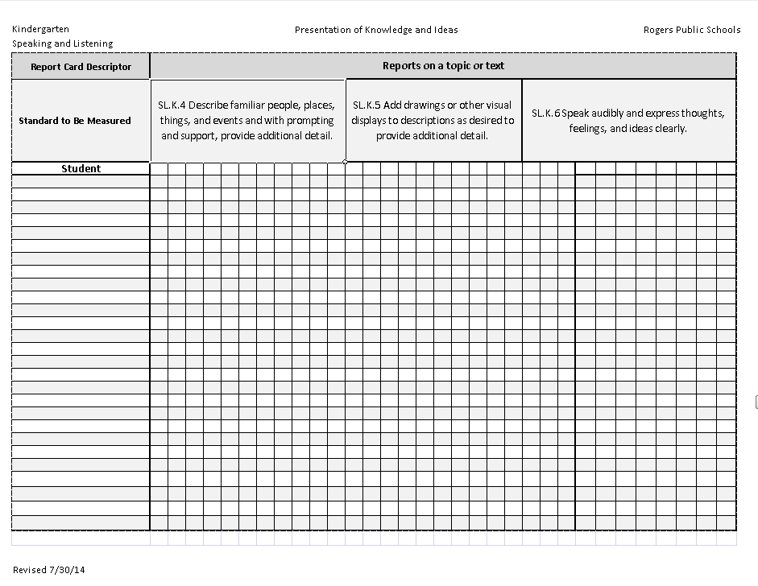
Score students ability to illustrate a poem. (SL.K.5)
Notes:
Score students ability to illustrate the poem.

Slide 11
Goal I can listen to and illustrate a poem.
Students score their understanding of the goal.
Standards: RL.K.1, RL.K.5, SL.K.1, SL.K.5
Notes:
Goal: I can listen to and illustrate a poem.
Have students rate themselves at the end of the lesson.

