Slide 1
Tigger Comes to the Forest and Has Breakfast
By A.A. Milne

Slide 2
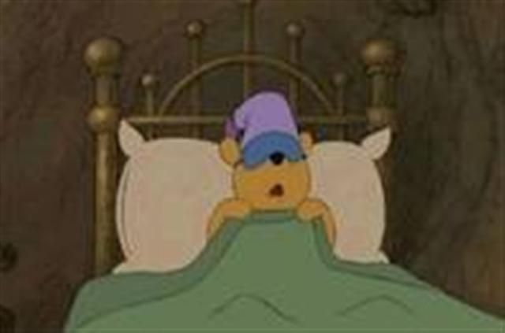
Winnie the Pooh hears a noise

Slide 3
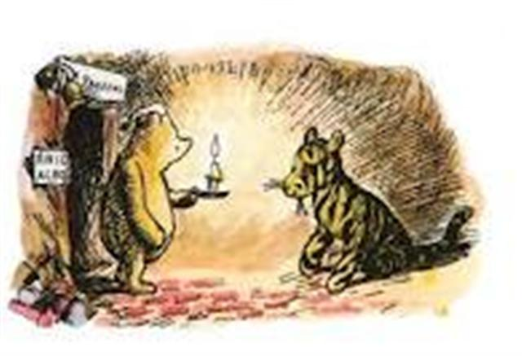
Winnie the Pooh meets Tigger

Slide 4
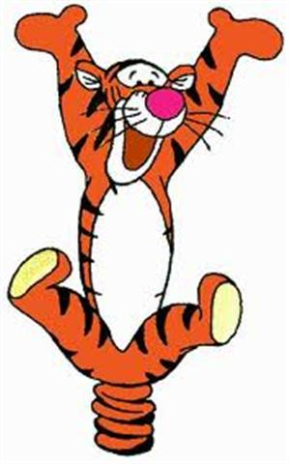
Tigger is happy

Slide 5
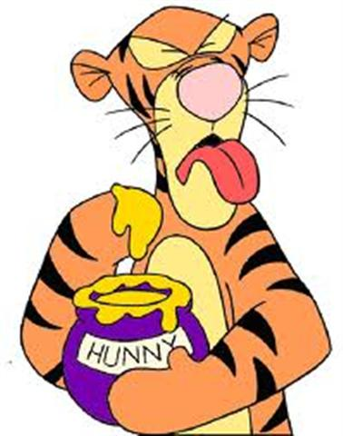
Tigger doesn’t like honey

Slide 6
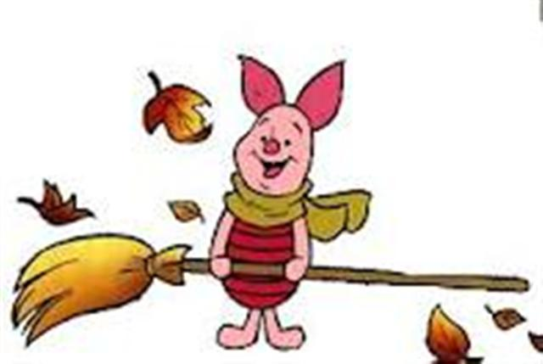
Tigger meets Piglet

Slide 7
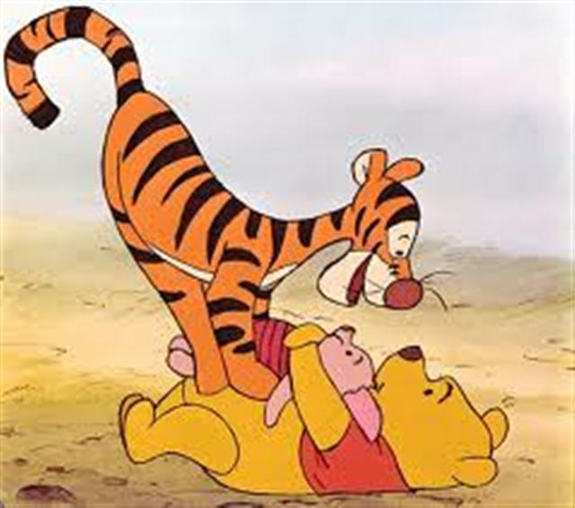
Tigger doesn’t like haycorns

Slide 8
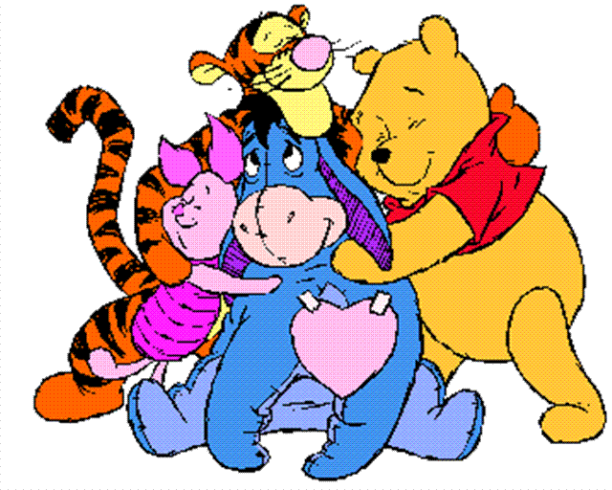
Tigger meets Eeyore

Slide 9
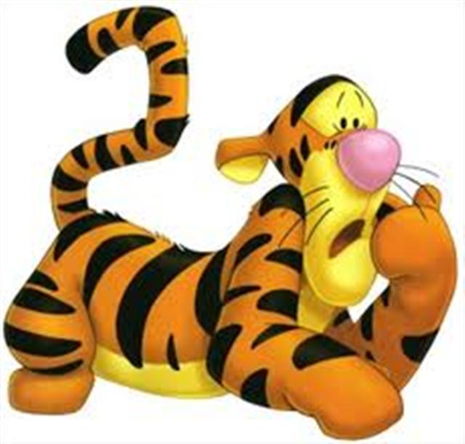
Tigger doesn’t like thistles.

Slide 10
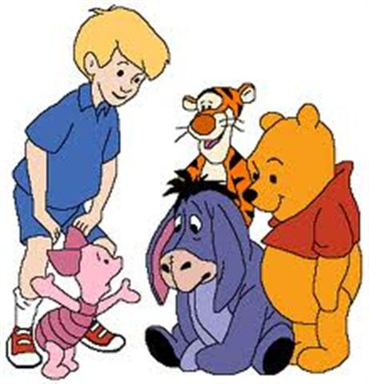
The friends ask Christopher Robin for help.

Slide 11
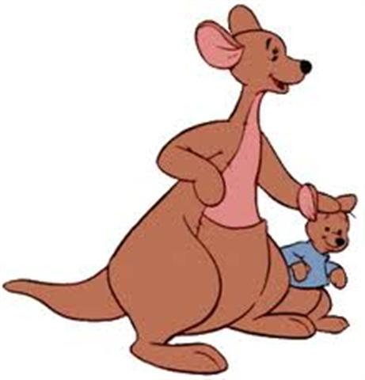
Tigger meets Kanga and Roo

Slide 12
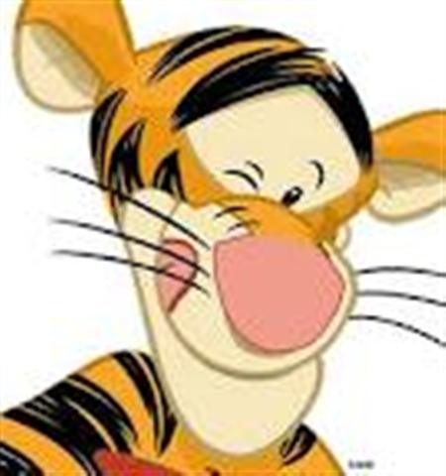
Tigger likes extract of malt

