Slide 1
Pooh Goes Visiting and Gets Into a Tight Place
By A.A. Milne

Slide 2
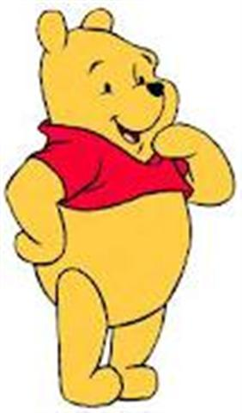
Winnie the Pooh was walking through the forest one day.

Slide 3
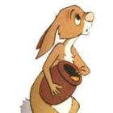
Are you Pooh Bear? Well, come on in.

Slide 4
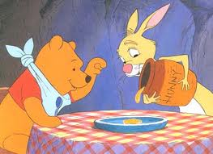
Pooh likes a little something around eleven o’clock.

Slide 5
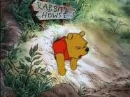
Pooh bear is stuck!

Slide 6
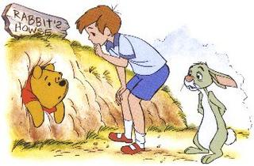
We have to wait for you to get thin again.

Slide 7
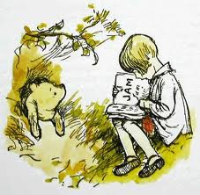
Christopher Robin read books to Pooh.

Slide 8
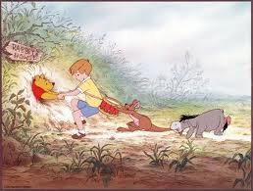
At the end of the week, Pooh’s friends pulled him out of Rabbit’s front door.

Slide 9
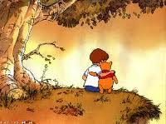
Silly old Bear!!

