Slide 1
Where Are Our Friends?
Written by Mrs. Hensley
Illustrated with Google Images
L.K.1.d & e

Slide 2
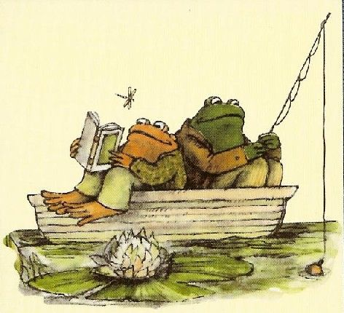
Where is Toad?
He is in the boat.

Slide 3
Where is the girl?
She is in the train.

Slide 4
Where is Gloria?
She is in the car.

Slide 5
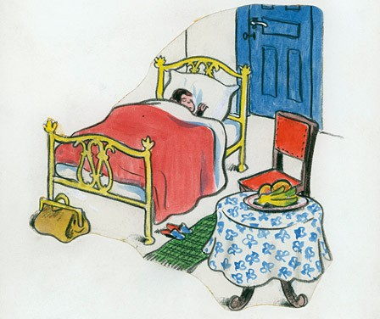
Where is George?
He is in the bed.

Slide 6
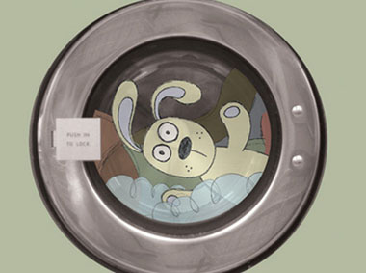
Where is Knuffle Bunny?
He is in the washing machine.

Slide 7
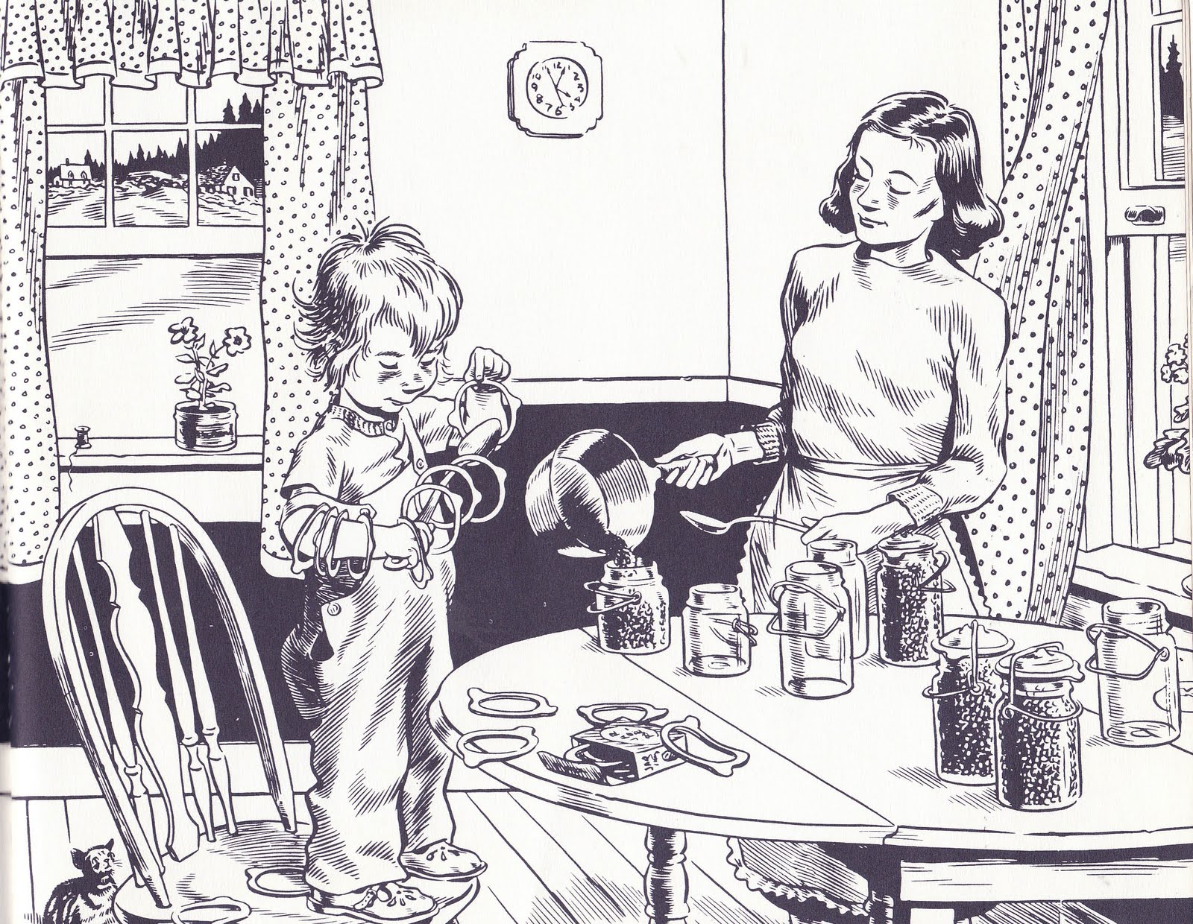
Where is Sal?
She is in the kitchen.

Slide 8
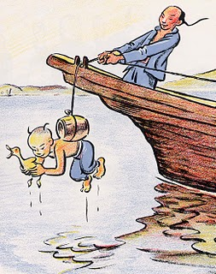
Where is Ping?
He is in the air.

Slide 9
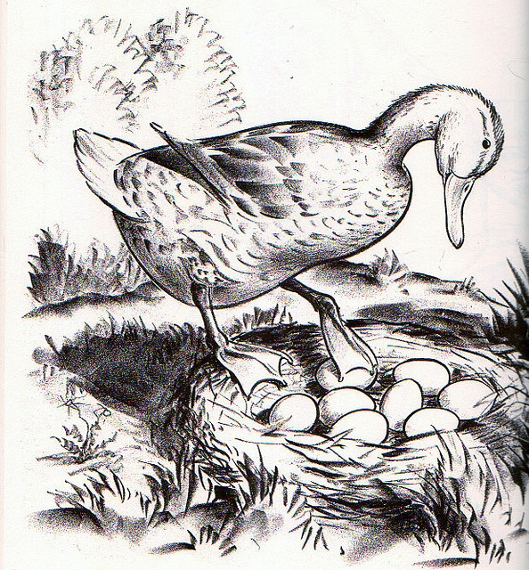
Where is Mrs. Mallard?
She is in the nest.

Slide 10
Where is Max?
He is in the tent.

Slide 11
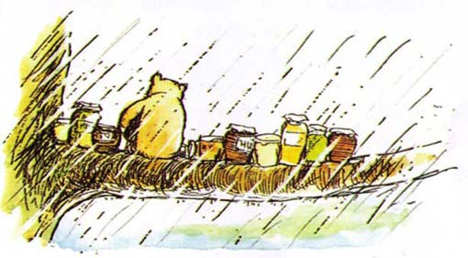
Where is Pooh?
He is in the rain.

Slide 12
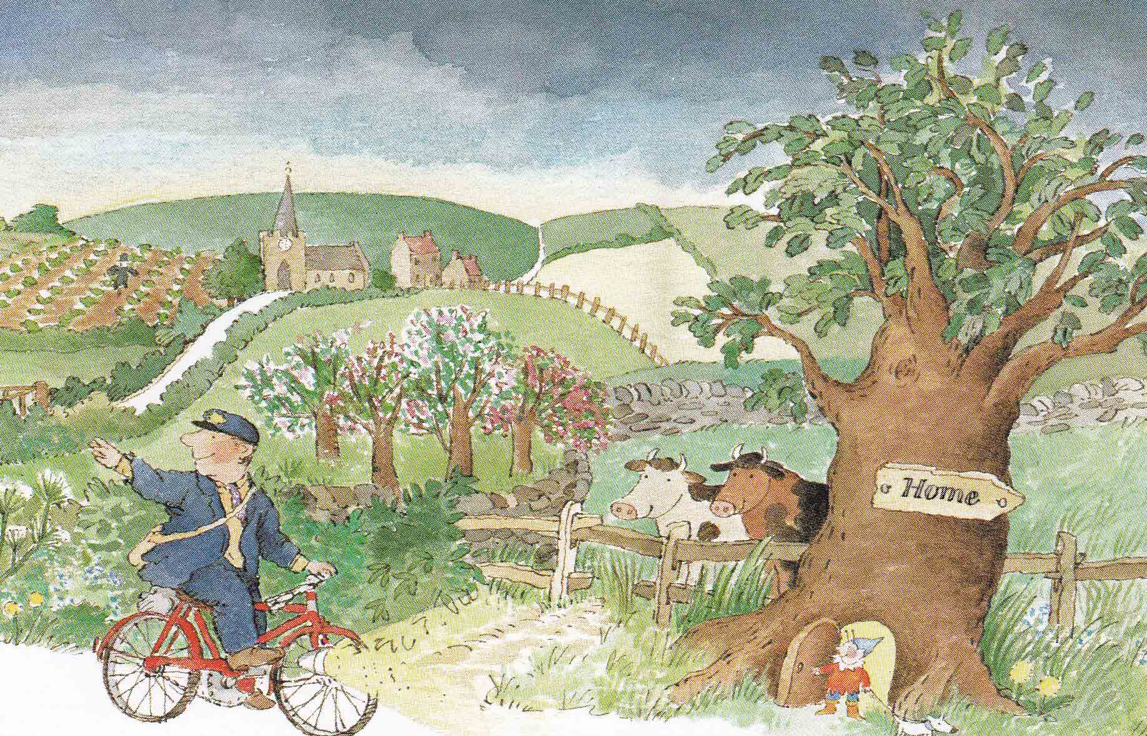
Where is the postman?
He is in the country.

Slide 13
Where is the boy?
He is in the water.

Slide 14
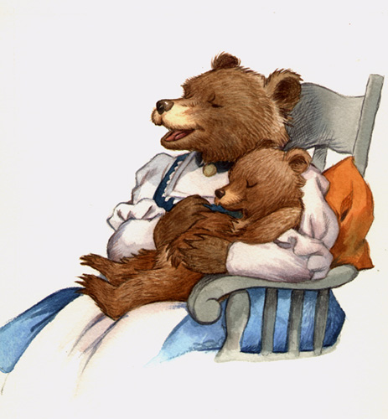
Where is Little Bear?
He is in his Mom’s lap.

