Slide 1
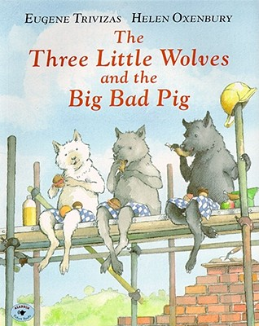
The Three Little Wolves and the Big Bad Pig

Slide 2
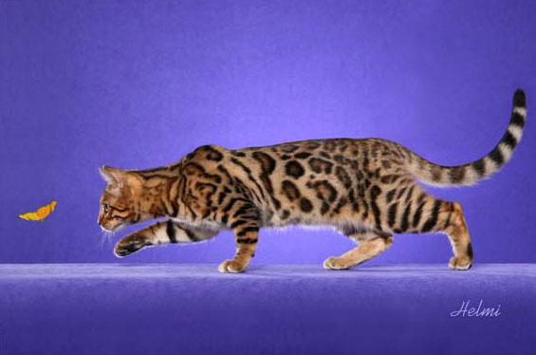
prowling
Looking for something secretly and quietly
The cat was prowling around, trying to catch the butterfly.

Slide 3
Prowling
Pretend that you are prowling.
If you are prowling you are…
Yelling
Stomping
Quiet as a mouse
Laughing

Slide 4
determined
Deciding to do something and sticking to it until it is done
It was a tough job, but the ducks were determined to climb out of the water.

Slide 5
Determined
What do we say when we are determined to do a good job with our writing?
If you are determined, you say…
I can’t do it!
It’s too hard!
I can do anything!

Slide 6
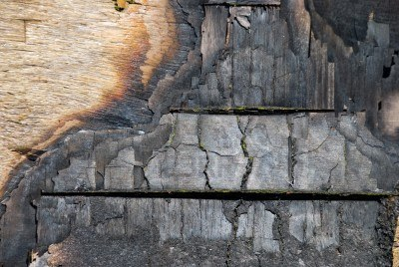
scorched
Leaving a brown mark after being burned
The wood was scorched from the fire.

Slide 7
Scorched
Who’s tail was scorched in The Three Little Javelinas?
Name some things that you could scorch your finger on.
What would you say if you scorched your finger?

Slide 8
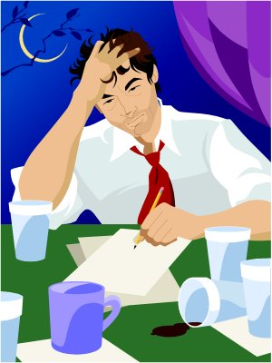
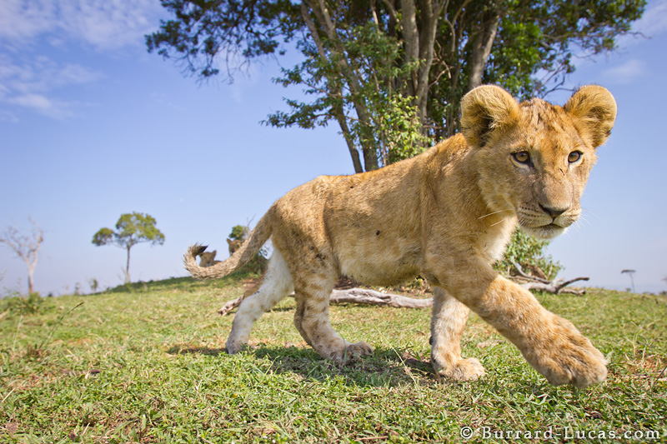
Which goes with prowling?

Slide 9
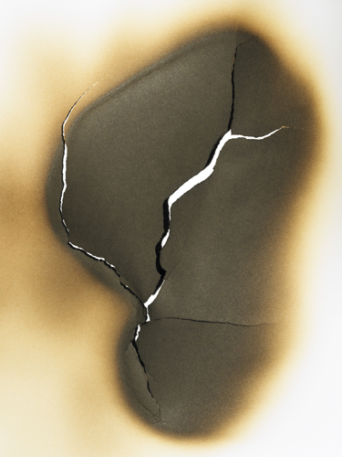
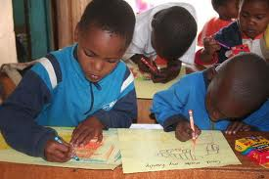
Which goes with determined?

Slide 10
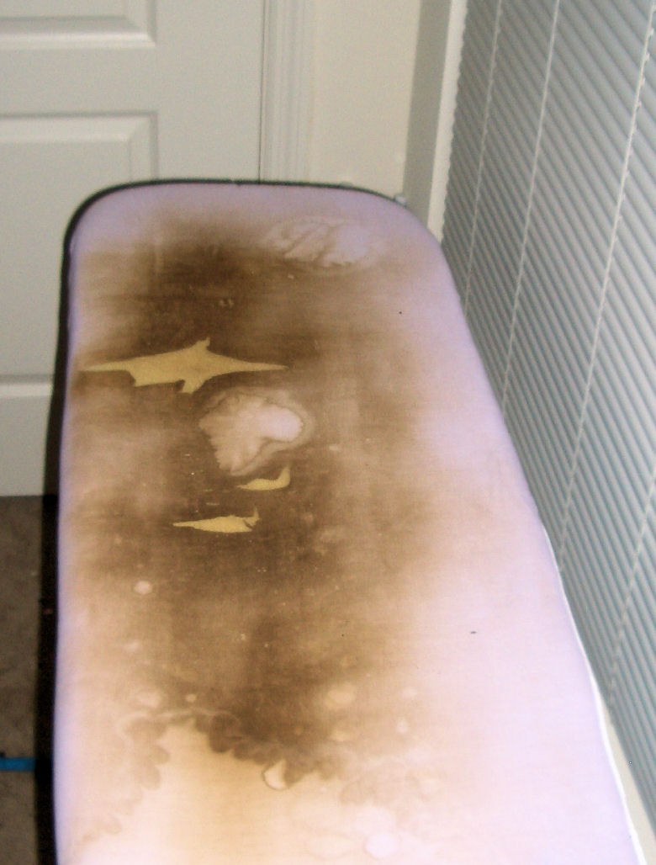
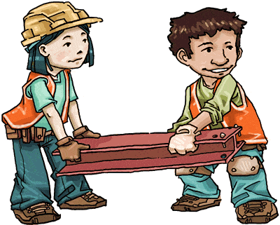
Which goes with scorched?

Slide 11
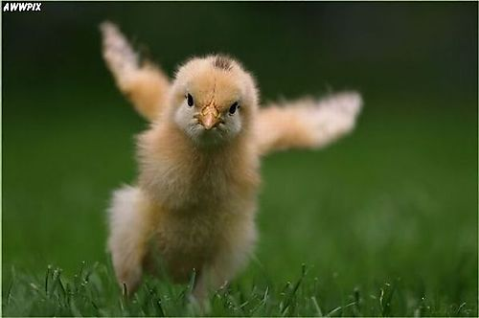
Which word goes with this picture? (prowling, determined, scorched)

Slide 12
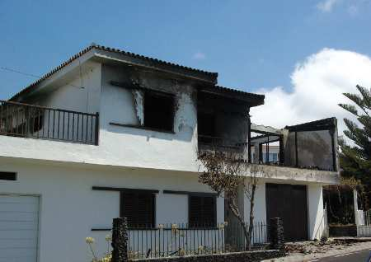
Which word goes with this picture? (prowling, determined, scorched)

Slide 13
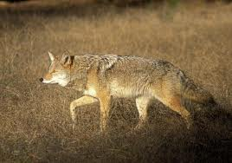
Which word goes with this picture? (prowling, determined, scorched)

