Slide 1
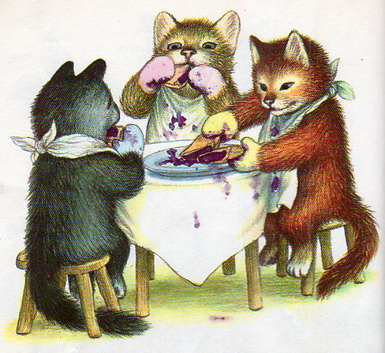
Kindergarten
Text Talk
Unit 2
The Three Little Kittens

Slide 2
I can use words I learn from a text.
Notes:
Goal-
Students need to engage with the goal- read it, repeat it, write it, etc.

Slide 3
Tell your partner about a new word you learned.
Notes:
Access Prior Knowledge- (APK)
Turn and Talk

Slide 4
Notes:
New Information-
Read the Poem- provide a brief explanation of any words that may be new or unfamiliar to the students.

Slide 5
fear
Notes:
Contextualize the word- Find it in the text
Say the word together

Slide 6
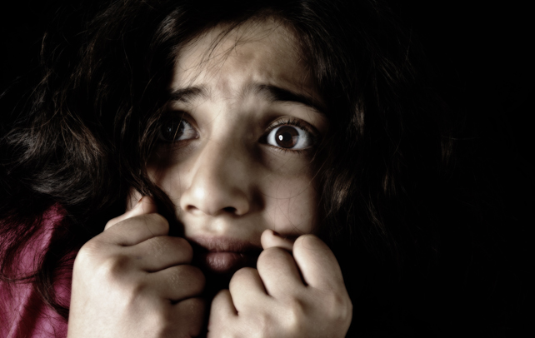
fear
to be afraid
Notes:
Give student friendly definition
Use the word in other contexts

Slide 7
Thumbs up if you would fear this. Thumbs down if not.
You are laying in your bed and something goes thump in your closet.
A snake is crawling across the sidewalk.
Your mom is making cookies.
Notes:
Engage the students with the word

Slide 8
naughty
Notes:
Contextualize the word- Find it in the text
Say the word together

Slide 9
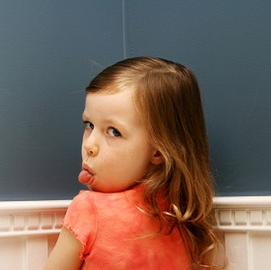
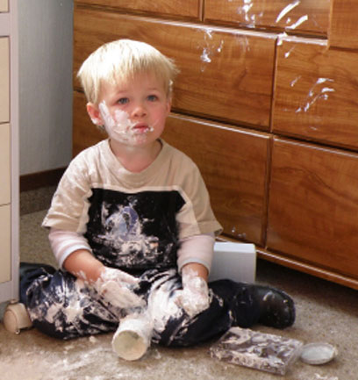
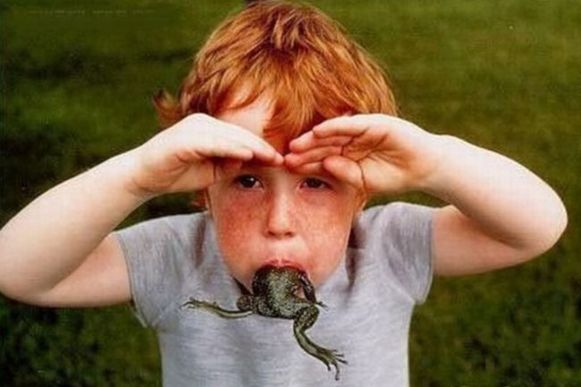
naughty
behave badly
Notes:
Give student friendly definition
Use the word in other contexts

Slide 10
Describe a time you were naughty.
Notes:
Engage the students with the word

Slide 11
soiled
Notes:
Contextualize the word- Find it in the text
Say the word together

Slide 12
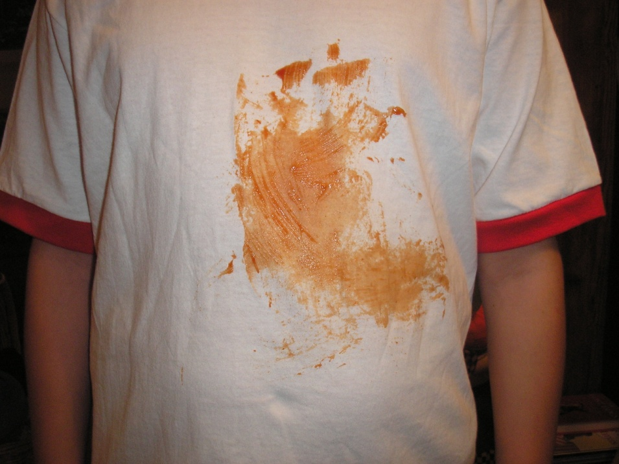
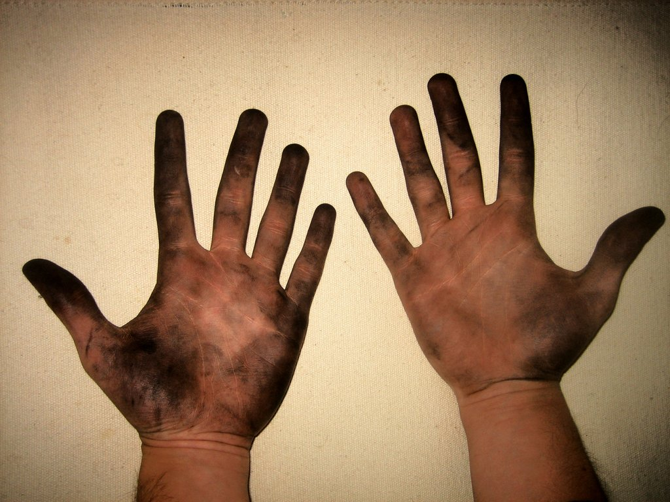
soiled
to get dirty
Notes:
Give student friendly definition
Use the word in other contexts

Slide 13
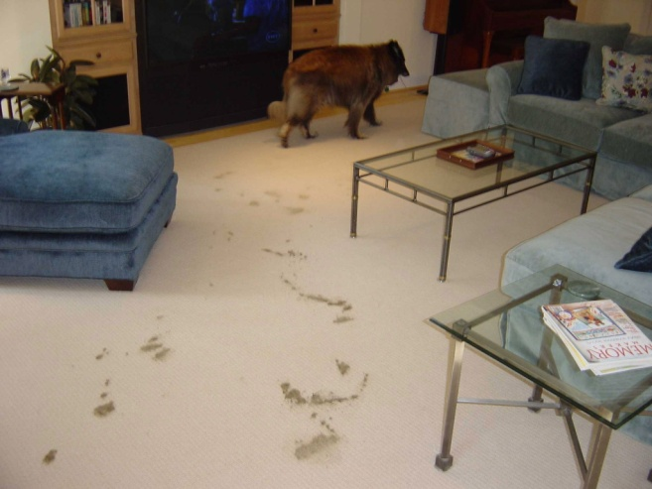
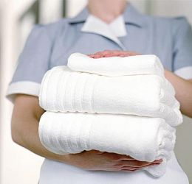
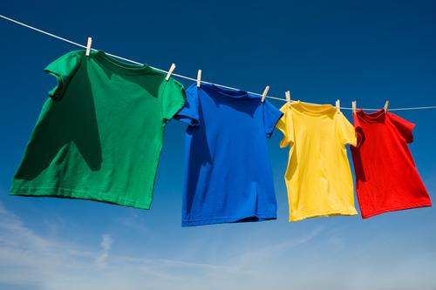
Which things are soiled?
Notes:
Engage the students with the word

Slide 14
Who can use all these words in a sentence?
fear
naughty
soiled
Notes:
Read all three words and see if you can use them in one sentence.

Slide 15
Draw a picture to show you know what these words mean.
fear
naughty
soiled
Notes:
Application-
Students need an opportunity to use the words they just learned from the text.

Slide 16
I can use words I learn from a text.
Notes:
Goal-
Revisit the Goal

