Slide 1
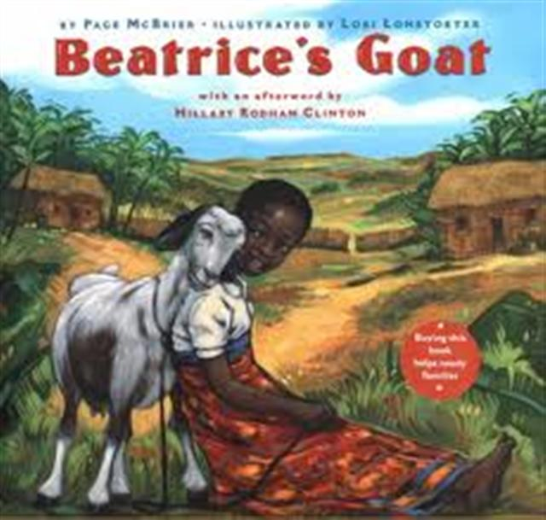
Beatrice’s Goat

Slide 2
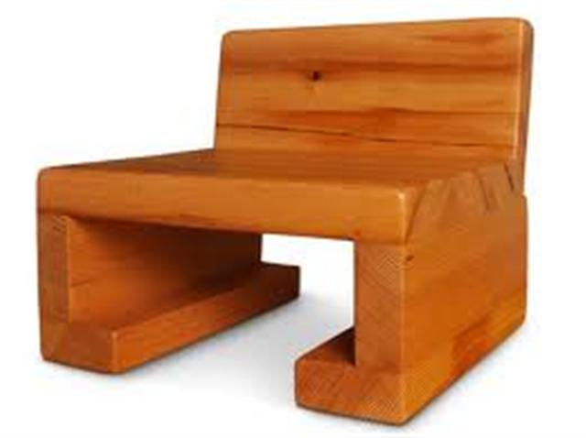
sturdy
sturdy – strong; hard to break
Papa Bear’s chair was very sturdy.

Slide 3
sturdy
Which things are sturdy?
Paper
Rock
Egg
Cookie
Desk
(Thumbs up/down)

Slide 4
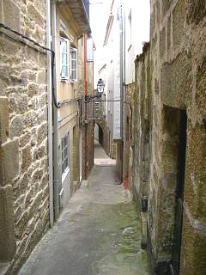
narrow
Narrow – skinny; not wide
- The road was narrow.

Slide 5
Narrow
Act like you are walking through something that is narrow.
If something is narrow…
You can run through it.
You can put your arms out.
You have to go slowly.

Slide 6
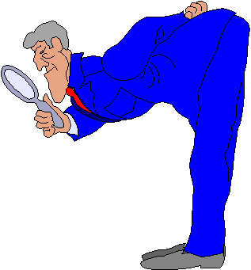
examined
examined – looked at closely
He examined the floor to make sure it was clean.

Slide 7
examine
What tools have we used before to examine the plants in the garden?
What does a doctor examine?
What does an eye doctor examine?
What does a dentist examine?

Slide 8
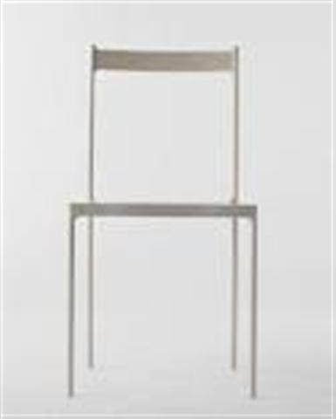
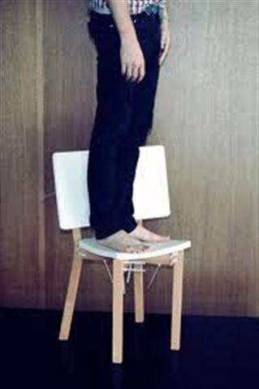
Which goes with sturdy?

Slide 9
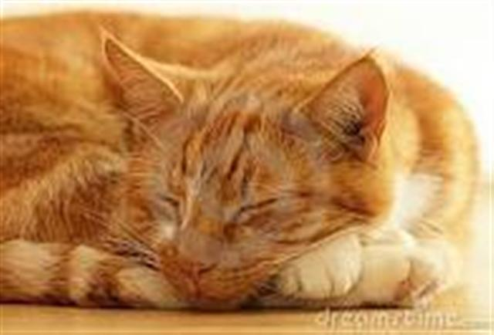
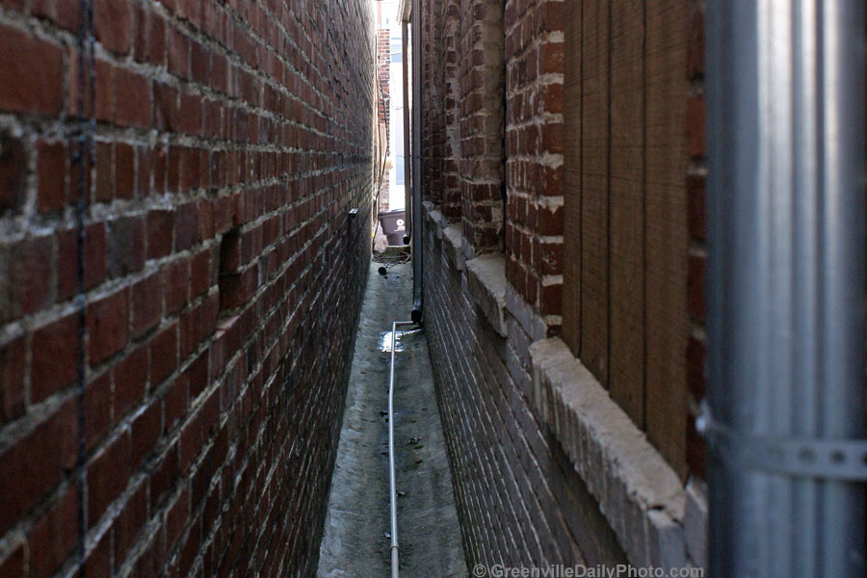
Which goes with narrow?

Slide 10
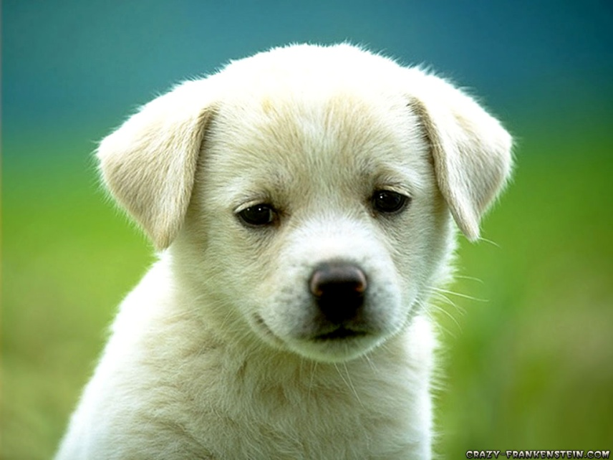
Which goes with examine?

Slide 11
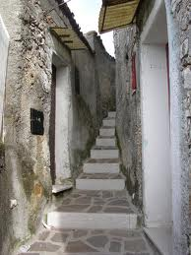
Which word goes with this picture? sturdy, narrow, examined

Slide 12
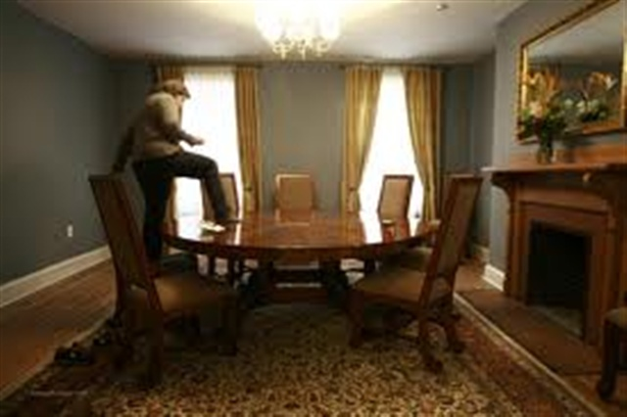
Which word goes with this picture? sturdy, narrow, examined

Slide 13
Which word goes with this picture? sturdy, narrow, examined

