Slide 1
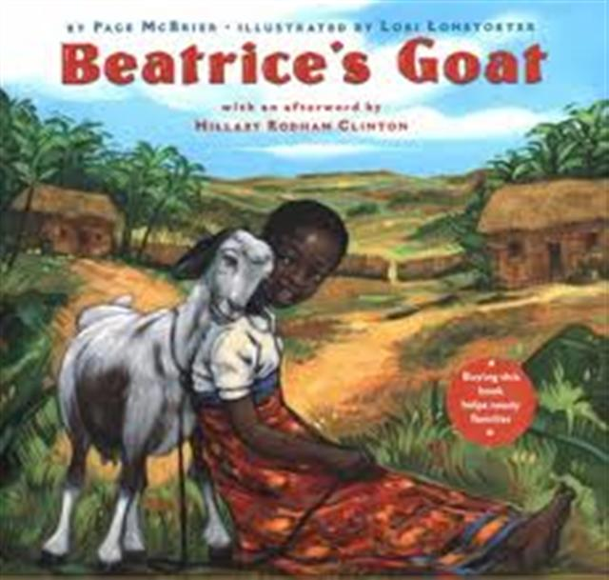
Beatrice’s Goat

Slide 2
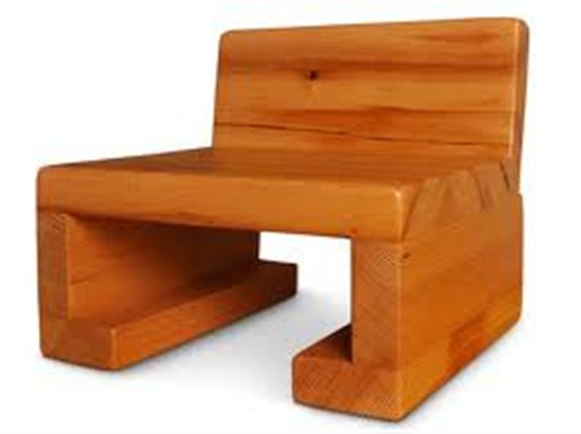
sturdy
sturdy – strong; hard to break
Papa Bear’s chair was very sturdy.

Slide 3
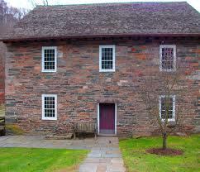
sturdy
“Beatrice lives here with her mother and five younger brothers and sisters in a sturdy mud house with a fine steel roof.”
The third little pig’s house was sturdy because it was made out of strong bricks.

Slide 4
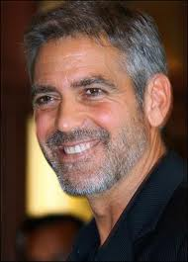
coarse
Coarse – rough and scratchy
- Dad’s beard was scratchy and coarse.

Slide 5
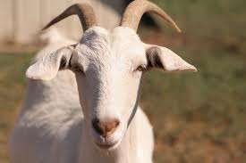
coarse
“Beatrice loves everything about Mugisa… the feel of her coarse brown-and-white coat, the way her chin hairs curl just so, and how Mugisa gently teases her by butting her knobby horns against Beatrice’s hand.”
Goats have coarse hair
under their chins.

Slide 6
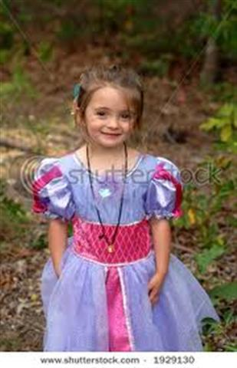
yearned
yearned – to want something badly
She yearned to have a beautiful dress with puffy sleeves.

Slide 7
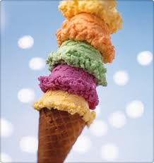
yearned
“Beatrice longed to be a schoolgirl! How she yearned to sit on one of the benches and figure sums on a small slate chalkboard.”
Another example- “I yearned to have a delicious ice cream cone.”

Slide 8
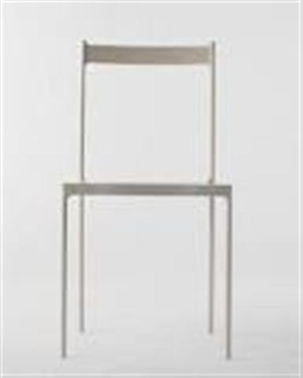
Which goes with sturdy?

Slide 9
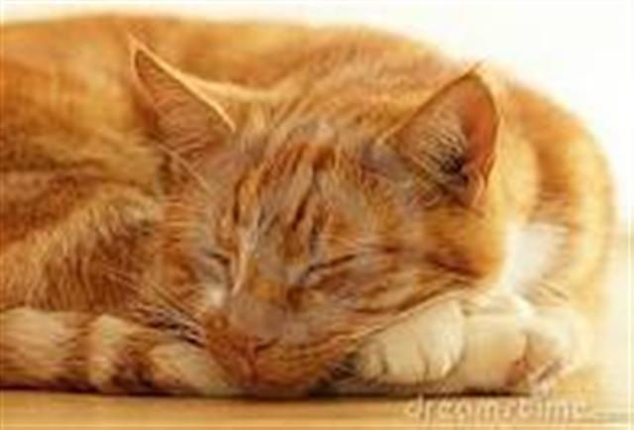
Which goes with yearned?

Slide 10
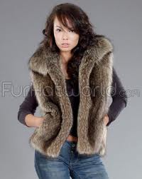
Which goes with coarse?

Slide 11
Which word goes with this picture? sturdy, coarse, yearned

Slide 12
Which word goes with this picture? sturdy, coarse, yearned

Slide 13
Which word goes with this picture? sturdy, coarse, yearned

