Slide 1
Retold by _________’s Class
Illustrated by Paul Galdone

Slide 2
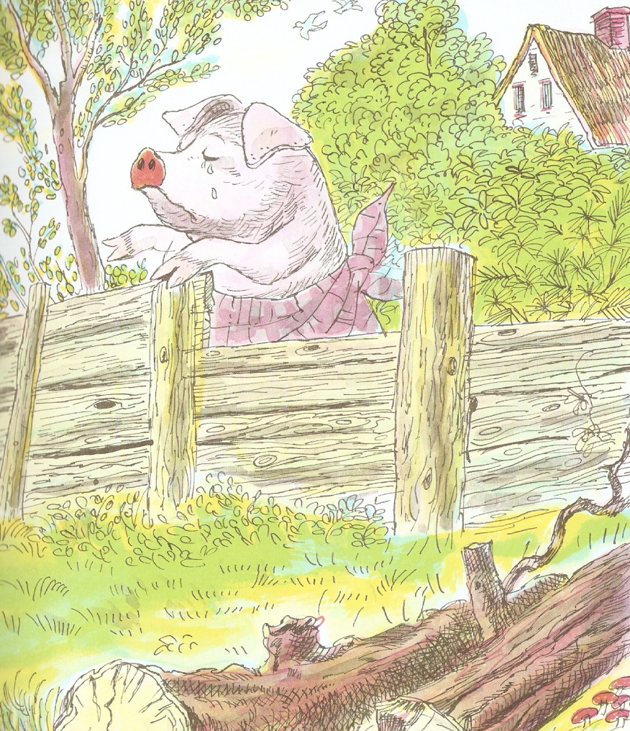
Type text here using two spaces between words.

Slide 3
Type text here using two spaces between words.

Slide 4
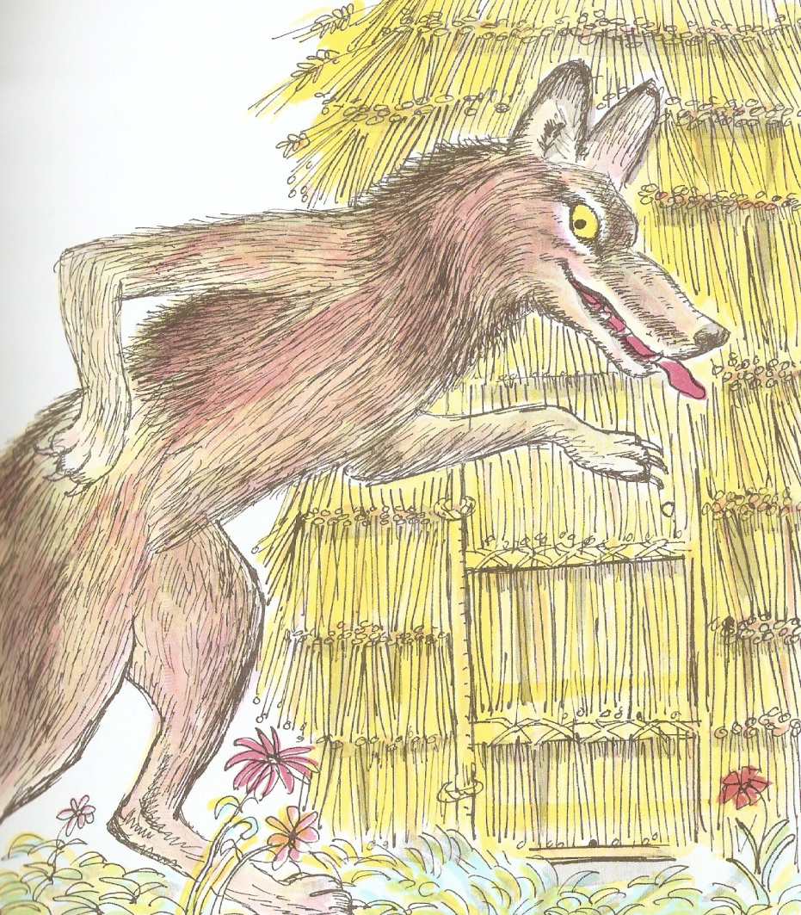
Type text here using two spaces between words.

Slide 5
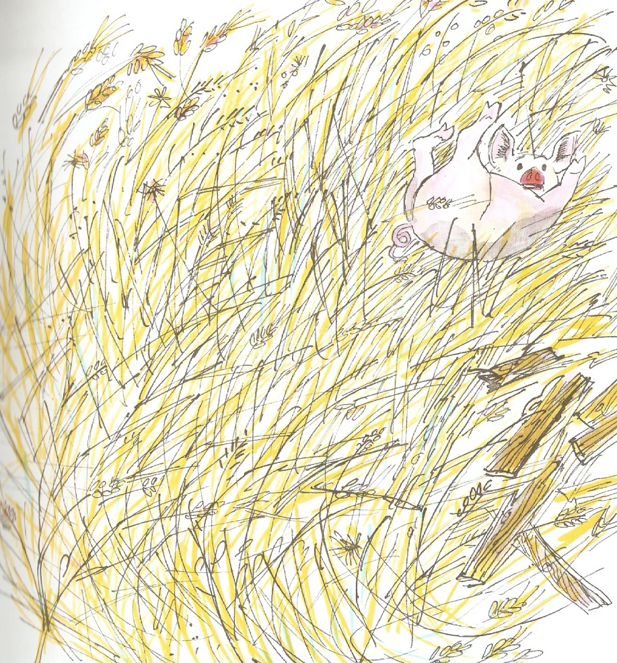
Type text here using two spaces between words.

Slide 6
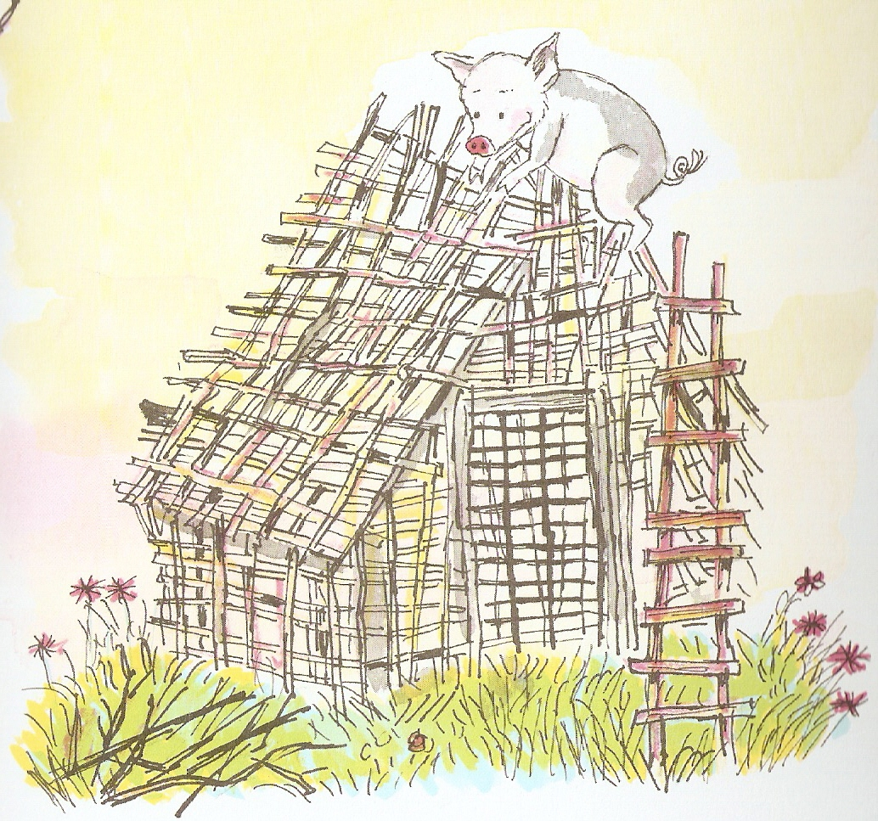
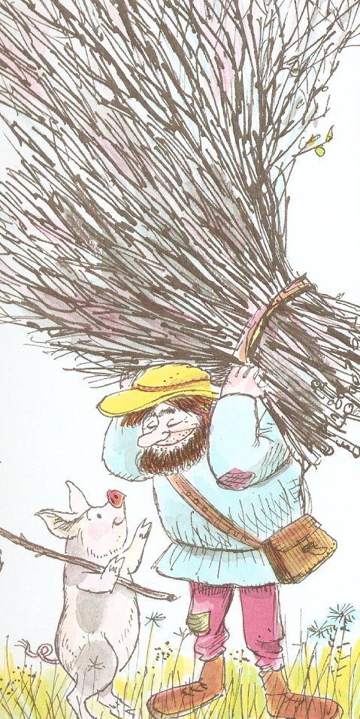
Type text here using two spaces between words.

Slide 7
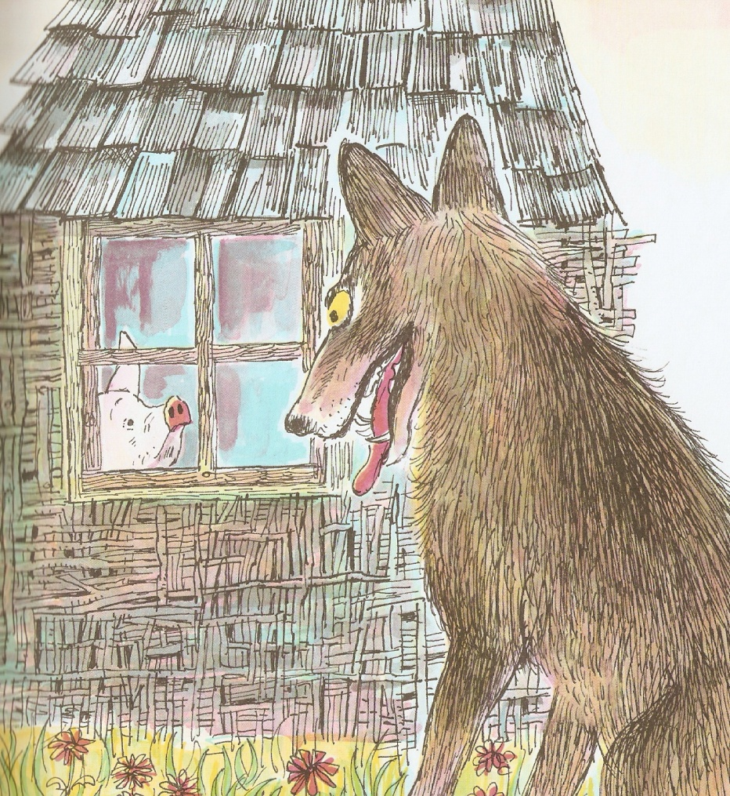
Type text here using two spaces between words.

Slide 8
Type text here using two spaces between words.

Slide 9
Type text here using two spaces between words.
Type text here using two spaces between words.

Slide 10
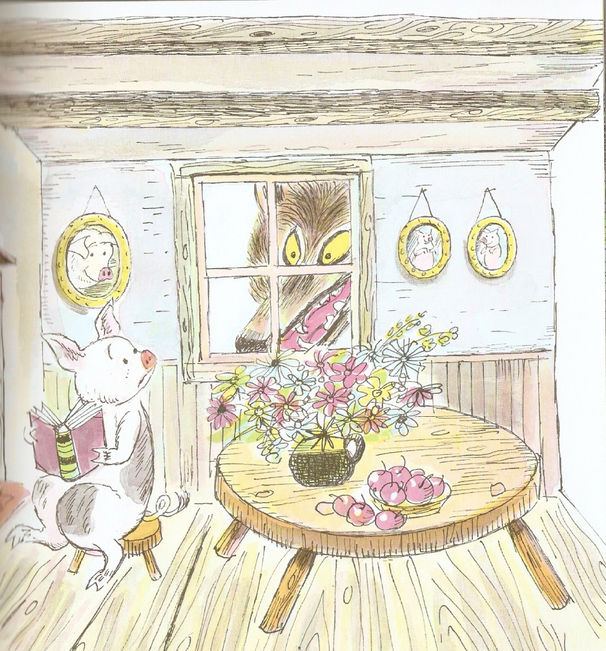
Type text here using two spaces between words.

Slide 11
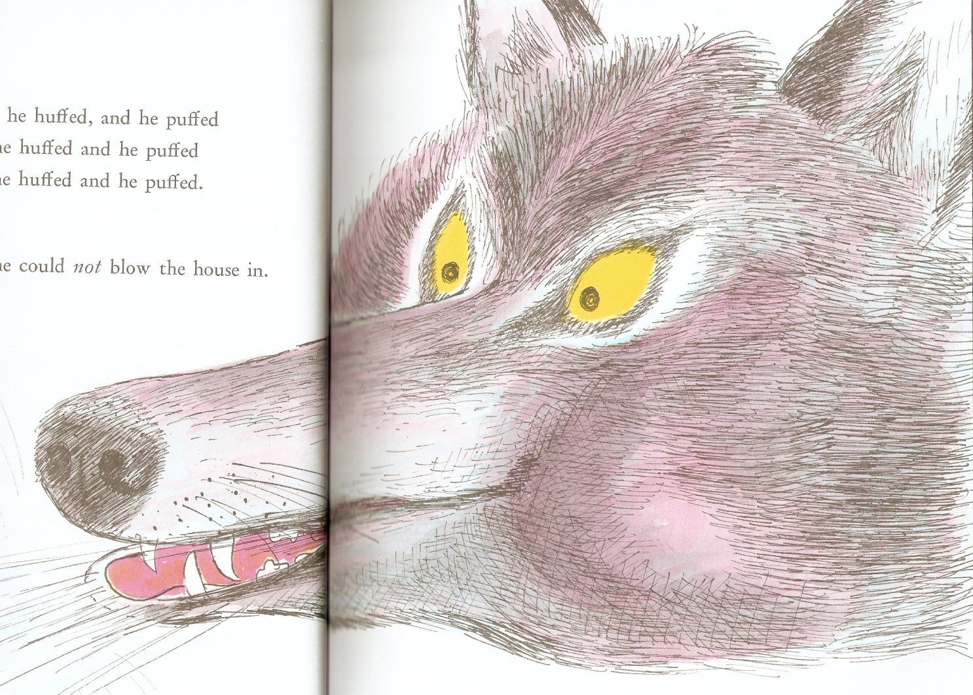
Type text here using two spaces between words.

Slide 12
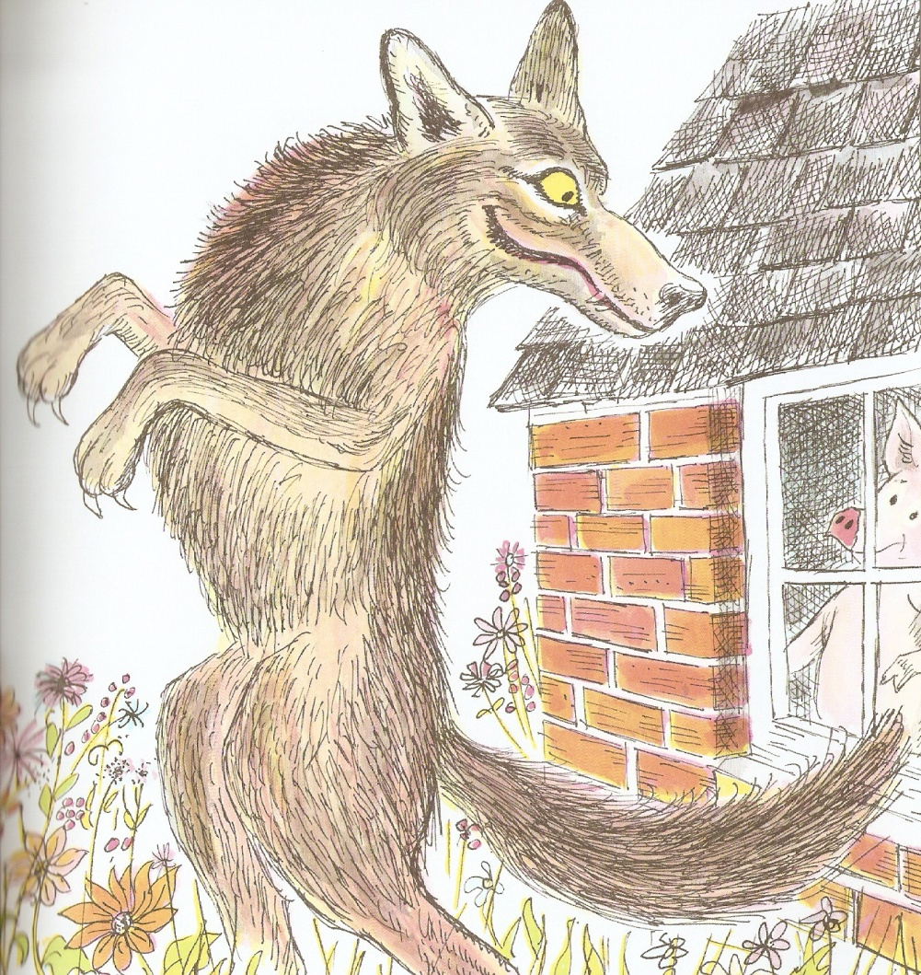
Type text here using two spaces between words.

Slide 13
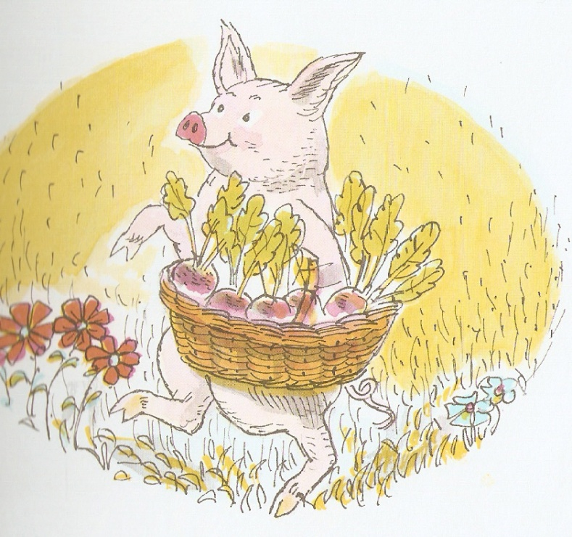
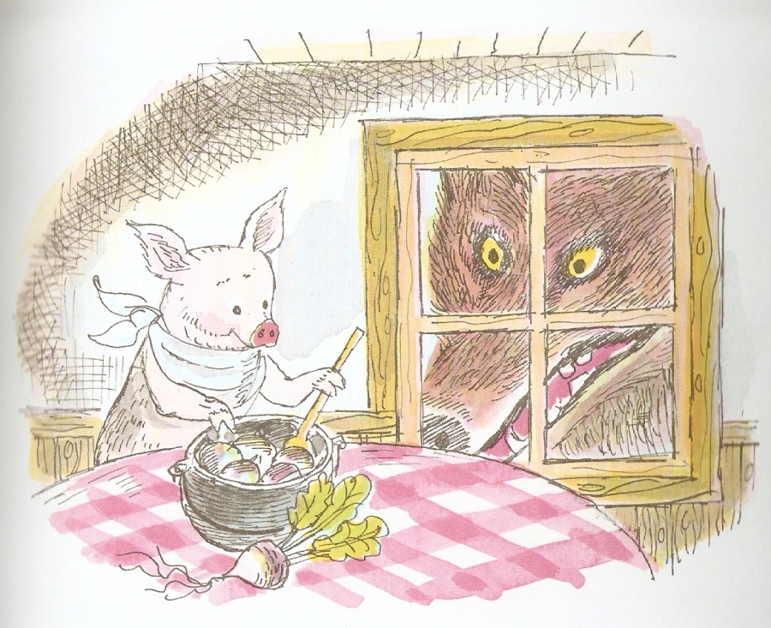
Type text here using two spaces between words.
Type text here using two spaces between words.

Slide 14
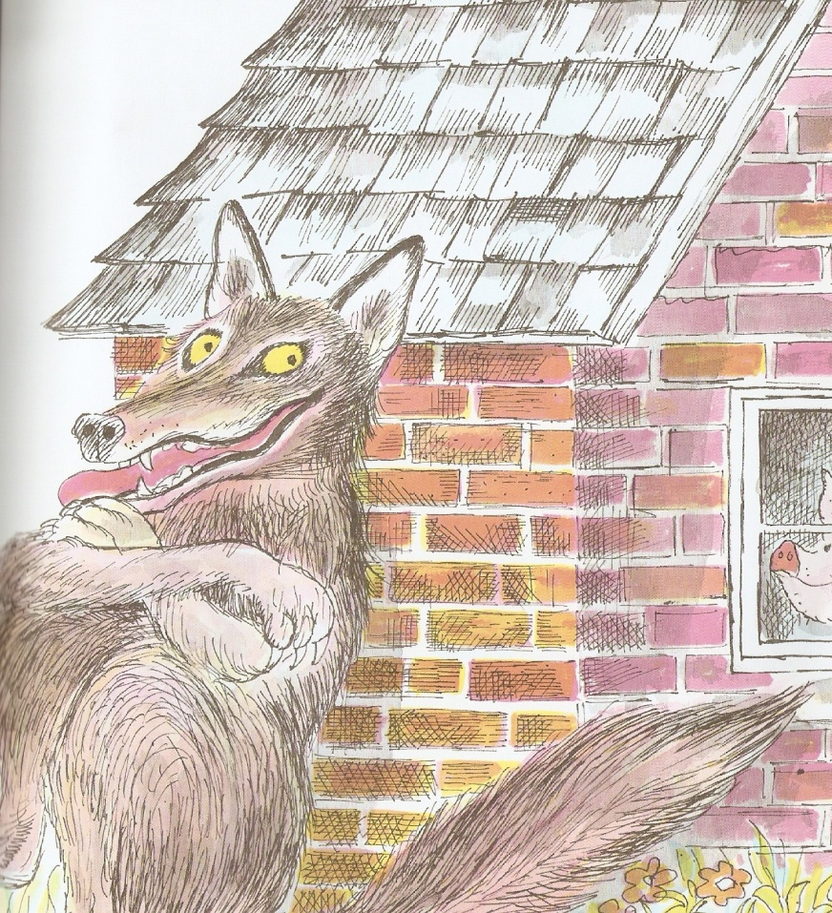
Type text here using two spaces between words.

Slide 15
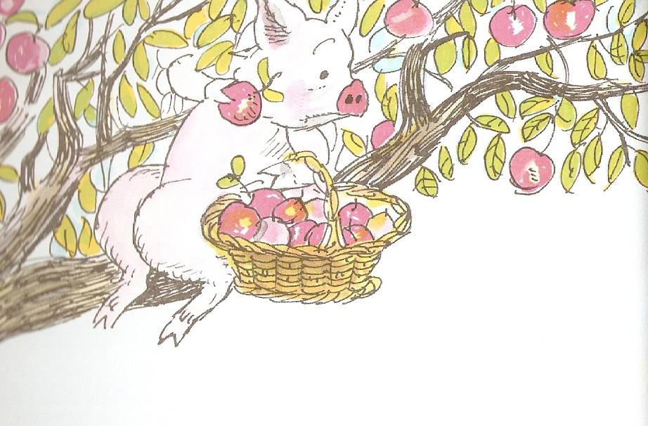
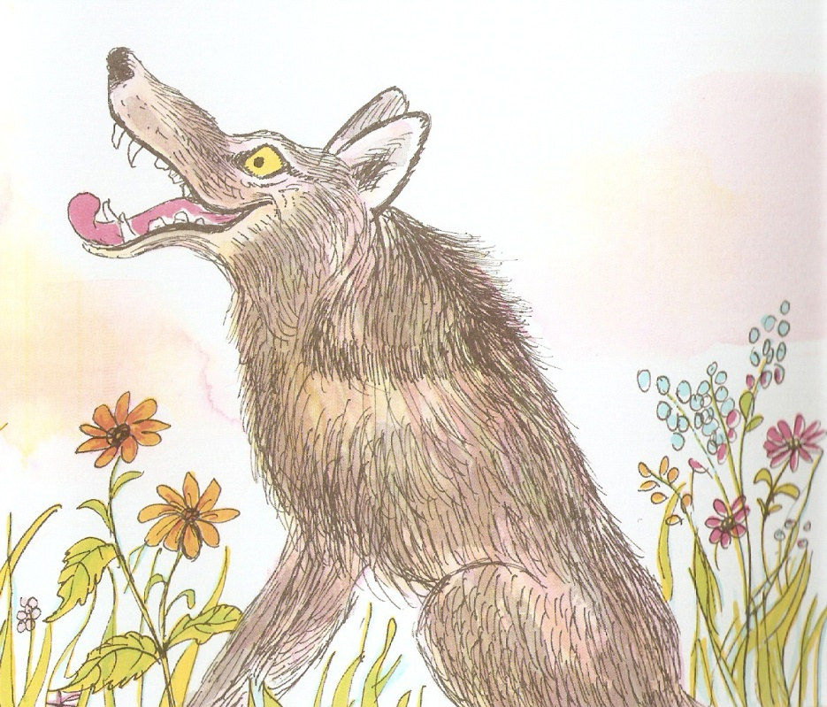
Type text here using two spaces between words.
Type text here using two spaces between words.

Slide 16
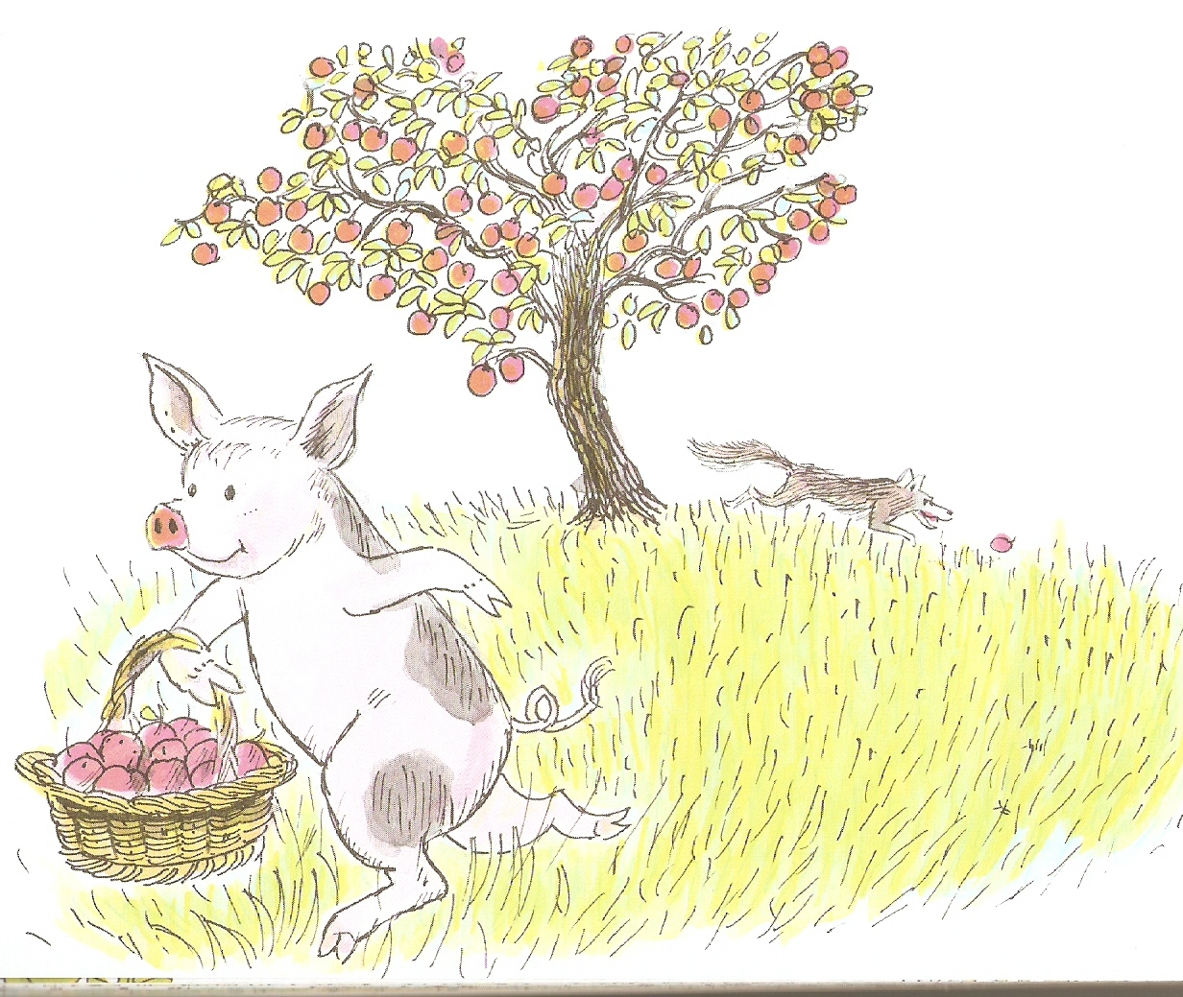
Type text here using two spaces between words.

Slide 17
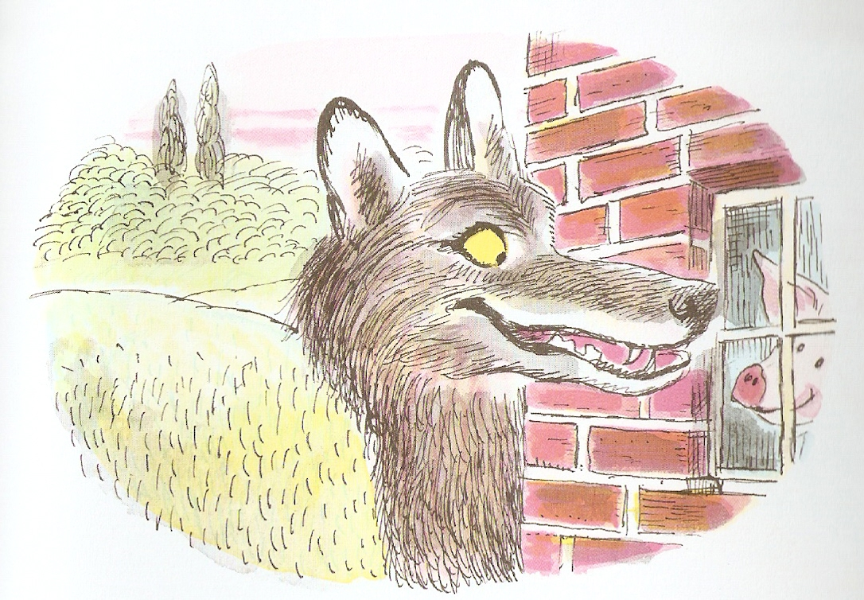
Type text here using two spaces between words.

Slide 18
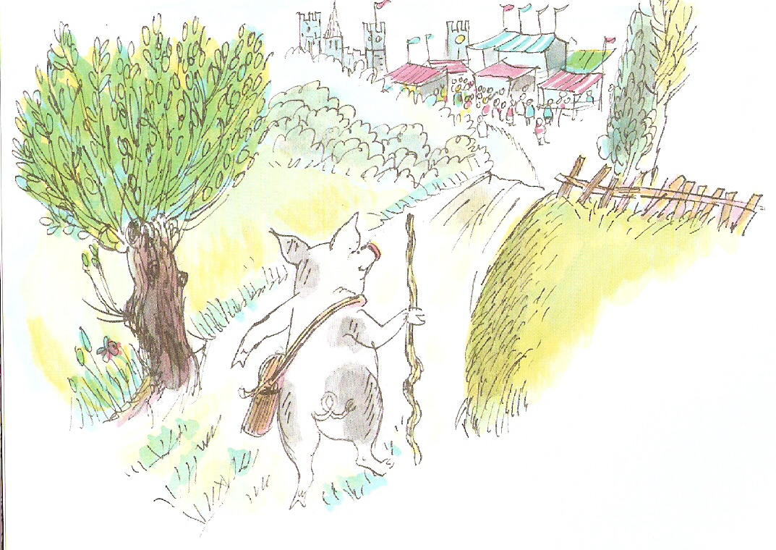
Type text here using two spaces between words.

Slide 19
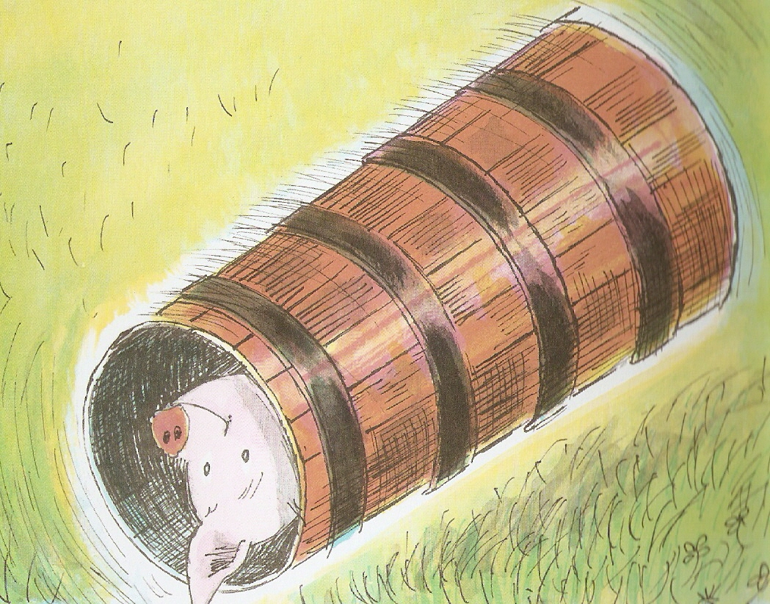
Type text here using two spaces between words.

Slide 20
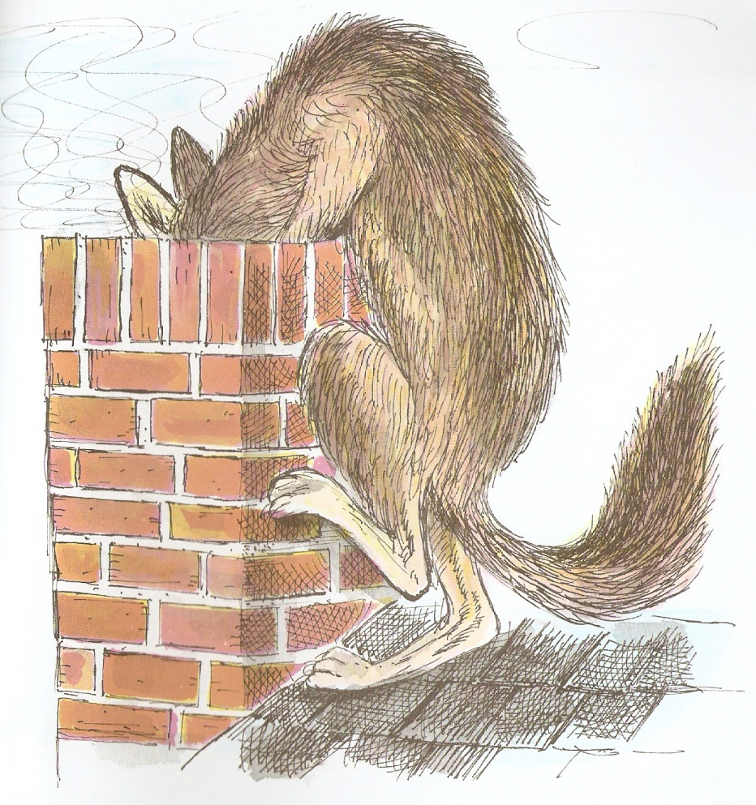
Type text here using two spaces between words.

Slide 21
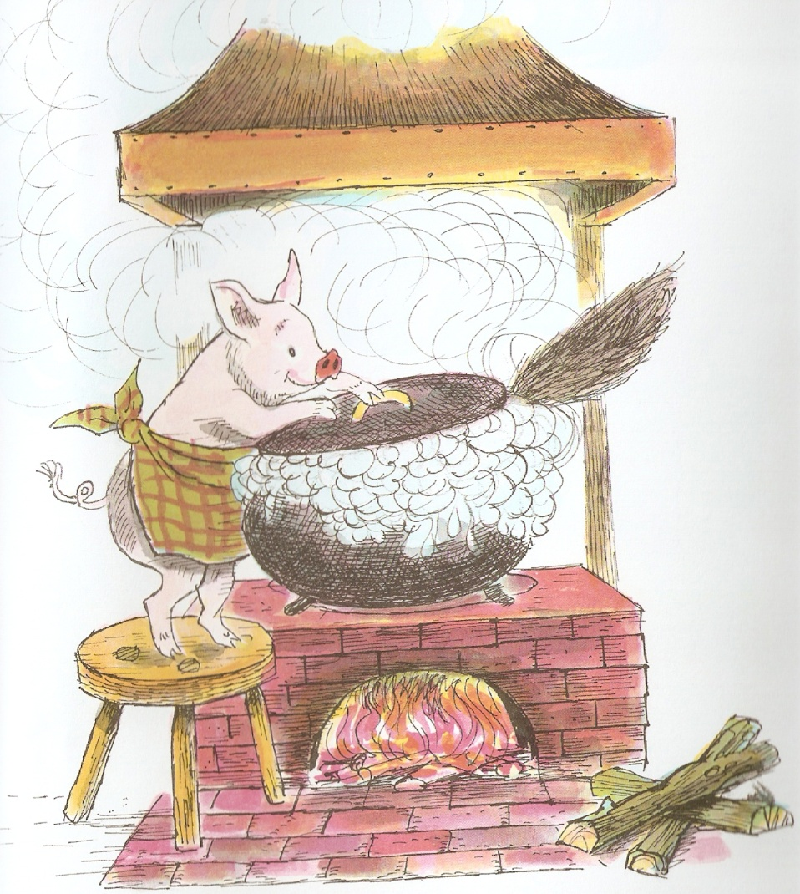
Type text here using two spaces between words.

Slide 22
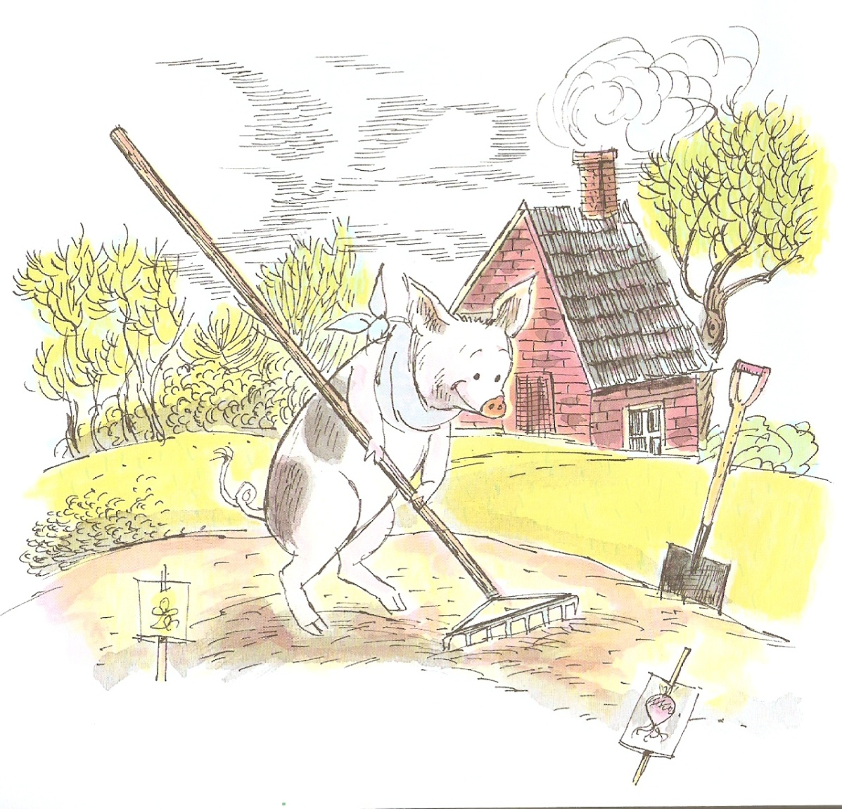
Type text here using two spaces between words.

