Slide 1
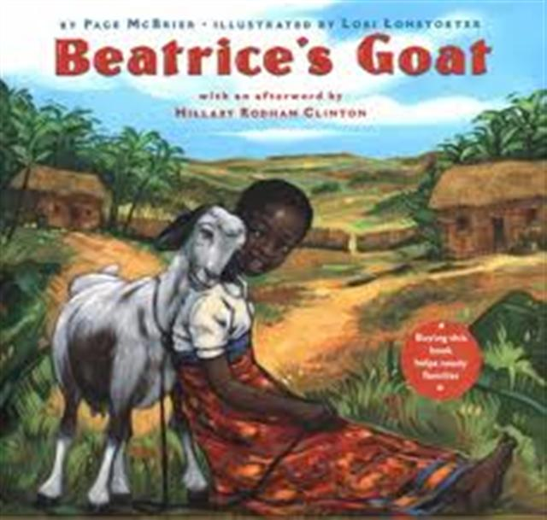
Beatrice’s Goat

Slide 2
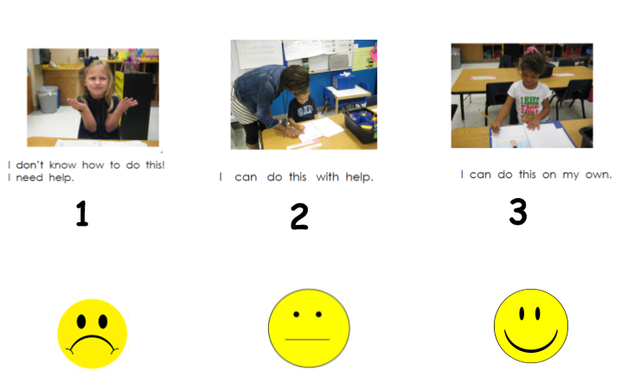
I can use words I learn from a text.
Notes:
I can use words I learn from a text.
*Score yourself

Slide 3
Tell your partner about a new word you learned.
Notes:
Turn and Talk; Show a picture of The Very Hungry Caterpillar . Discuss Who, where, what!
(character, setting, events)

Slide 4
Notes:
Re-read the story Beatrice’s Goat; provide a brief explanation of any words that may be new or unfamiliar to the students.
-Teach the following words- sturdy, coarse, yearned.
Define and engage the students in using the word.
(see powerpoint..tshare/TextTalk)

Slide 5
sturdy

Slide 6
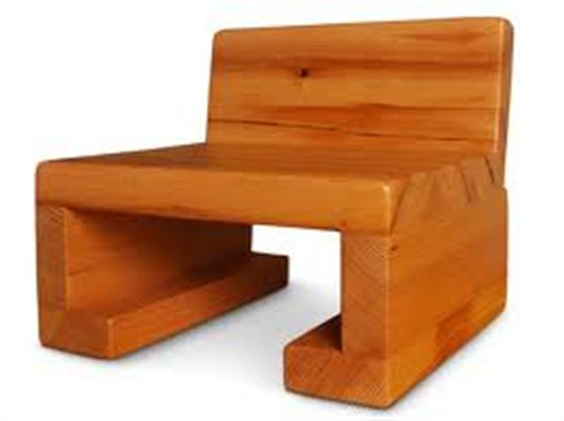
sturdy
sturdy – strong; hard to break
Papa Bear’s chair was very sturdy.

Slide 7
Thumbs up if you agree, thumbs down if you disagree.
Is our school sturdy?
Is a kleenex sturdy?
Is your desk sturdy?

Slide 8
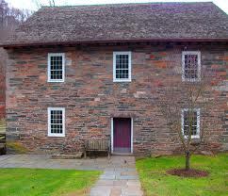
sturdy
“Beatrice lives here with her mother and five younger brothers and sisters in a sturdy mud house with a fine steel roof.”
The third little pig’s house was sturdy because it was made out of strong bricks.

Slide 9
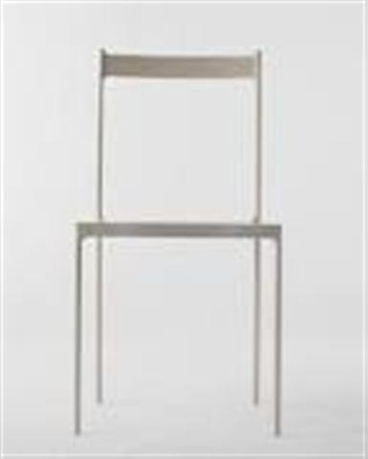
Which goes with sturdy?

Slide 10
coarse

Slide 11
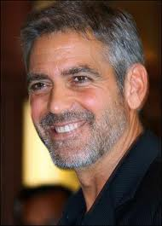
coarse
Coarse – rough and scratchy
- Dad’s beard was scratchy and coarse.

Slide 12
Thumbs up if you agree, thumbs down if you disagree.
Is a feather coarse?
Is sand paper coarse?
Is your shirt coarse?
Notes:
Have these things available for students to feel.

Slide 13
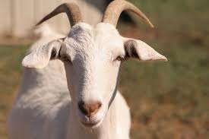
coarse
“Beatrice loves everything about Mugisa… the feel of her coarse brown-and-white coat, the way her chin hairs curl just so, and how Mugisa gently teases her by butting her knobby horns against Beatrice’s hand.”
Goats have coarse hair
under their chins.

Slide 14
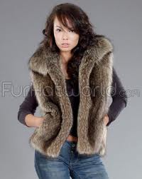
Which goes with coarse?

Slide 15
yearned

Slide 16
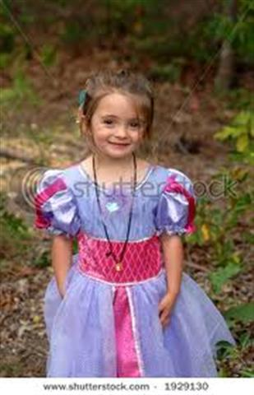
yearned
yearned – to want something badly
She yearned to have a beautiful dress with puffy sleeves.

Slide 17
Thumbs up if you agree, thumbs down if you disagree.
Have you yearned for ice cream?
Have you yearned for a toy?
What is something you have
yearned for?

Slide 18
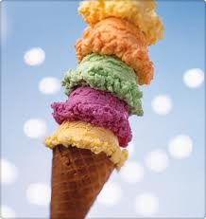
yearned
“Beatrice longed to be a schoolgirl! How she yearned to sit on one of the benches and figure sums on a small slate chalkboard.”
Another example- “I yearned to have a delicious ice cream cone.”

Slide 19
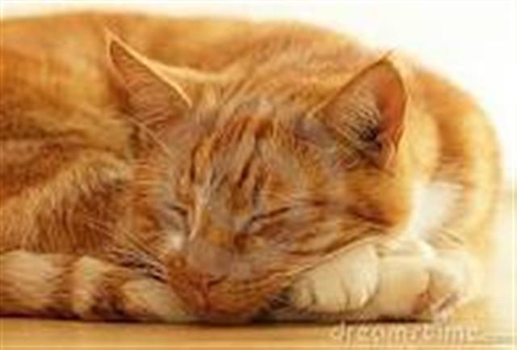
Which goes with yearned?

Slide 20
Which word goes with this picture? sturdy, coarse, yearned

Slide 21
Which word goes with this picture? sturdy, coarse, yearned

Slide 22
Which word goes with this picture? sturdy, coarse, yearned

Slide 23
Circle one word of your choosing and draw a picture or write a sentence to show what it means.
Sturdy
Coarse
Yearned
Notes:
Glue words in their interactive notebook. Circle one word of their choosing and draw a picture or write a sentence to show they know what it means.

Slide 24
I can use words I learn from a text.
Notes:
I can use words I learn from a text.
*Score yourself

