Slide 1
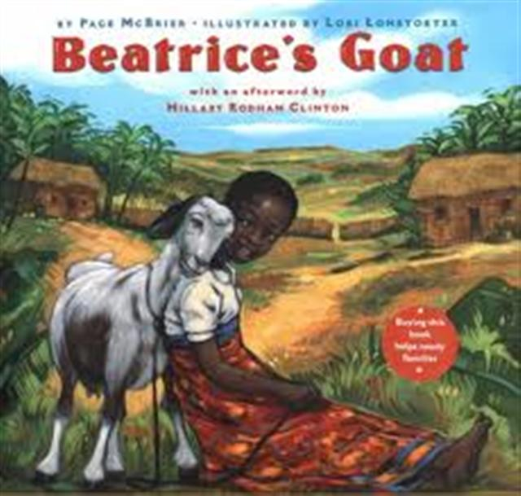
Beatrice’s Goat

Slide 2
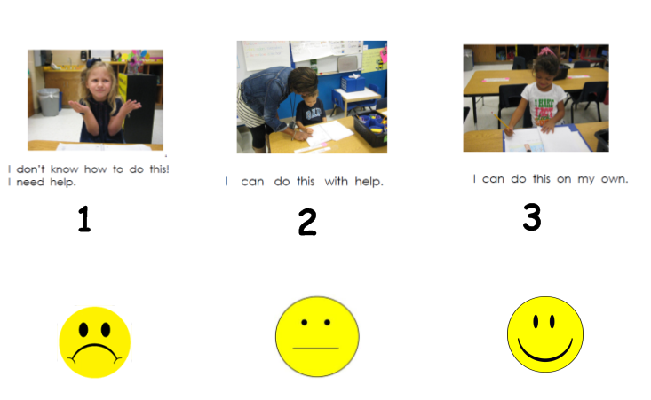
I can identify the characters in a story.
Notes:
I can identify the characters in a story.
*Score yourself

Slide 3
Turn and Talk
Notes:
Turn and Talk; Show a picture of The Very Hungry Caterpillar . Discuss Who, where, what!
(character, setting, events)

Slide 4
Notes:
Discuss what a character means and what we should be listening for before we begin reading.
Read Beatrice’s Goat

Slide 5
Characters
Who were the characters in the story?
Glue down characters page and draw who the characters are in the story.
Come back to carpet to finish up whole groups discussion about characters.
Notes:
Give students time to draw the characters from the story in their notebooks. (Score RLK3) Whole group discussion. Add to chart!

Slide 6
I can identify the characters in a story.
Notes:
I can identify the characters in a story.
*Score yourself

