Slide 1
The Three Little Pigs
Retold by Mrs. Hensley
Illustrated by Paul Galdone

Slide 2
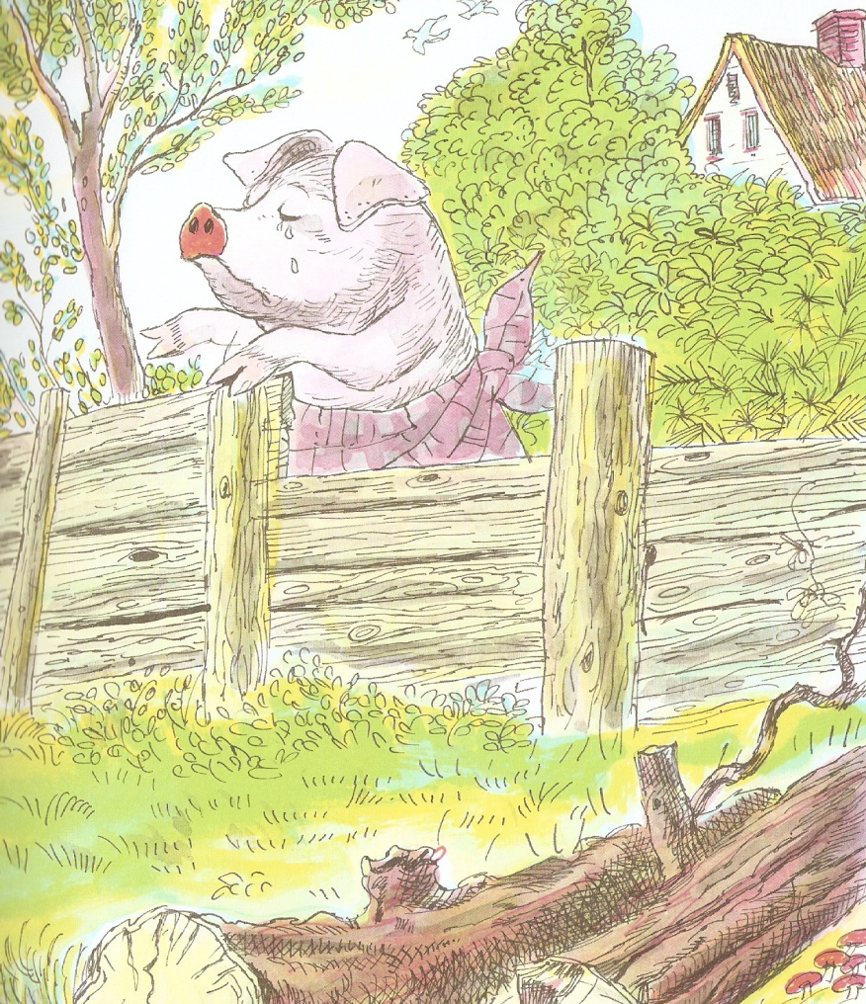
Once upon a time there were three
little pigs.
They set off to build their houses.

Slide 3
The first little pig built
a house with straw.

Slide 4
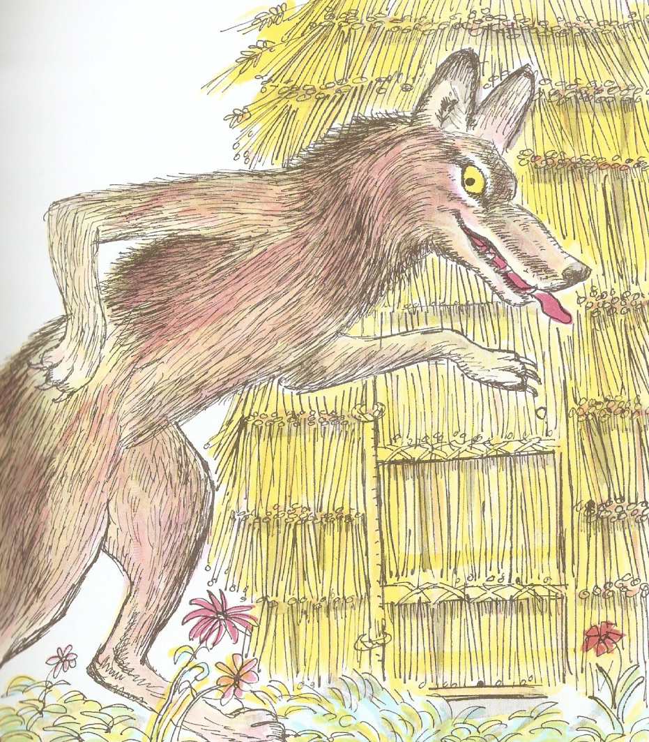
Along came the Big Bad Wolf.
I will huff and
I will puff and
I will blow your house in!

Slide 5
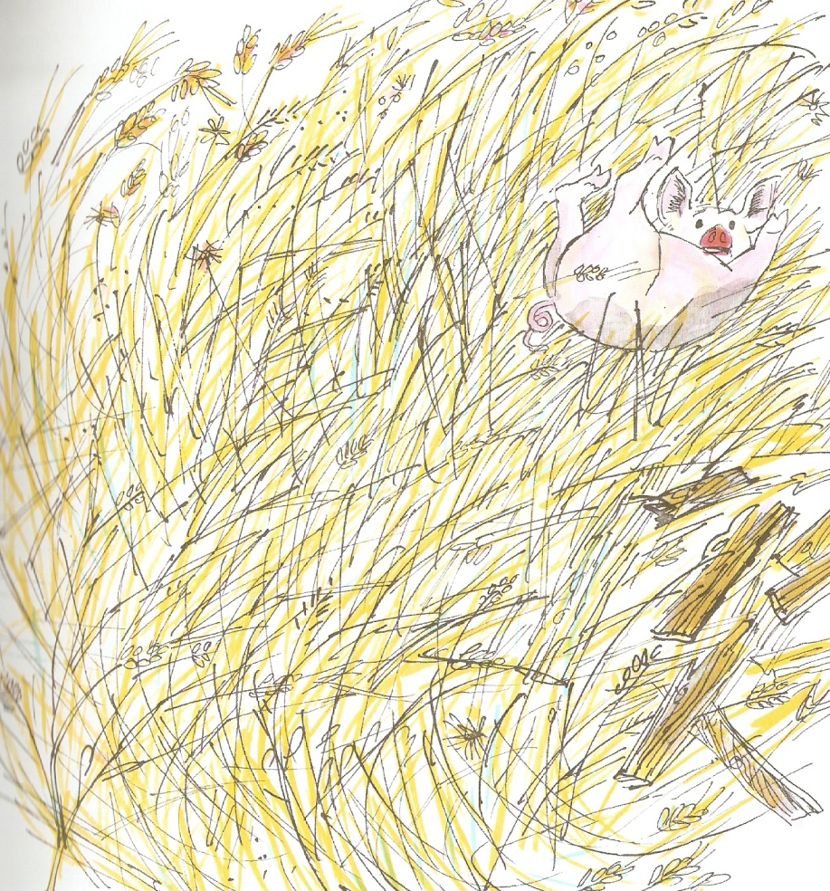
The wolf blew the house in,
and he ate the pig!

Slide 6
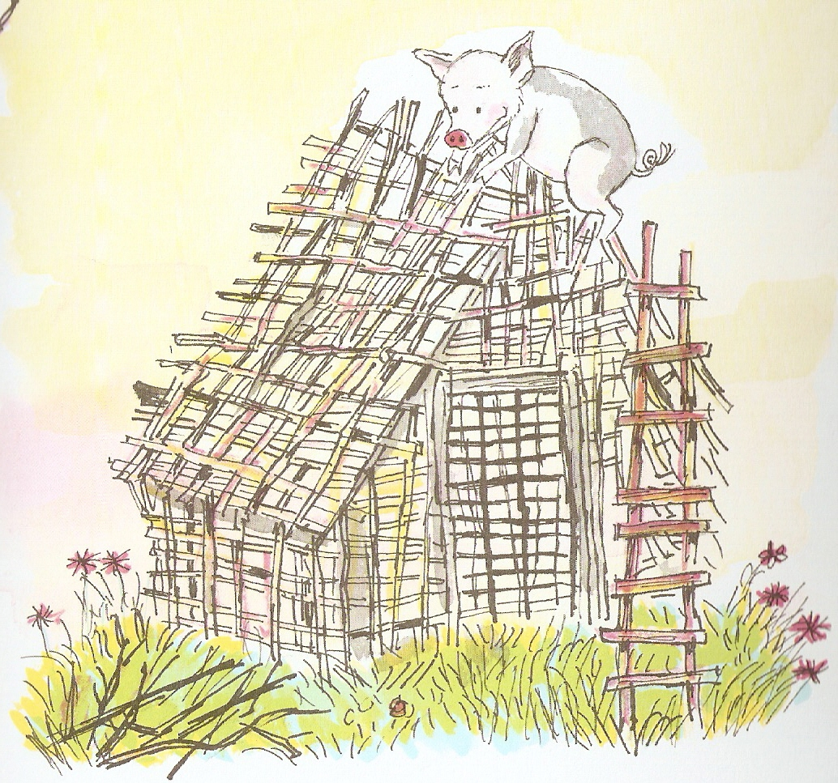
The second little pig built
a house with sticks.

Slide 7
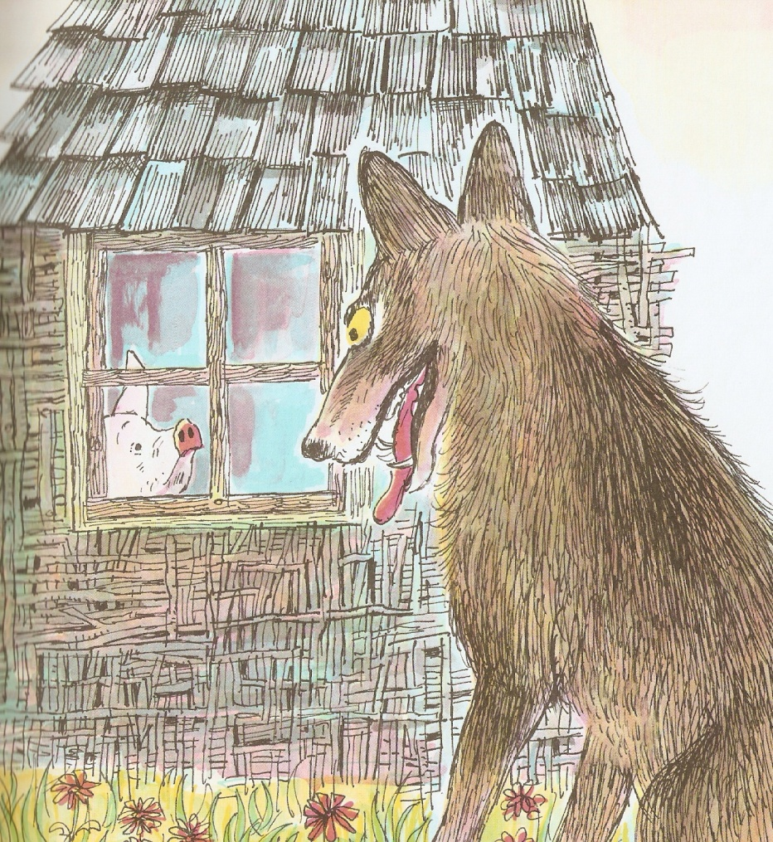
Along came the Big Bad Wolf.
I will huff and
I will puff and
I will blow your house in!

Slide 8
The wolf blew the house in,
and he ate the pig!

Slide 9
The third little pig built
a house with bricks.

Slide 10
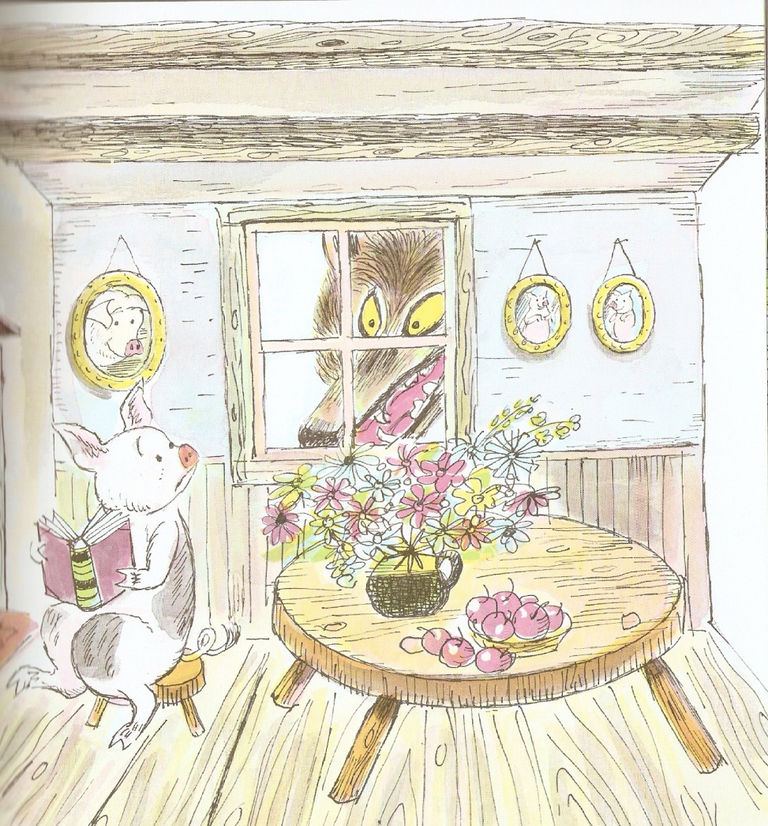
Along came the Big Bad Wolf.
I will huff and
I will puff and
I will blow your house in!

Slide 11
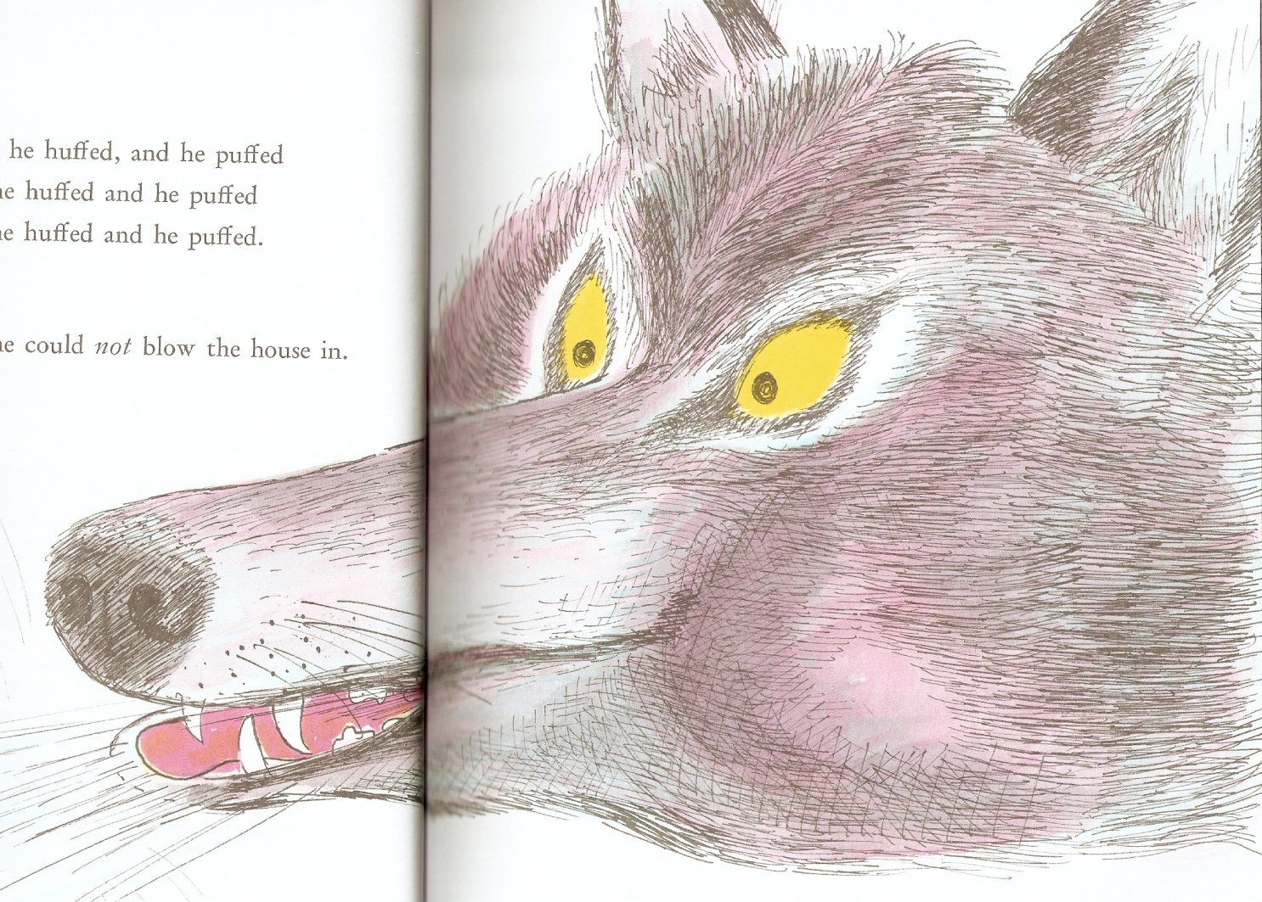
The wolf blew and blew,
but he could not blow the house in!

Slide 12
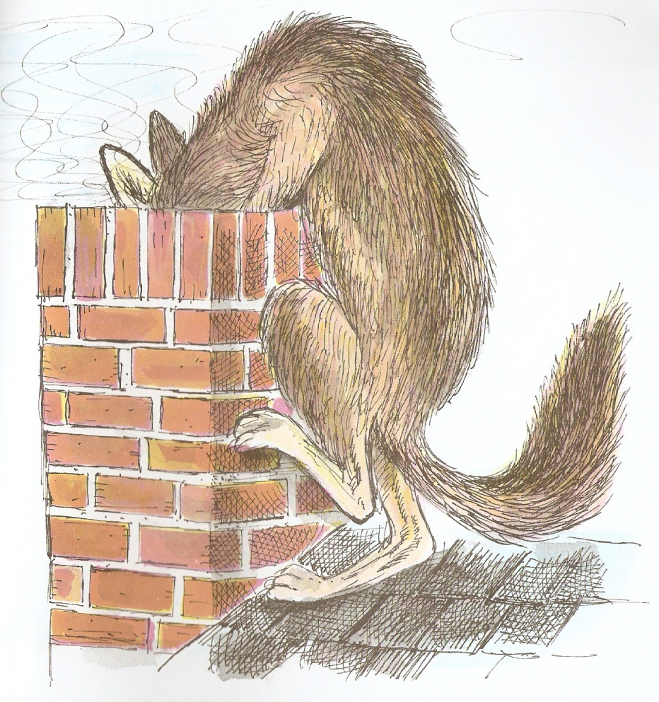
The wolf climbed up to the roof.
He crawled into the chimney!

Slide 13
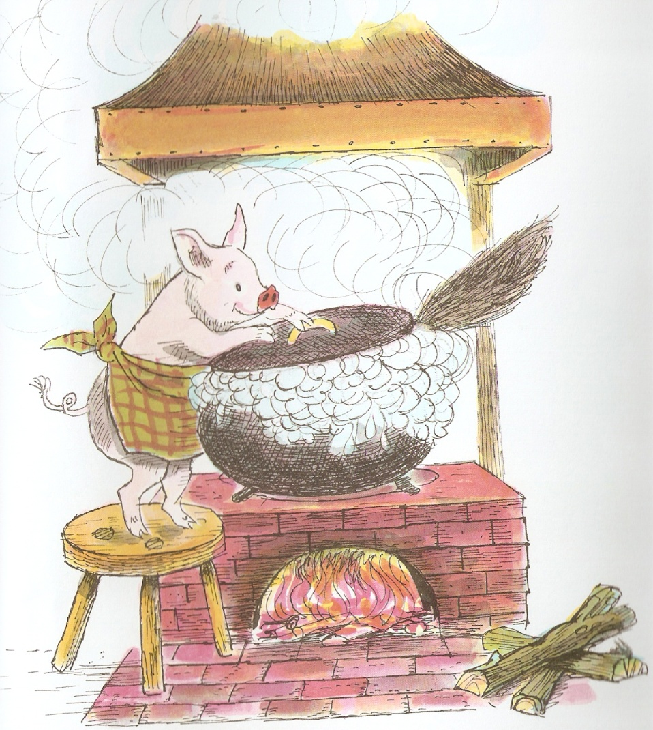
He fell into a pot of hot water!
And that was the end of
the Big Bad Wolf!

