Slide 1
Rap a Tap Tap, Here’s Bojangles – Think of That!
Text Talk
Kindergarten, Unit 1
Old Wire Road Elementary

Slide 2
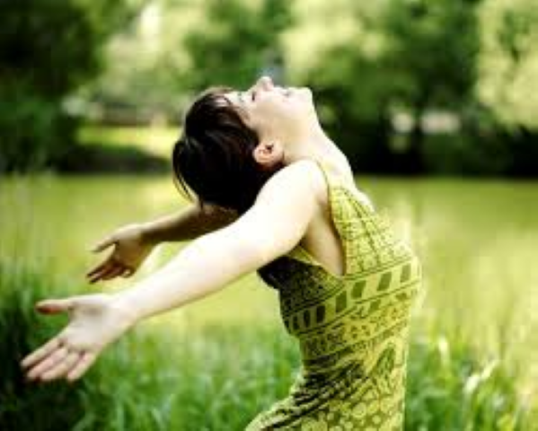
Pleasure: a happy feeling
It was a pleasure to be out in the beautiful sunshine!

Slide 3
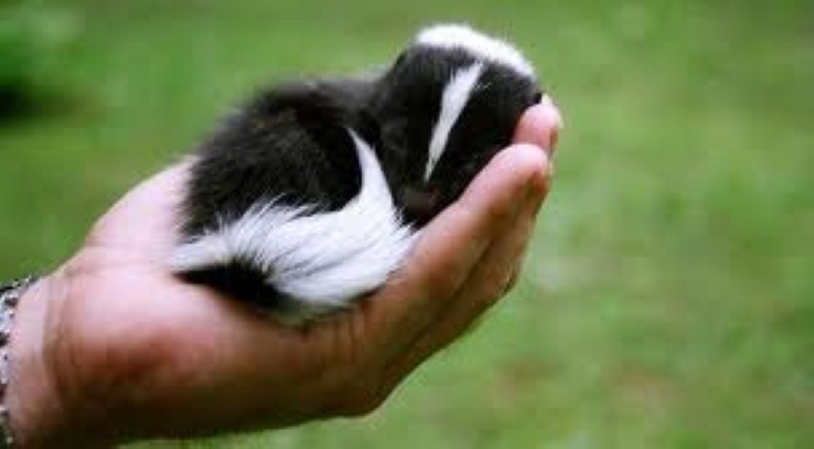
Seldom: not often
We seldom see a pet skunk.

Slide 4
Fame: famous or well-known
Mickey Mouse is a famous cartoon character.

Slide 5
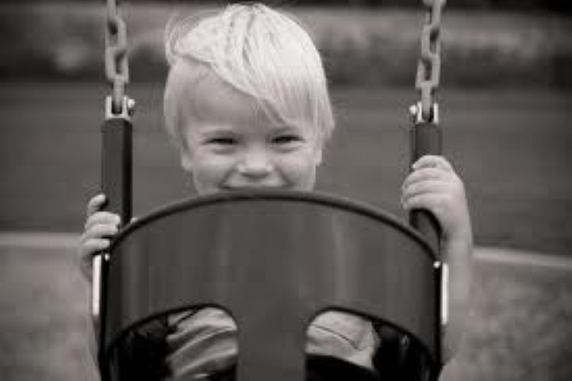
Which picture shows pleasure?

Slide 6
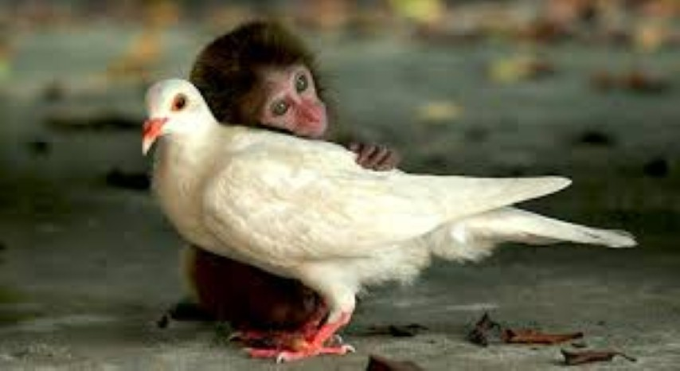
Which picture shows something that we seldom see?

Slide 7
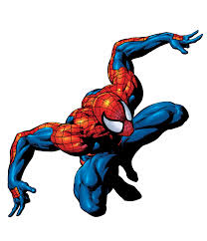
Which picture goes with fame (someone who is famous)?

Slide 8
What does this picture show: pleasure, seldom, fame?

Slide 9
Which word does this picture go with: pleasure, seldom, fame?

Slide 10
Which word does this picture go with: pleasure, seldom, fame?

