Slide 2
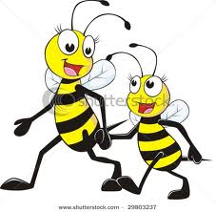
pleasure – a happy feeling

Slide 3
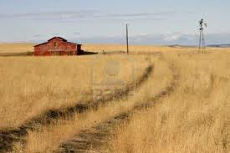
seldom- not often

Slide 4
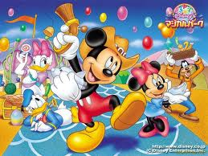
fame –famous;
well known

