Slide 1
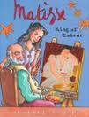
Matisse
King of
Color

Slide 2
teased
To annoy or bother someone

Slide 3

ordinary
usual, common, normal

Slide 4
crept
To move slowly and carefully (like sneaking up on someone)

