Slide 1
If Kisses Were Colors?
Author: Janet Lawler
Illustrator: Alison Jay

Slide 2
sparkling
to reflect light like glitter

Slide 3
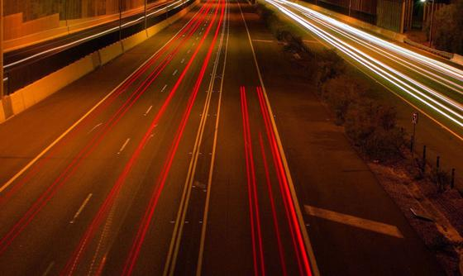
streak
Something moving very fast

Slide 4
flashes
Turns on and off quickly

