Slide 1
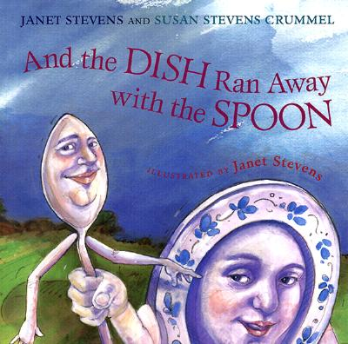

Slide 2
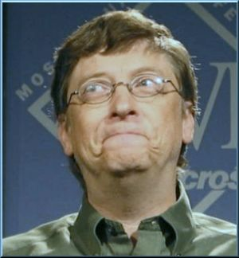
smirked- to smile but not mean it

Slide 3
grumbled- unhappy sounds or words coming out of your mouth (grrr…..)
grrrrrrr

Slide 4
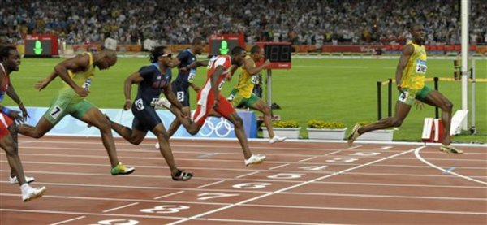
bolted- ran away from quickly

