Slide 1
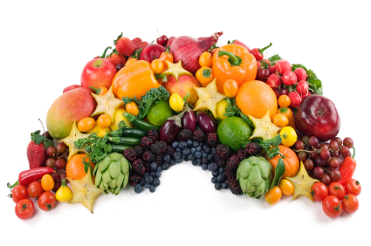
Food Rainbow
Written by Mrs. Hensley
Illustrated with Google images

Slide 2
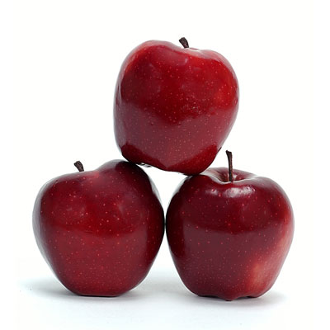
The apples are red.

Slide 3
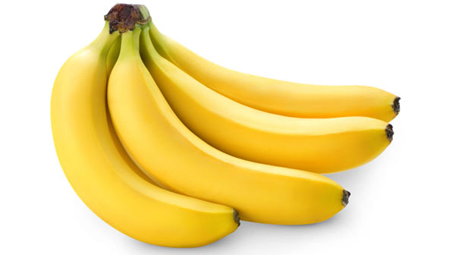
The bananas are yellow.

Slide 4
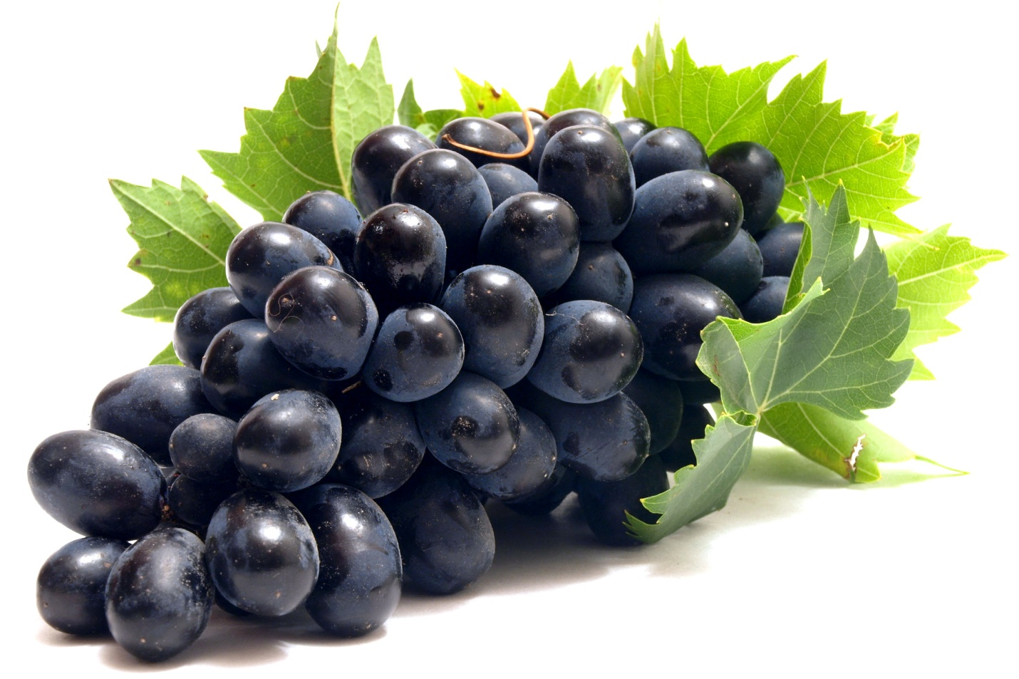
The grapes are purple.

Slide 5
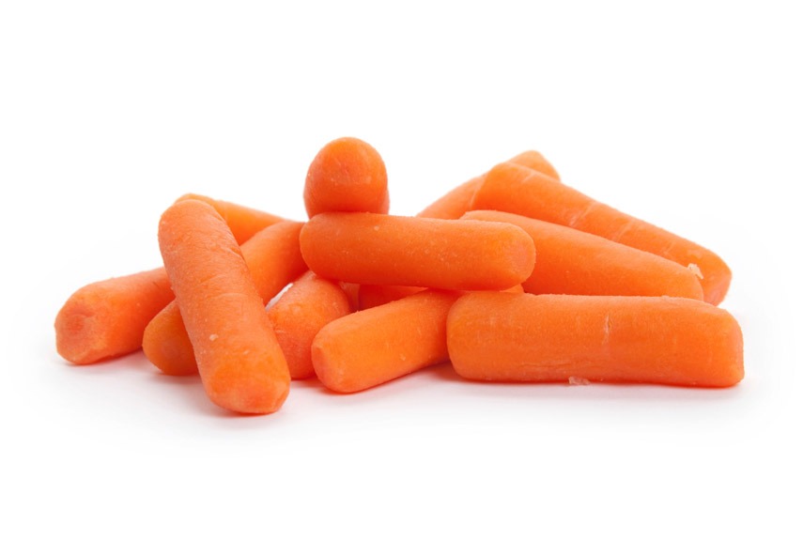
The carrots are orange.

Slide 6
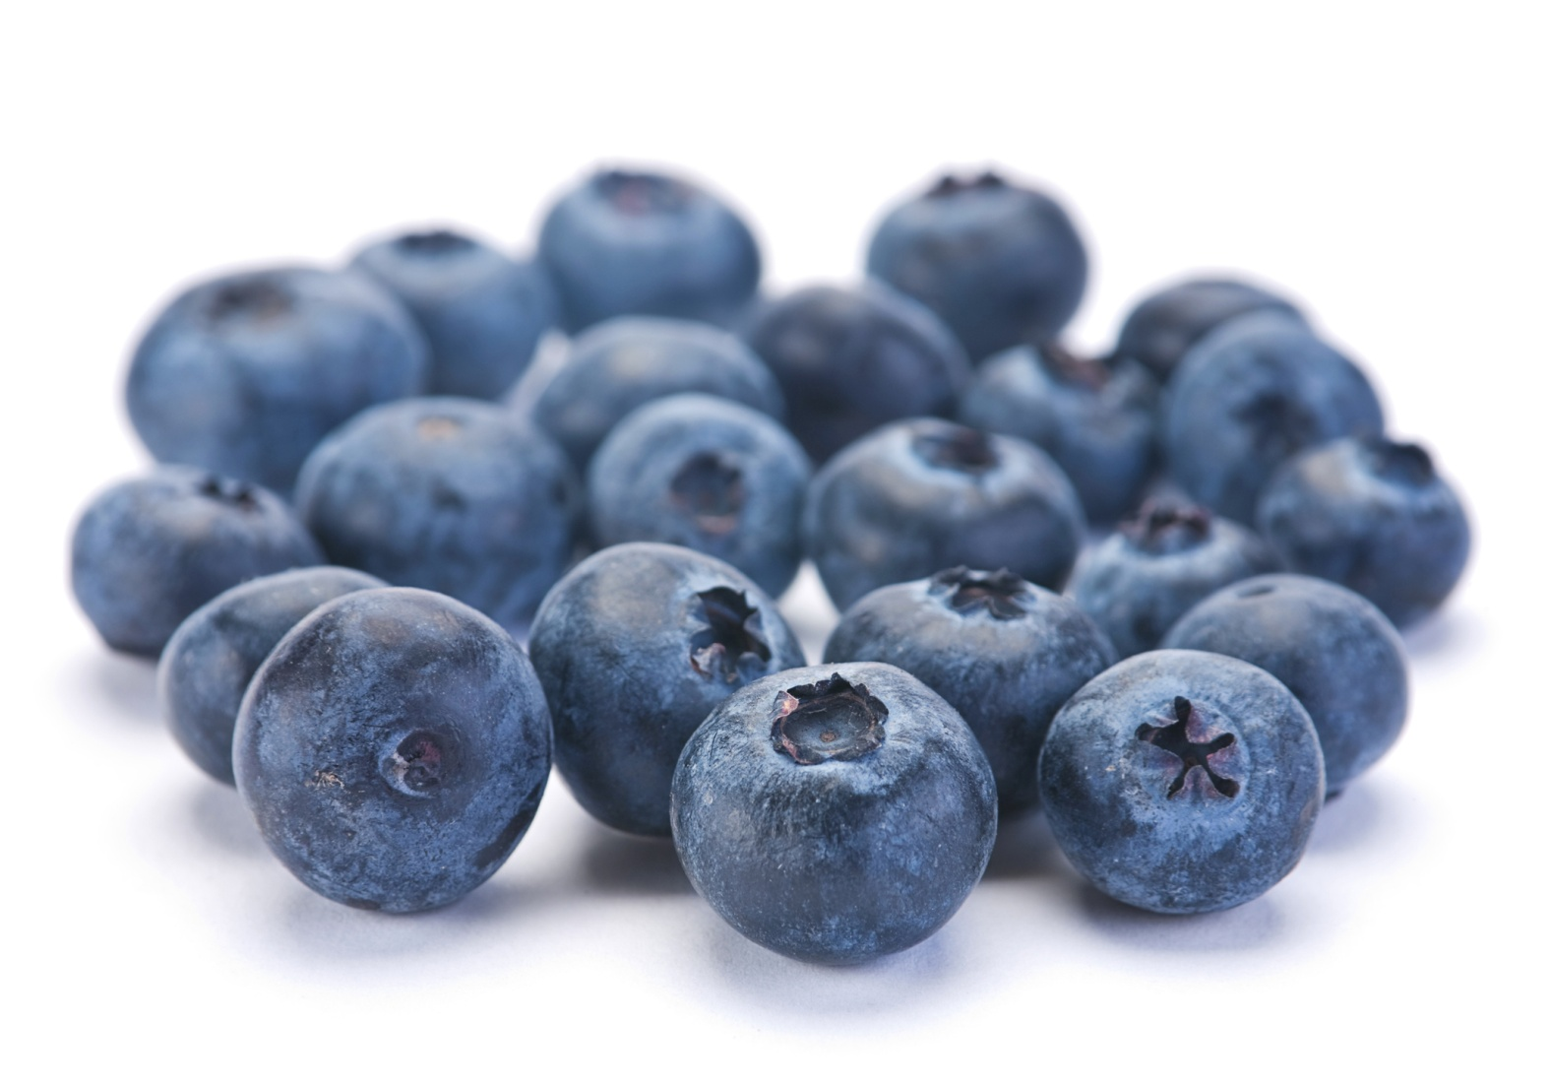
The berries are blue.

Slide 7
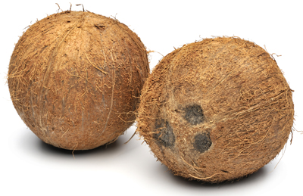
The coconuts are brown.

Slide 8
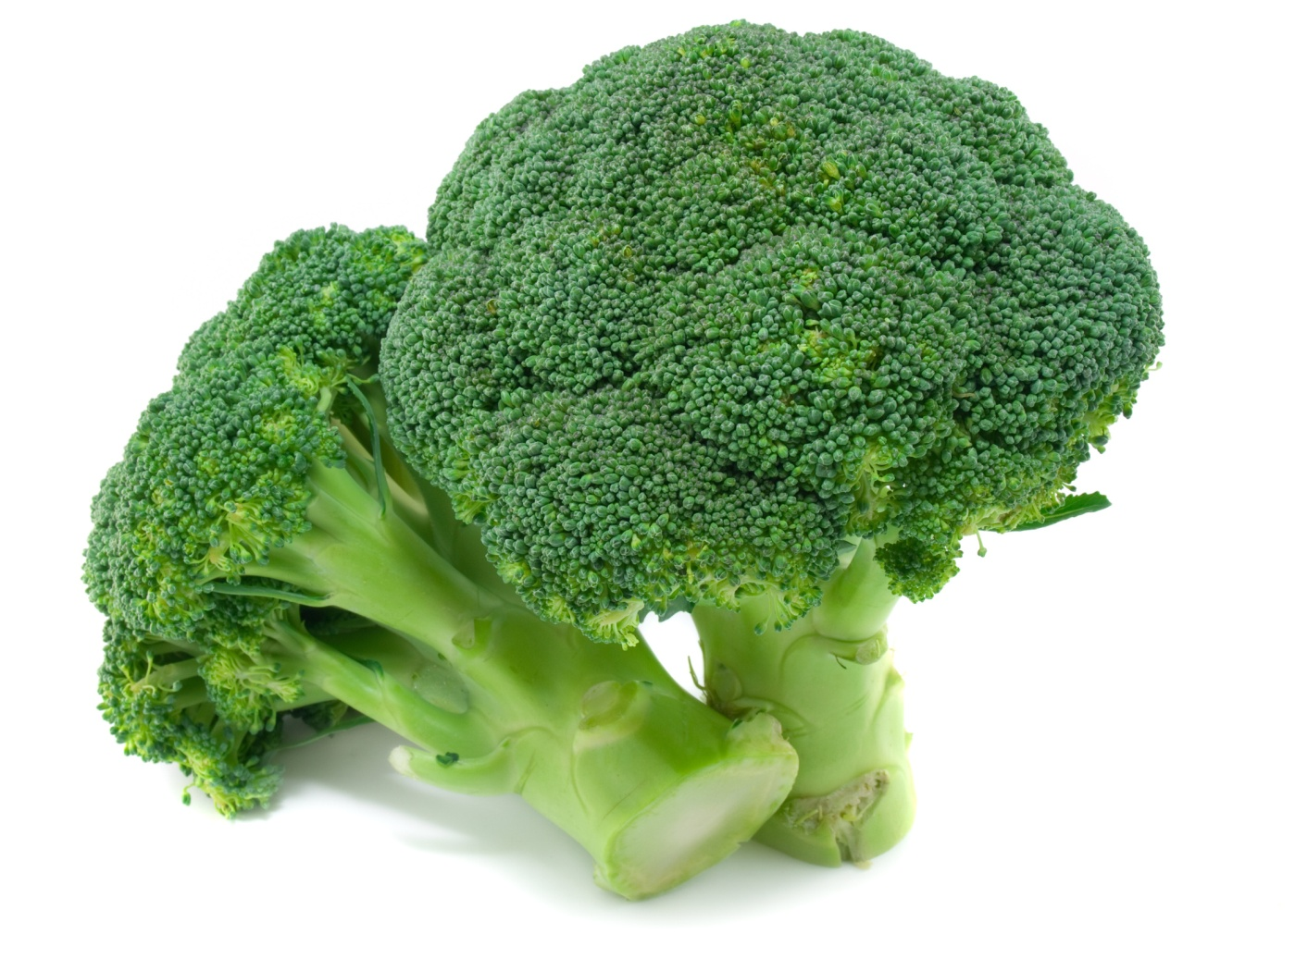
The broccoli is green.

