Slide 1
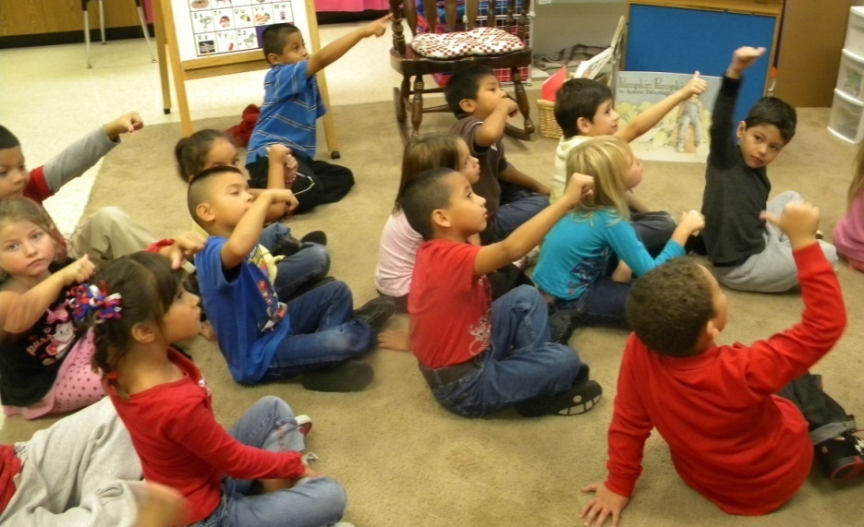
Ask and Answer Questions Part 2
Mrs. Kirkland’s Kindergarten Class
Grace Hill Elementary
Rogers, Arkansas
October 26, 2011

Slide 2
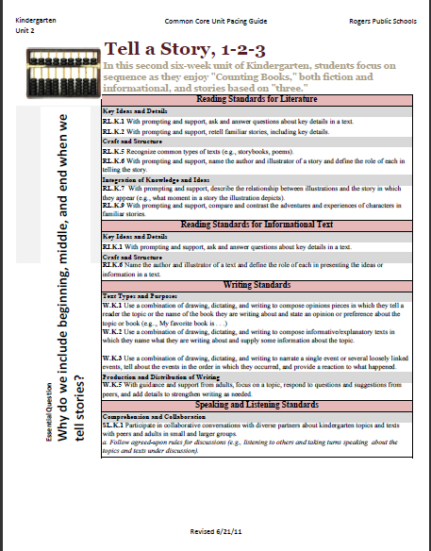
Unit 2 Pacing Guide- Kindergarten
The Common Core Standards emphasize a balance between literature and informational text.
RL.K.1 With prompting and support, ask and answer questions about key details in text.
RI.K.1 With prompting and support, ask and answer questions about key details in text.
Mrs. Kirkland used photographs in the first lesson, focusing on RI.K.I. (informational text).
In this second lesson, she selected the big book In the Dark, Dark Wood by Christine Ross and is focusing on standard RL.K.1 (literature).

Slide 3
Anchor Standard 1: Read closely to determine what the text says explicitly and to make logical inferences from it; cite specific textual evidence when writing or speaking to support conclusions drawn from the text.
K | With prompting and support, ask and answer questions about key details in a text.
1st | Ask and answer questions about key details in a text.
2nd | Ask and answer such questions as who, what, where, when, why and how to demonstrate understanding of key details in a text.
3rd | Ask and answer questions to demonstrate understanding of a text, referring explicitly to the text as the basis for the answer.
4th | Refer to details and examples in a text when explaining what the text says explicitly and when drawing inferences from the text.
5th | Quote accurately from a text when explaining what the text says explicitly and when drawing inferences from the text.
6th | Cite textual evidence to support analysis of what the text says explicitly as well as inferences drawn from the text.
7th | Cite several pieces of textual evidence to support analysis of what the text says explicitly as well as inferences drawn from the text.
8th | Cite the textual evidence that most strongly supports an analysis of what the text says explicitly as well as inferences drawn from the text.
9-10 | Cite strong and thorough textual evidence to support analysis of what the text says explicitly as well as inferences drawn from the text.
11-12 | Cite strong and thorough textual evidence to support analysis of what the text says explicitly as well as inferences drawn from the text, including determining where the text leaves matters uncertain.

Slide 4
The purpose of the GANAG structure
To give students the opportunity to actively use the nine high-yield strategies:
(2) Identifying Similarities and Differences
(7) Cooperative Learning
(8) Setting Objectives and Providing Feedback
(3) Summarizing and Note Taking
(4) Reinforcing Effort and Providing Recognition
(9) Generating and Testing Hypotheses
(5) Homework and Practice
(10) Cues, Questions and Advance Organizers
(6) Nonlinguistic Representations

Slide 5
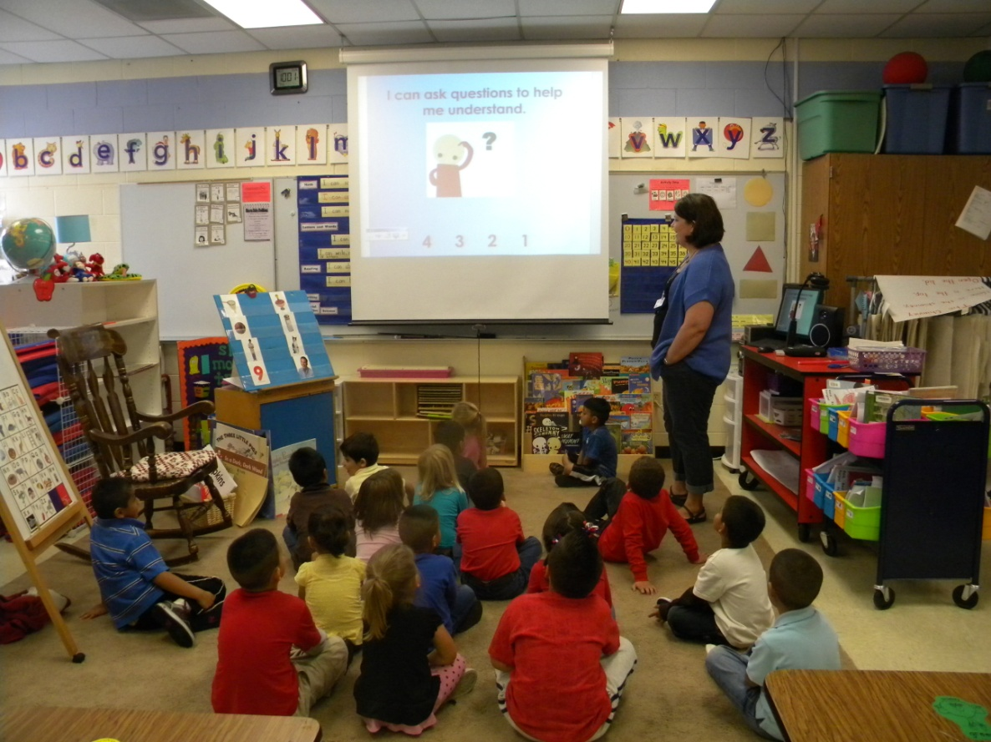
Goal:
Say it with me…
“I can ask questions to help me understand.”
(8) Setting Objectives and Providing Feedback

Slide 6
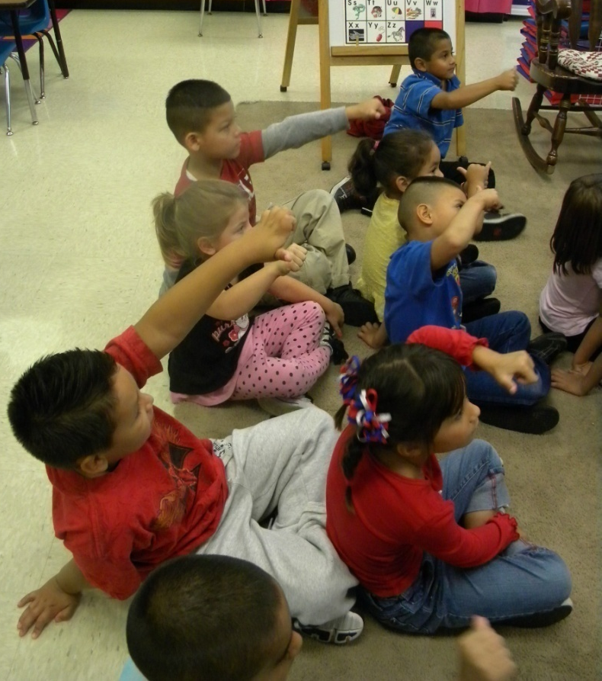
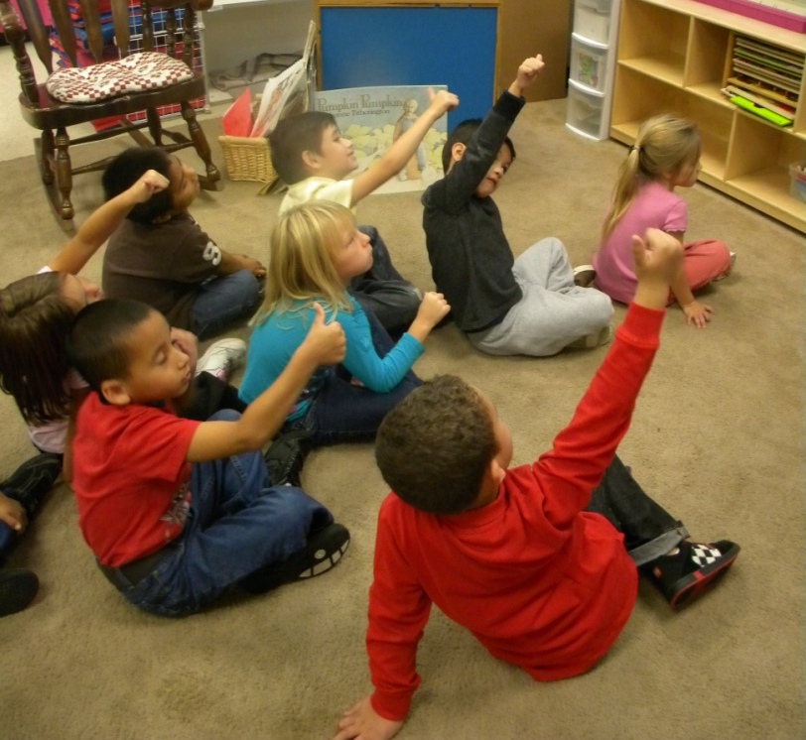
Score yourself…
“I can ask questions to help me understand.”
3
4
1
2

Slide 7
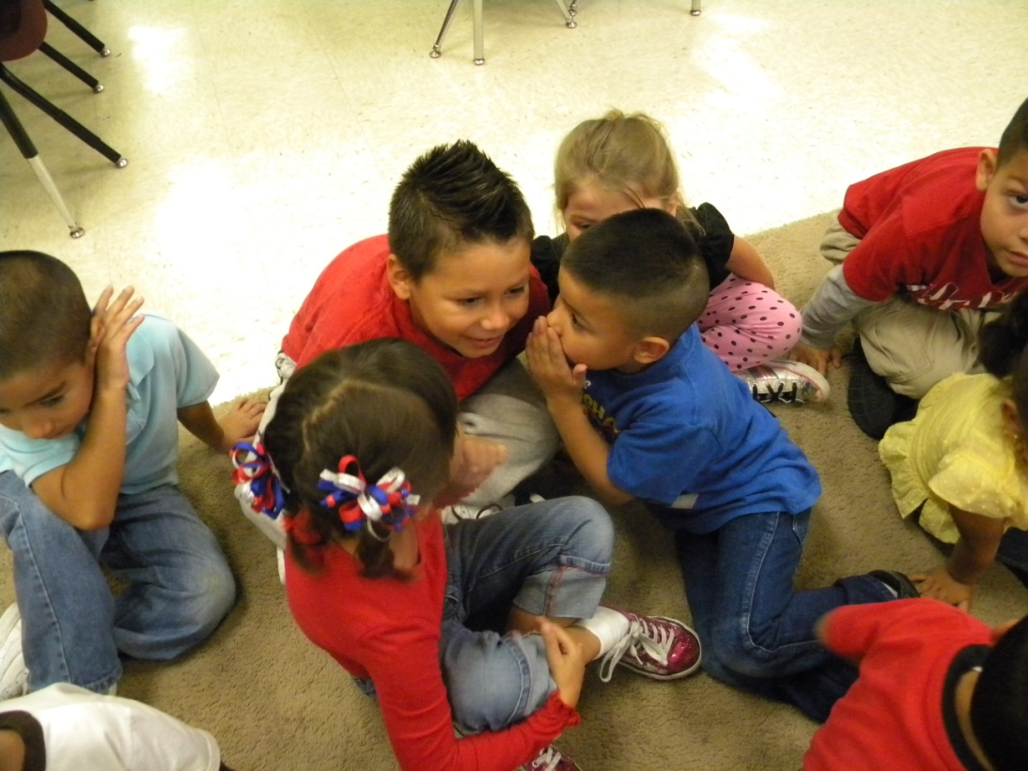
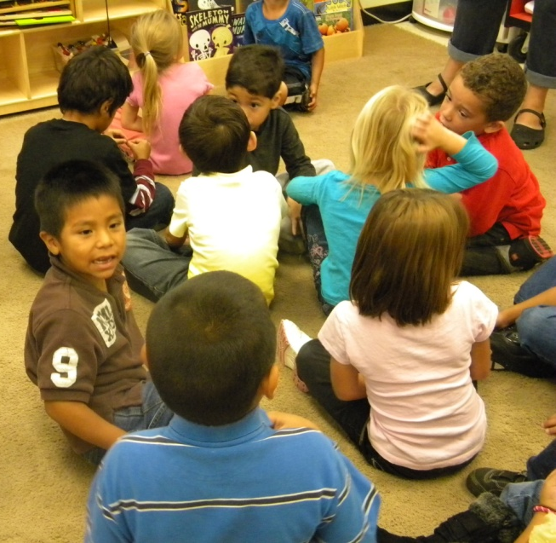
Access Prior Knowledge:
“Talk to your friend about this picture.”
“What did you talk about?”
(6) Nonlinguistic Representations
(7) Cooperative Learning

Slide 8
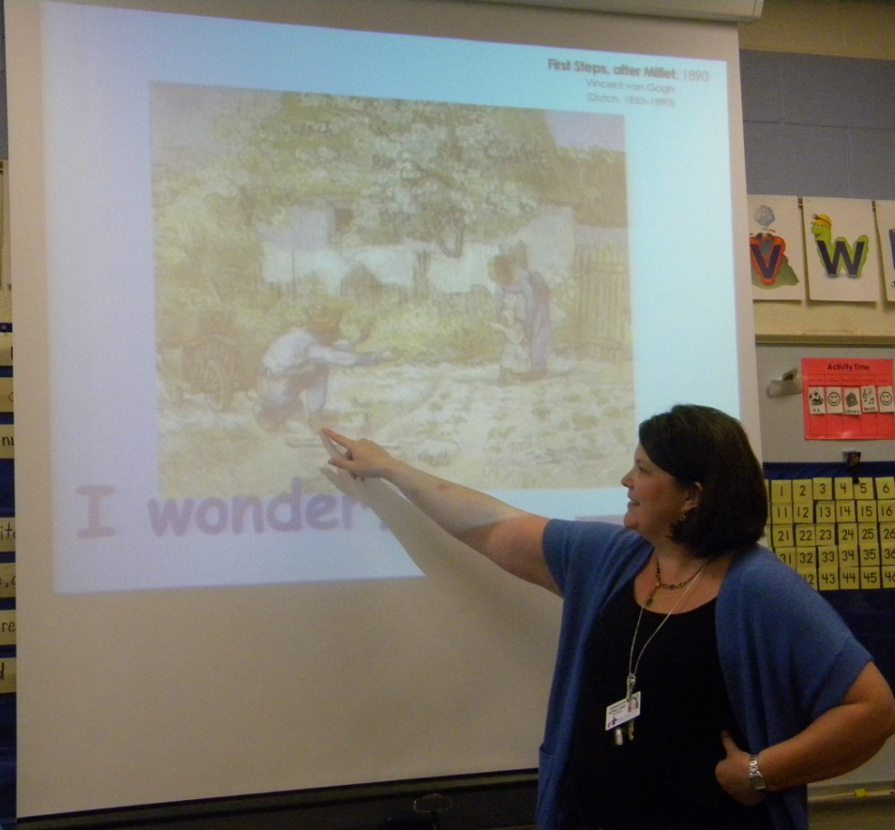
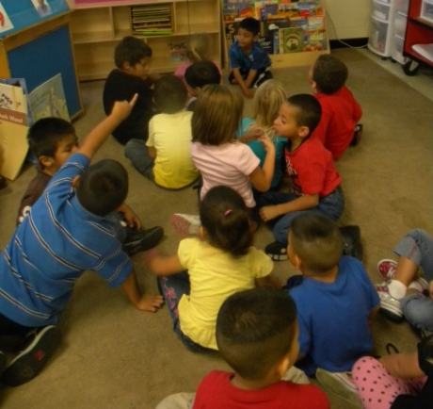
New Information: Modeling
“When I look at this painting, I ask myself a lot of questions..”
Mrs. Kirkland modeled using the stem “I wonder…” to ask questions about a painting.
The students practiced asking questions using the stem.
(6) Nonlinguistic Representations
(This painting is from Unit 2)
Vincent van Gogh, First Steps, after Millet (1890)
(10) Cues, Questions and Advance Organizers

Slide 9
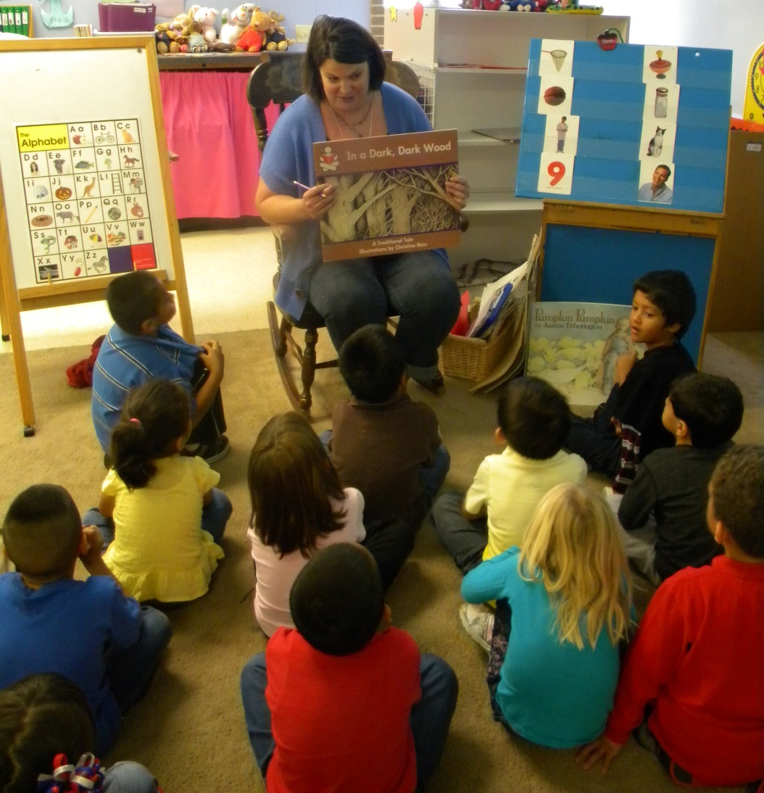
Application:
“Did you know that we can do the same thing when we read? Asking questions can help us better understand the story we are reading.”

Slide 10
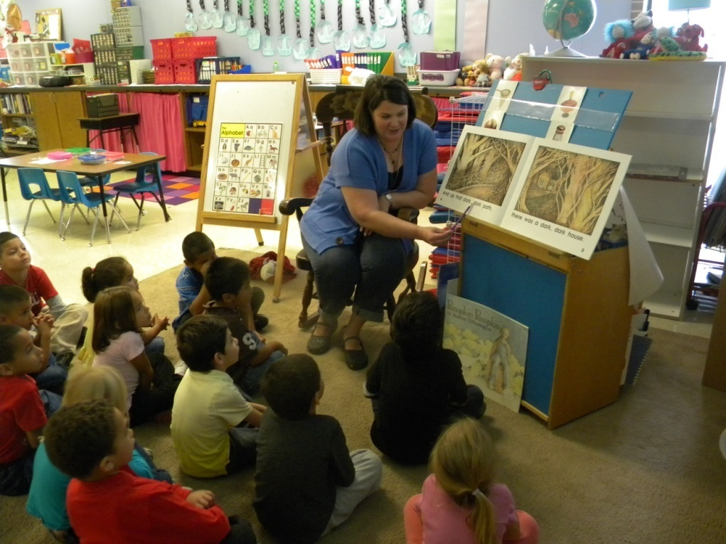
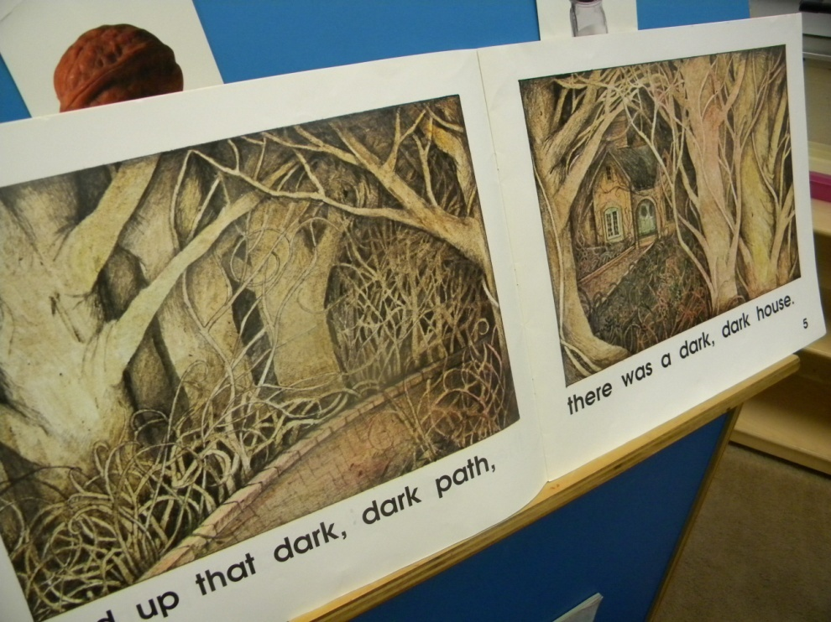
Do you have some questions about this part of the story?
STUDENTS
“I wonder …is there a dark room?
“I wonder…is there a skeleton?”
“I wonder…is there a mummy?”
“I wonder…is that the mummy’s home?”
(5) Homework and Practice

Slide 11
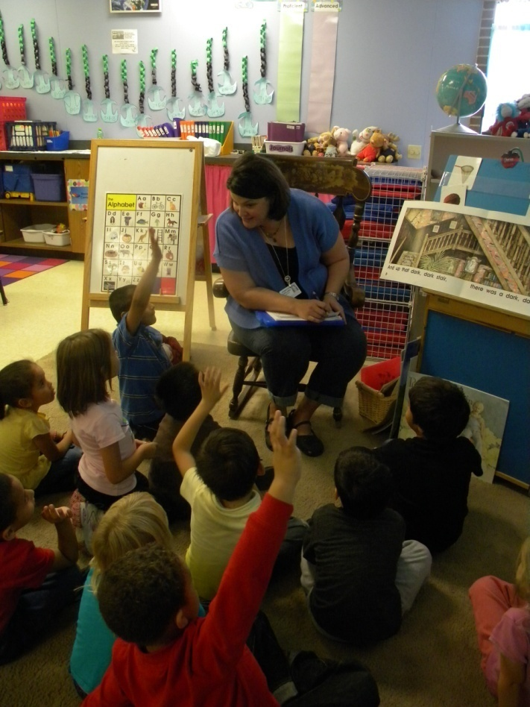
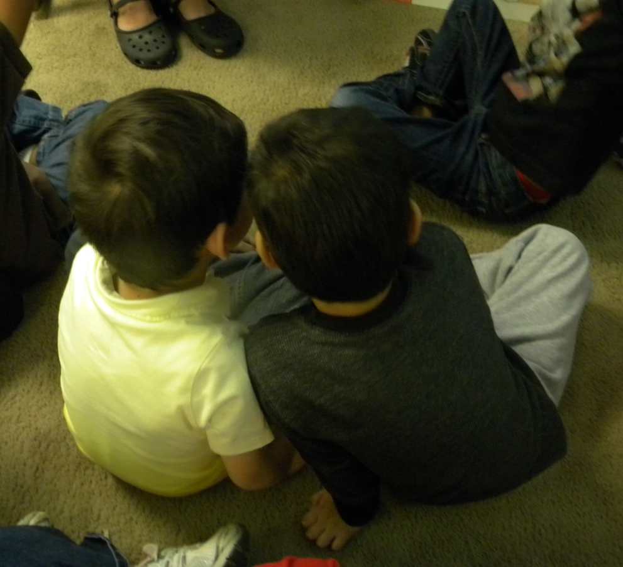
Application:
After Mrs. Kirkland read a page, she would ask the students to turn and share their questions with a partner.
(7) Cooperative Learning
(5) Homework and Practice

Slide 12
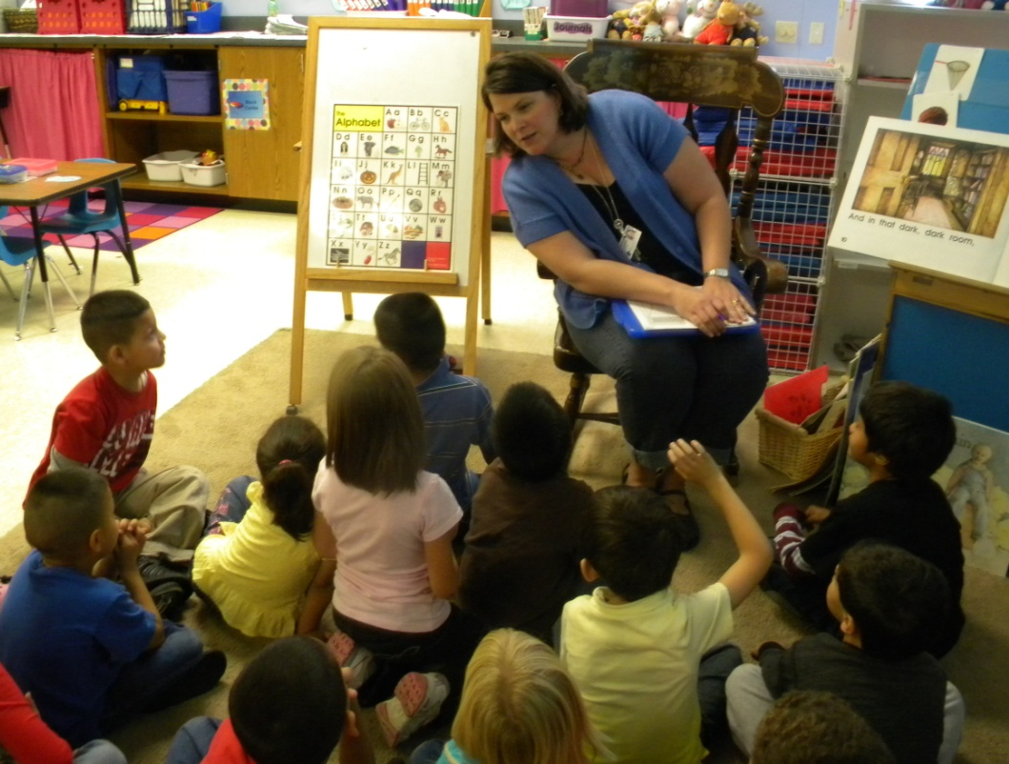
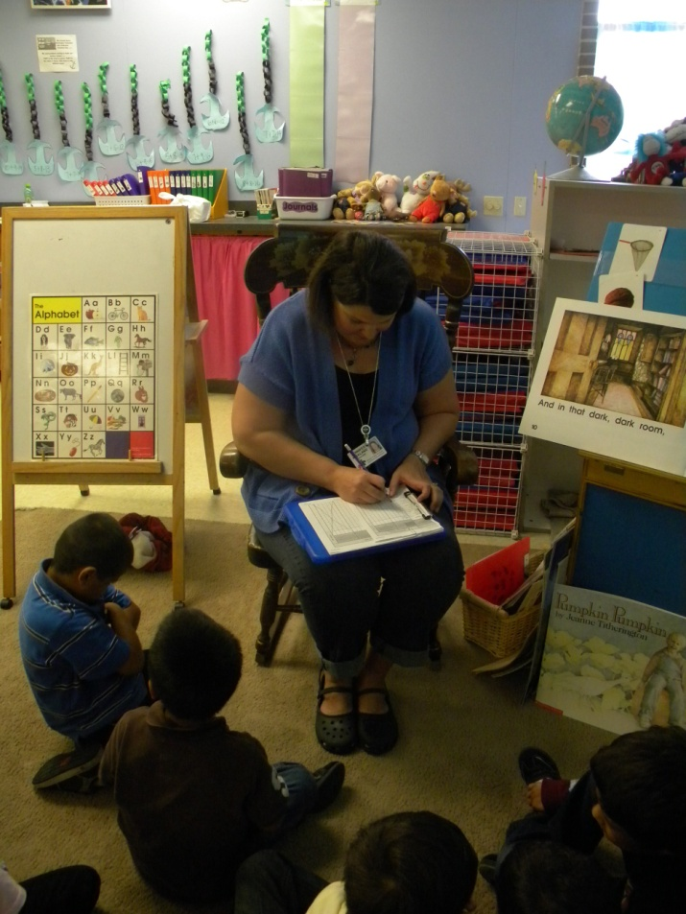
Mrs. Kirkland listened to partners share their questions.
She then used her clipboard to score students to the standard.
(8) Setting Objectives and Providing Feedback
(7) Cooperative Learning
(5) Homework and Practice

Slide 13
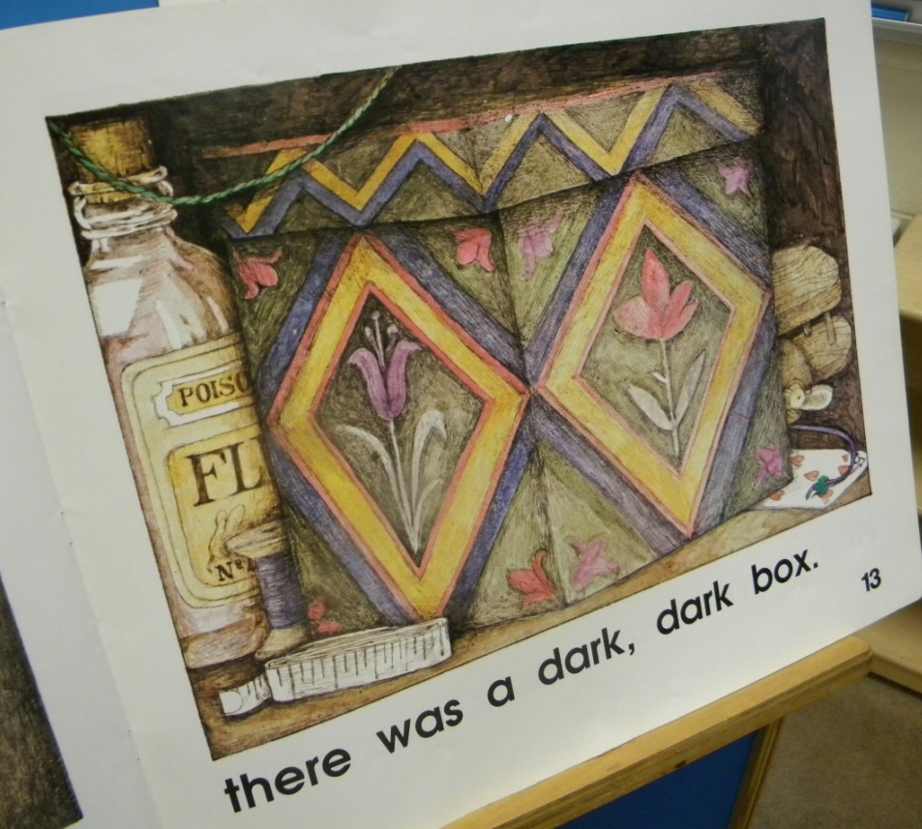
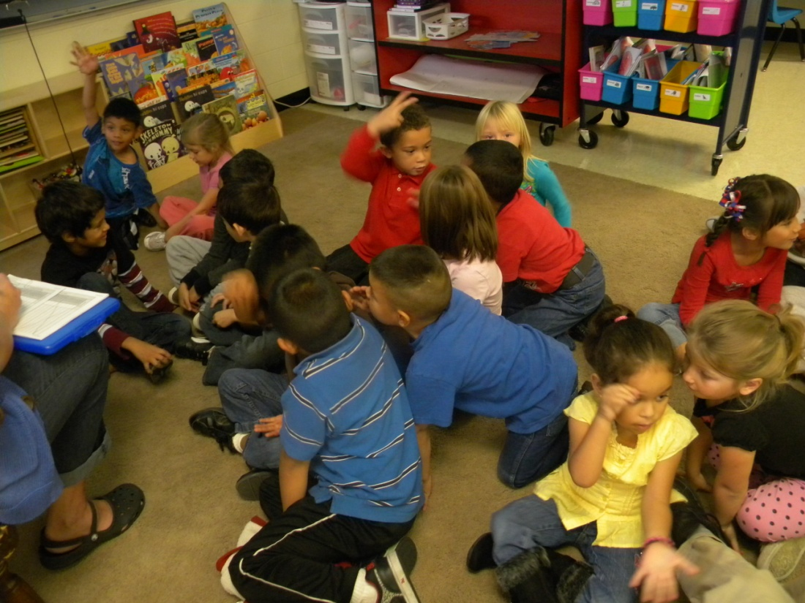
STUDENTS
“I wonder …what is in the box?
“I wonder…why is there poison?

Slide 14
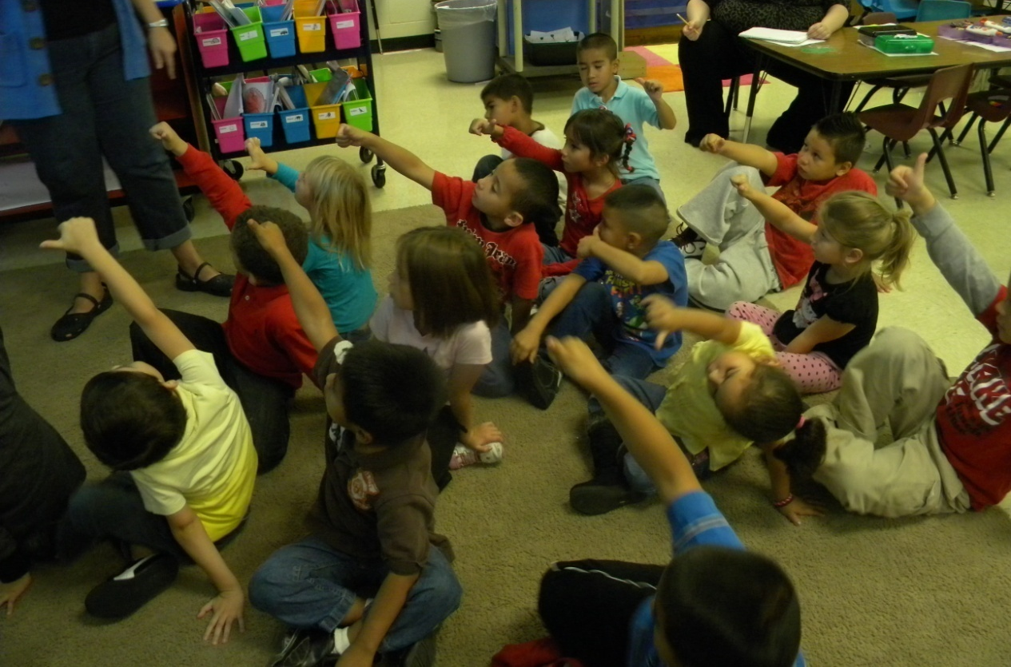
Generalize the Goal- Now how would you score yourself?
“I can ask questions to help me understand.”
3
4
1
2
(8) Setting Objectives and Providing Feedback

Slide 15
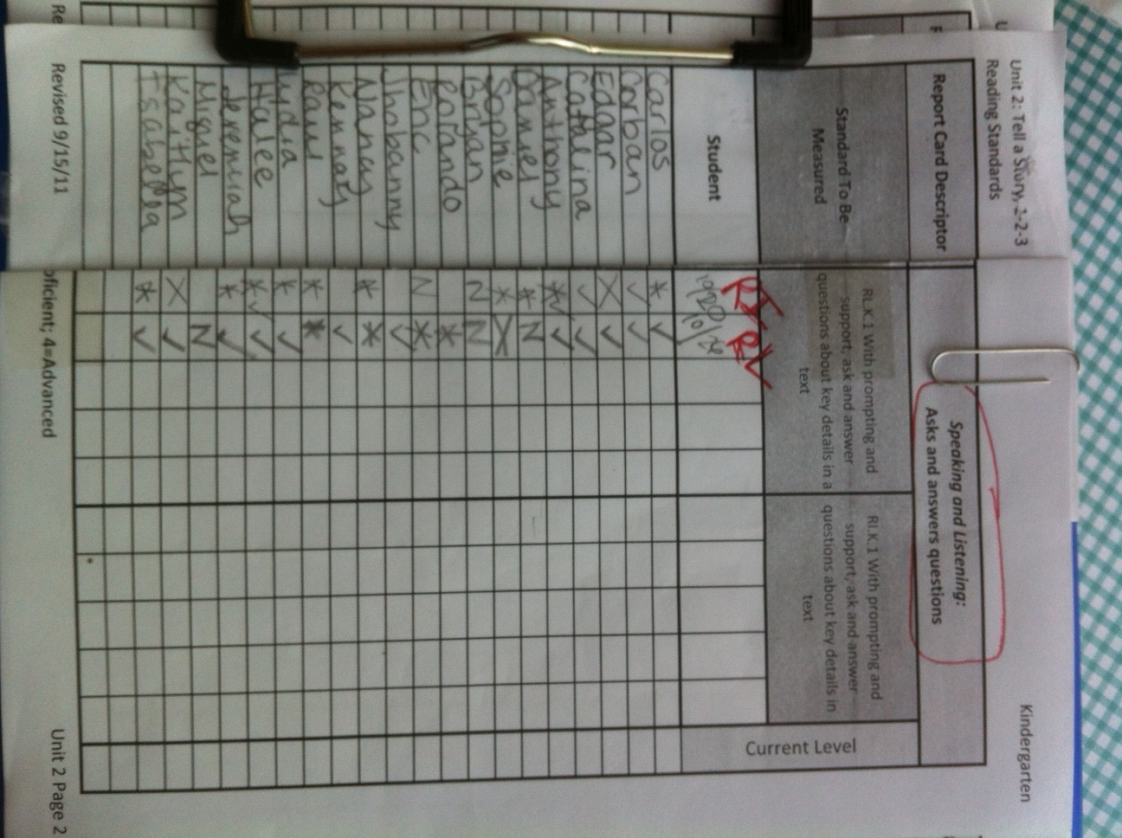
*= with support
X= absent
N= not yet
= proficient

