Slide 1
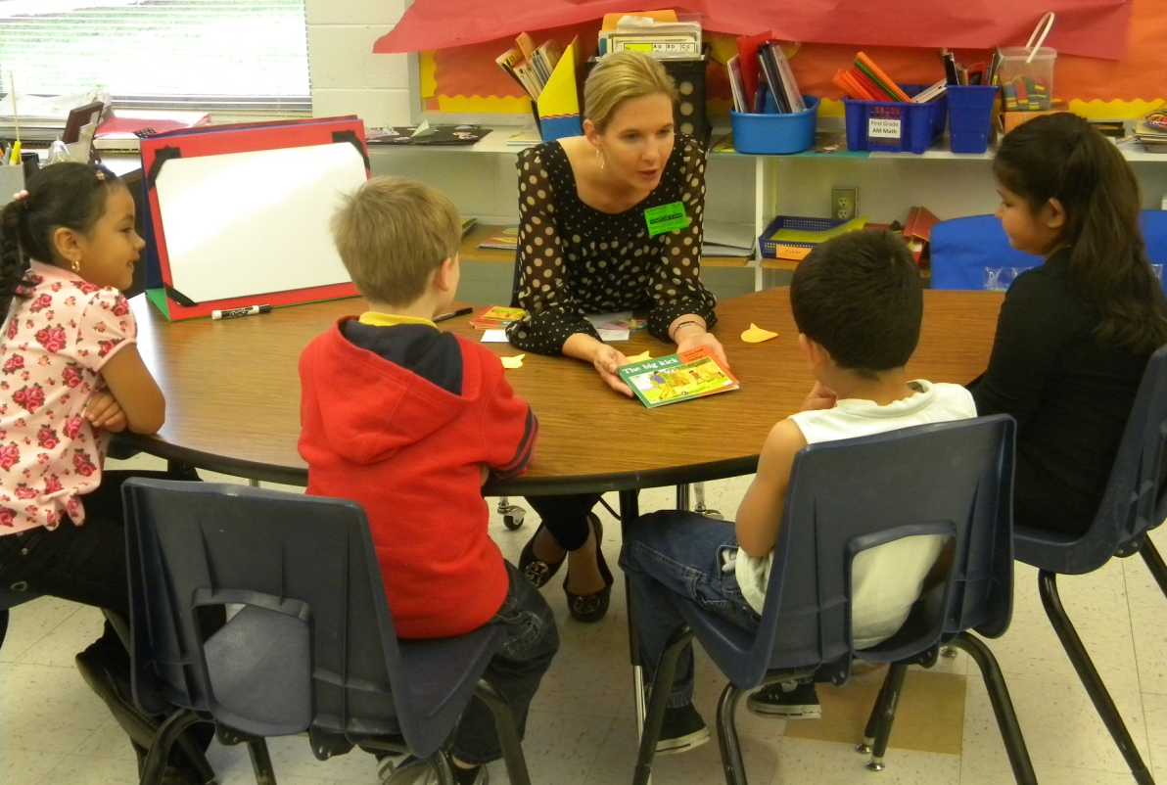
Small Group Instruction
Kindergarten
Small Group Instruction
with Gretchen Childs
with Gretchen Childs
Eastside Elementary
Rogers Public Schools
April 26, 2011
S.Hensley

Slide 2
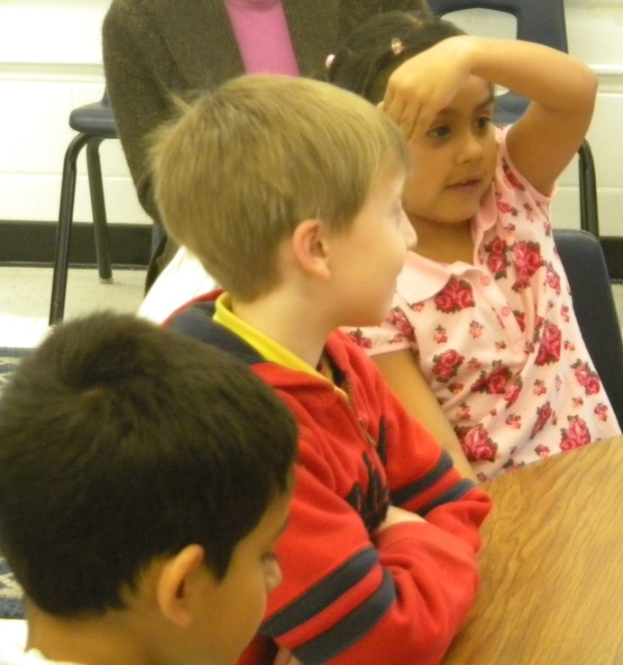
Group: Kindergarten (Eastside Elementary)
Focus/Goal: Monitoring My Own Reading
Title: The Big Kick by Beverly Randell
Level: 4

Slide 3
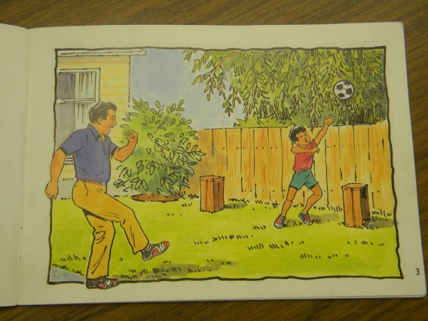
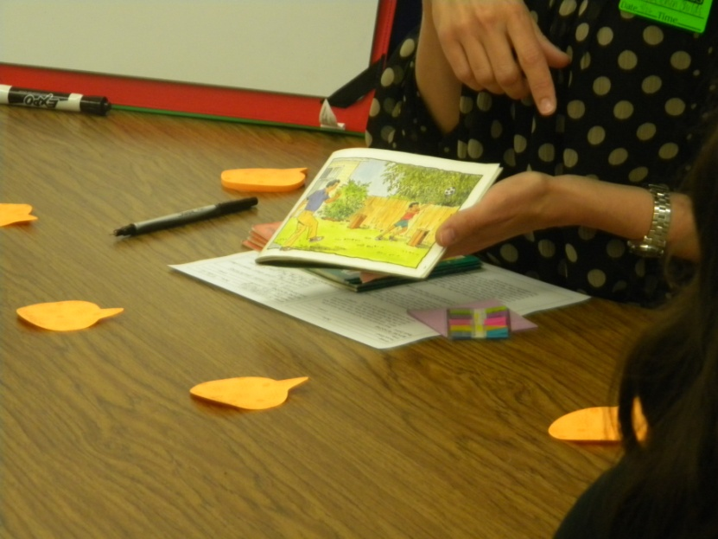
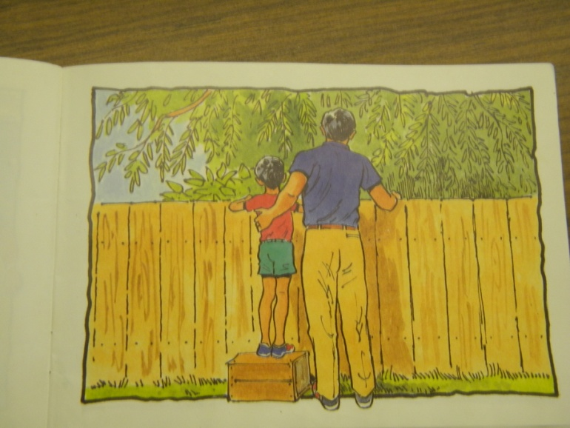
Before Reading
Book Introduction (APK)
Read the title
The Big Kick
Make predictions
“What do you think is going to happen in this story?”
Picture walk a few pages
Goal:
“You are going to read to find out where the ball went.”

Slide 4
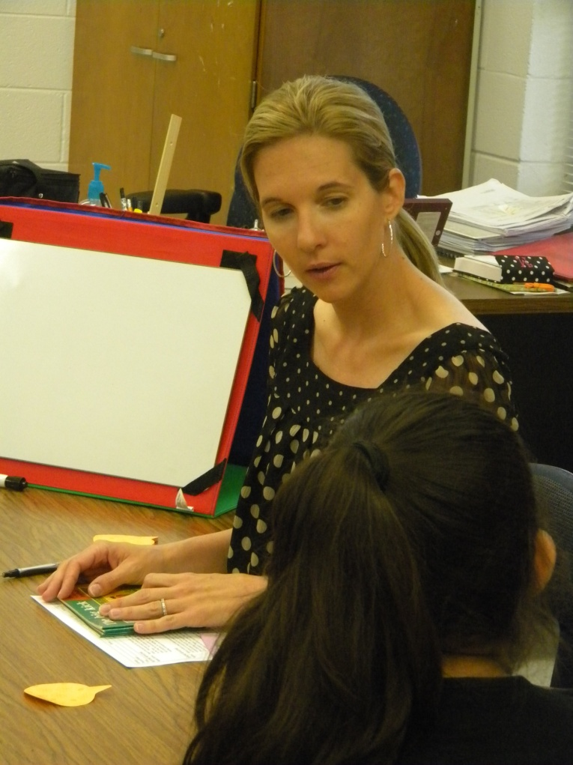
Before Reading
New Information: (monitoring)
“When you are reading do you ever get to a part where you get stuck?”
“What do you do?”
“Today when you are reading and get to a tricky part, I want you to STOP and think…”
“I am stuck.
How can I help myself?”

Slide 5
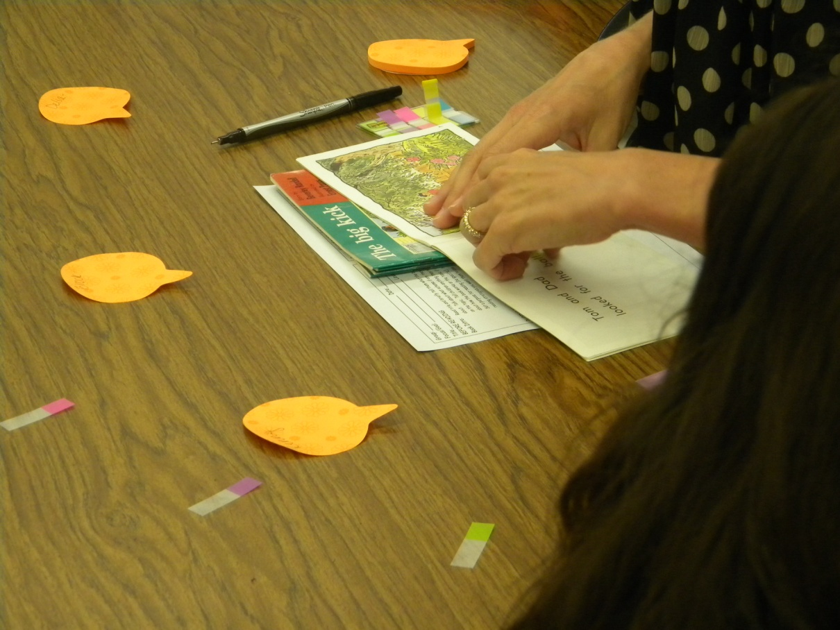
Before Reading
“While you are reading, if you get to a tricky part, I want you to mark it with one of these sticky tabs.”

Slide 6
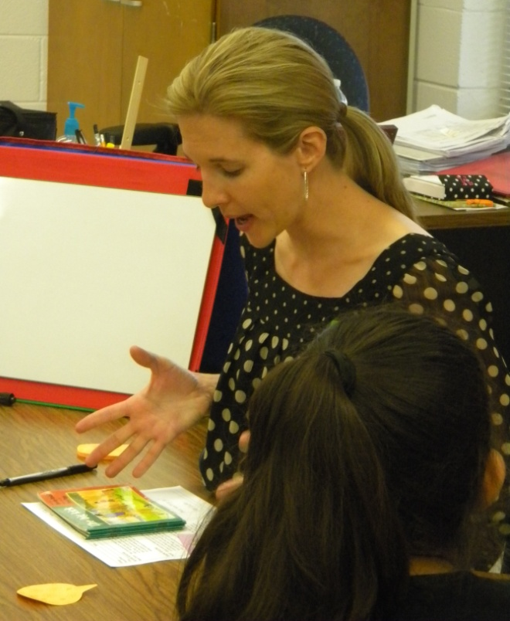
Before Reading
Review Jobs (Goals):
Read to find out where the ball went
2. When you come to a tricky part STOP and think:
“How can I help myself?”
3. Mark any tricky parts with a sticky tab

Slide 7
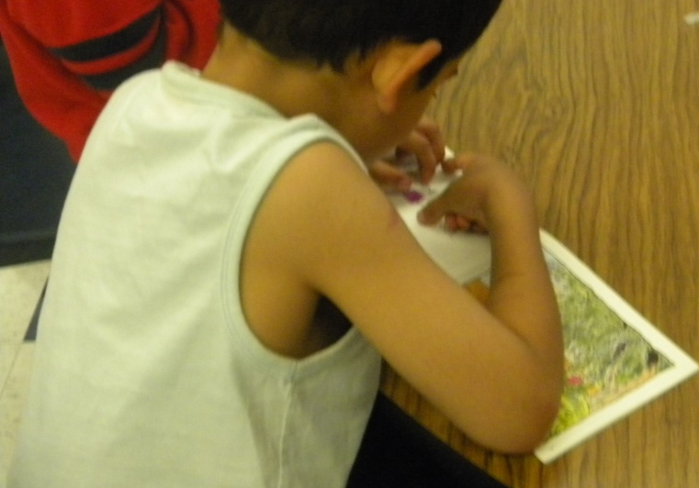
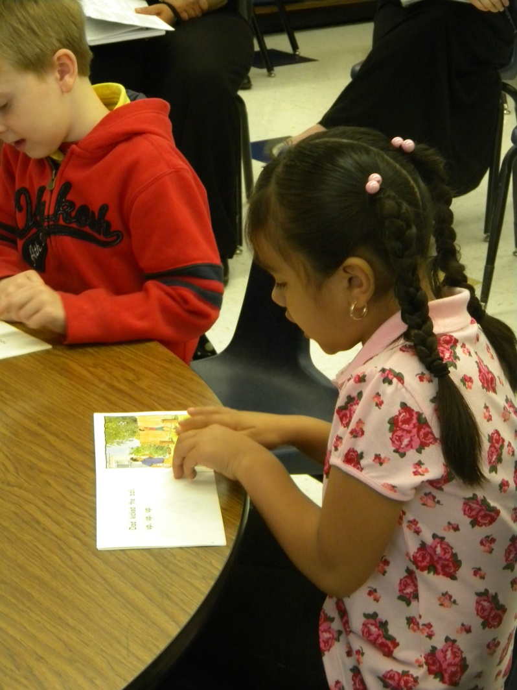
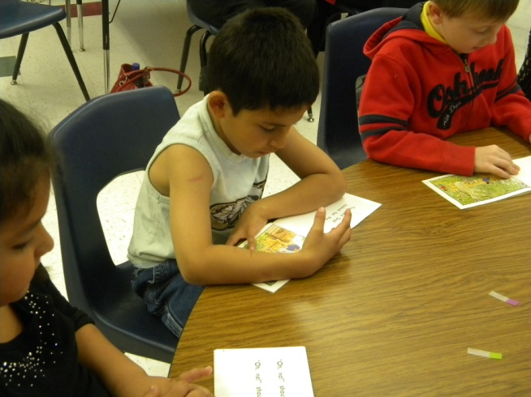
During Reading
The students:
read in whisper voices
marked tricky parts of the text

Slide 8
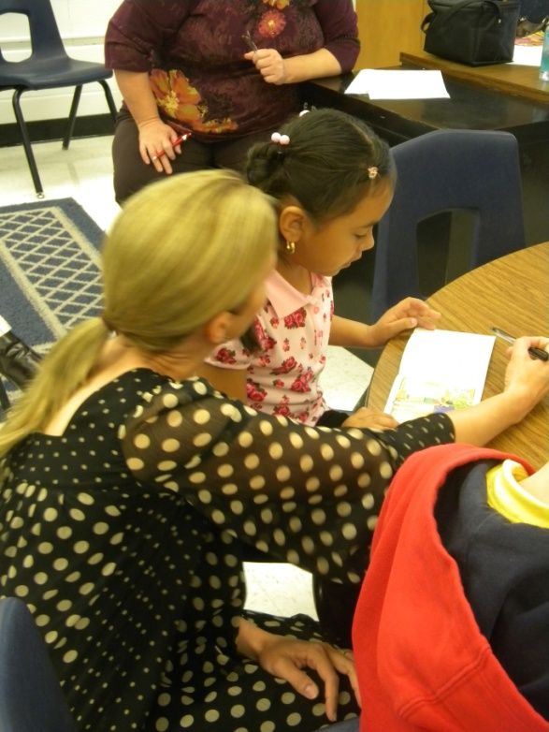
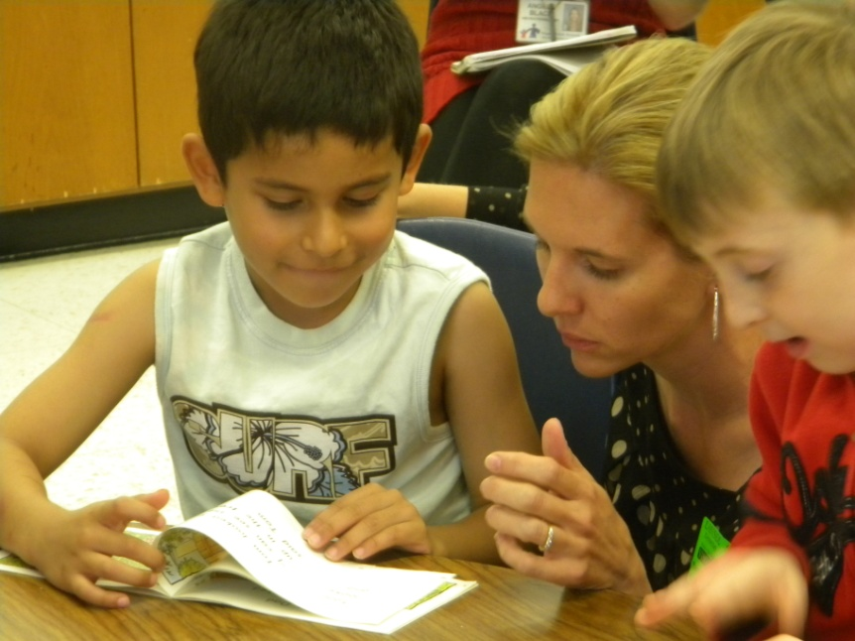
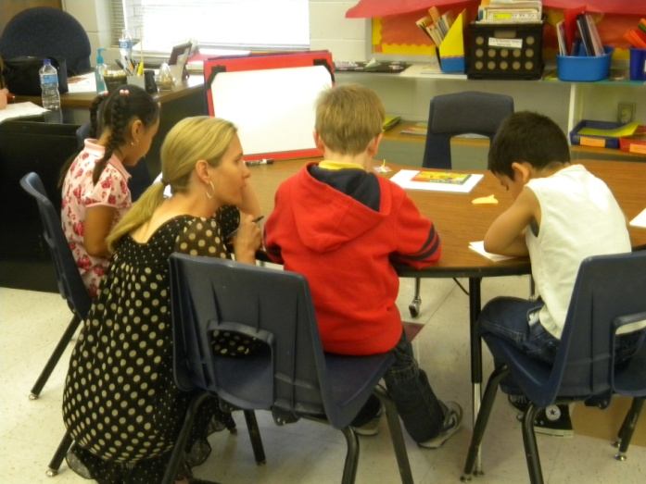
During Reading
Gretchen (the teacher):
listened to students read a portion of the text
prompted to the goals when necessary
jotted anecdotal notes about the students

Slide 9
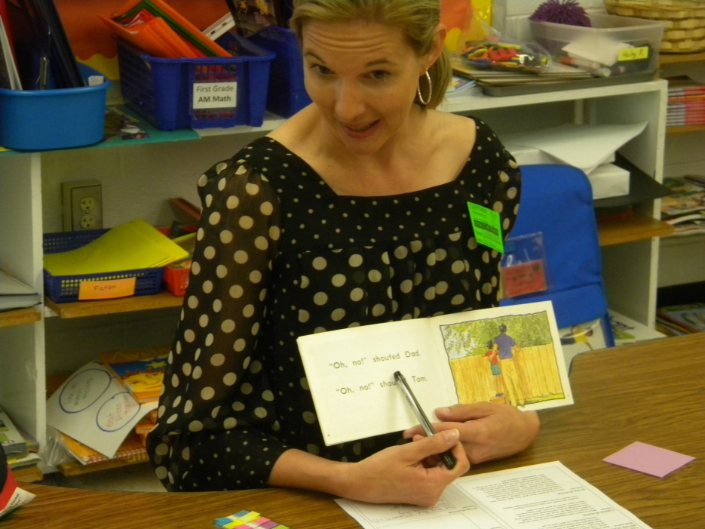
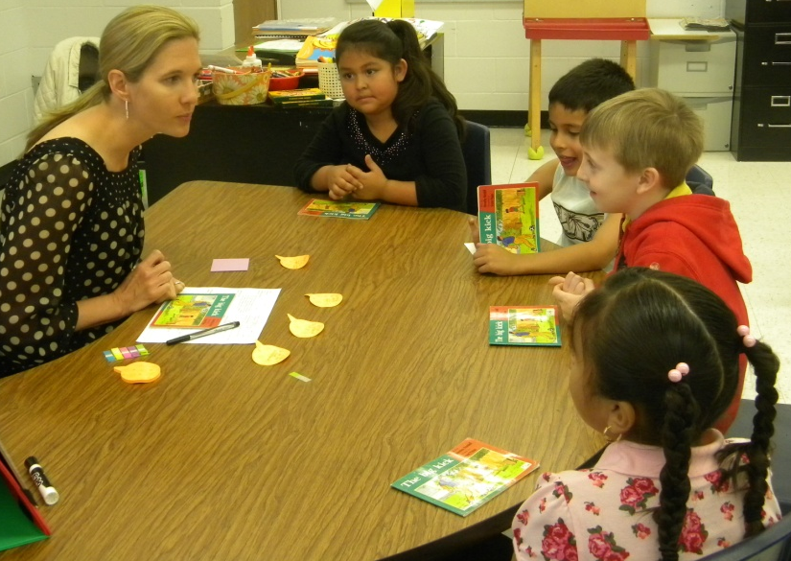
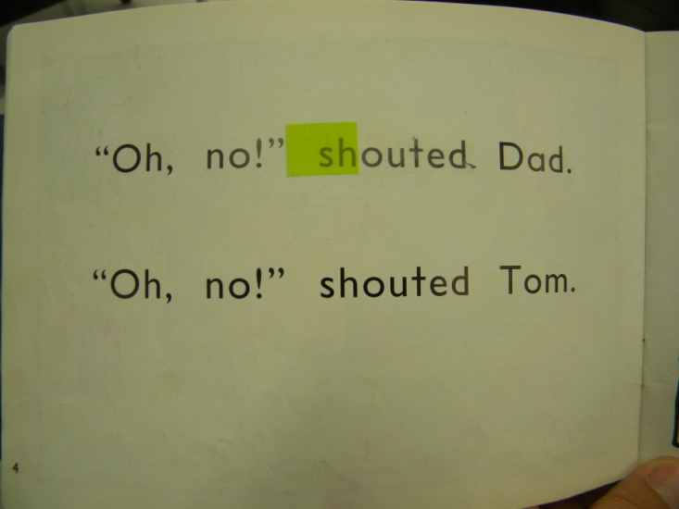
After Reading
Revisit the Goals:
The group discussed where the ball went and how Tom and his dad found it.
Students shared where they placed their sticky tabs and explained how they helped themselves.

Slide 10
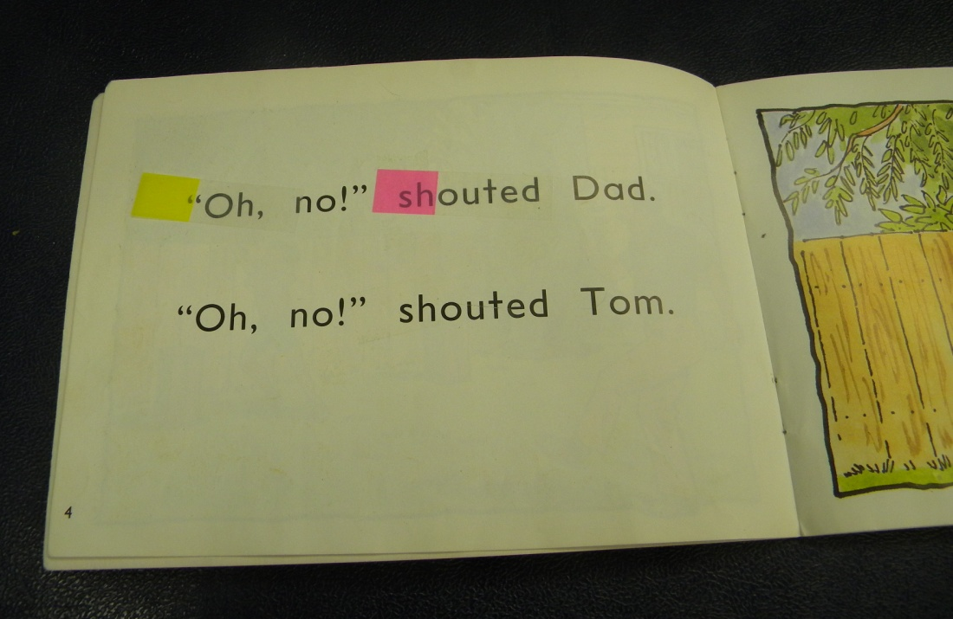
After Reading
Feedback from the students:
Gretchen asked the group, “How did you do stopping and thinking about how you could help yourself? Was it easy, tricky or hard?”
The group used thumbs up, sideways or down to respond.

Slide 11
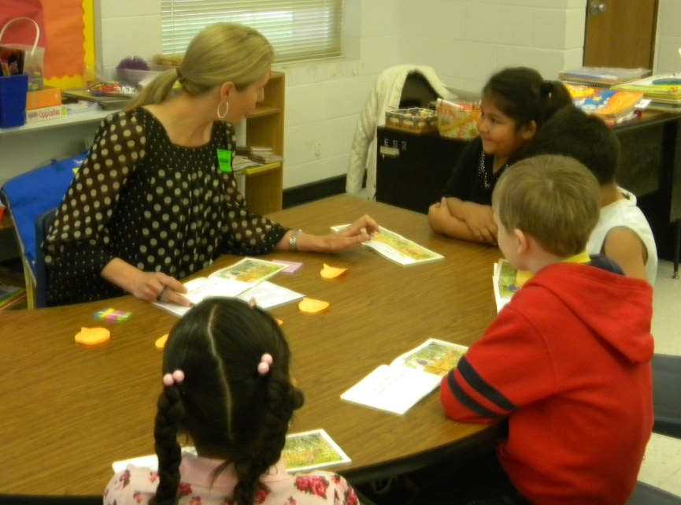
After Reading
Individual Feedback:
Gretchen gave each student individual feedback that was specific to the goals of the lesson.

Slide 12
Big Ideas from the debriefing session after the lesson:
Teach a skill or strategy, not the book.
Use activities and procedures that are specific to the focus of the lesson.
Students must be attending to print to move beyond level 3.

Slide 13
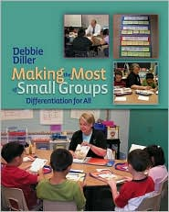
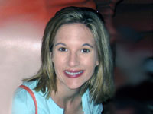
Diller, Debbie (2007). Making the Most of Small Groups; Differentiation for All. Portland, Maine: Stenhouse Publishers.
Gretchen Childs has been an educator for over 15 years. She has taught kindergarten and 2nd grade, as well as Special Education in Pre-K, 5th and 6th grades. She has been a District Literacy Coach, District Math Coach, and Reading Specialist. Gretchen has presented numerous workshops on literacy topics, and has traveled the country as a consultant for Debbie Diller & Associates since 2005. Gretchen earned her degree from Southwest Texas State University, with specializations in both Special Education and Reading. She also carries an Early Childhood Education endorsement. She resides in Pearland, Texas with her husband, Michael, and their three daughters.

