Slide 1
Stories from Earth and Sky
Unit 5

Slide 2
Goal
I can paraphrase information presented through a video.
Score yourself:
1- not sure I can listen and remember.
2- I can probably remember something.
3- I am a great listener and will remember some of the information.
4-I can remember everything.
Notes:
Explain what it means to paraphrase…rewording of something spoken or written
Have students score themselves on the listening guide (or interactive notebooks). Tell students to use the hexagon to put their before score and the triangle to put their after score.

Slide 3
Let’s see if you remember…
Notes:
APK: video from Jumping Mouse; this was used in Unit 3; Native American legend.
What do you remember about this story?

Slide 4
Oral Story Telling
The video we will watch is from the point of view of a Native American.
How many times will we need to watch it to get all our information?

Slide 5
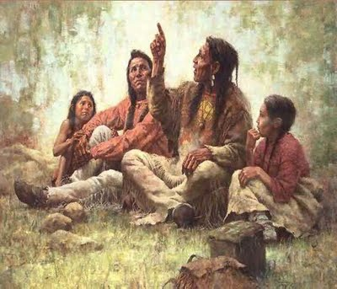
The goal of watching this video is to be able to paraphrase the information presented.
Notes:
In your note taking guide, you have some guiding questions: let’s look at what you need to listen for:
Refer to the notes page of the lesson and it has the questions.

Slide 6
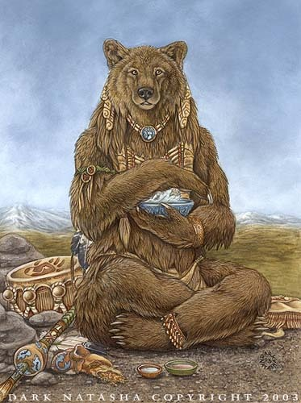
Paraphrase the story of Medicine Bear
What is the moral of the story?
Notes:
Paraphrase the story of the medicine bear with your partner and write down what you think the moral of the story would be.
Let partners share their moral.
What was the name of the legend?

Slide 7
Now it is your turn…
Use your listening guide and paraphrase the information from the video.
Questions to discuss:
What was this video mainly about?
Why is story telling important to the Native American culture?
Notes:
Score students to the speaking and listening standard

Slide 8
Goal
I can paraphrase information presented through a video.
Score yourself:
1- not sure I can listen and remember.
2- I can probably remember something.
3- I am a great listener and will remember some of the information.
4-I can remember everything.
Notes:
Tell students to use the triangle to put their “after” score and the triangle to put their after score.
Take up listening guides to score.

