Slide 1
Text Talk
Day 1-Monday, read the book aloud
Day 2-Tuesday, introduce all 3 words
review all 3 words each day before going through the new activities on PowerPoint
Day 3-Wednesday
Day 4-Thursday
Day 5-Friday, assess

Slide 2
Day 1
Notes:
Monday

Slide 3
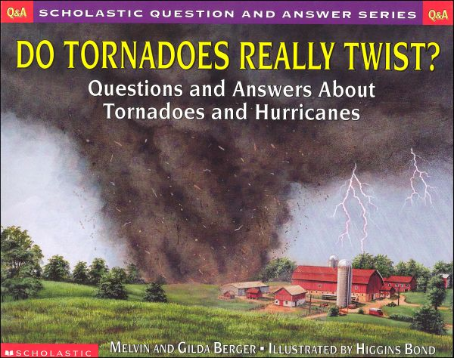
Do Tornadoes Really Twist?
Notes:
Read book aloud
Provide a brief explanation of any of the words that may be new or unfamiliar to the students.

Slide 4
Day 2
Notes:
Tuesday

Slide 5
I can determine the meaning of unknown words.
Notes:
Goal- Students need to engage with the goal- read it, repeat it, write it, etc.
Standard: RI.4.4 Determine the meaning of general academic and domain-specific words or phrases in a text relevant to a grade 4 topic or subject area.

Slide 6
Notes:
Access Prior Knowledge (APK)-
Turn and talk to your shoulder partner about the book you read yesterday. Tell your partner 2 things you remember about Do Tornadoes Really Twist?

Slide 7
funnel
“You know it’s a tornado when you spot a twisting, spinning funnel reaching down from a huge dark cloud. The funnel looks like a huge elephant trunk swaying back and forth.”
Notes:
New Information-
Contextualize the word- Find it in the text
Say the word together

Slide 8
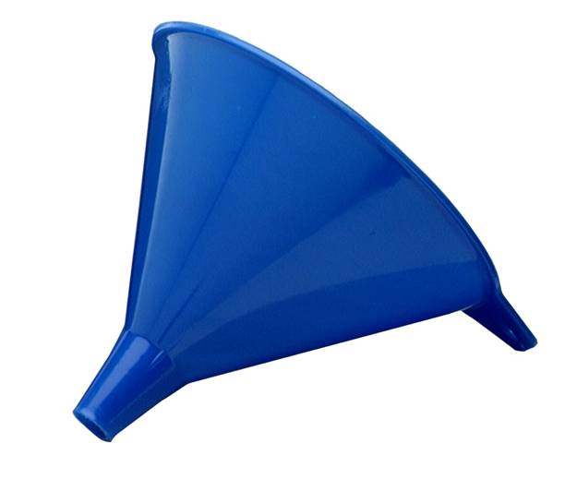
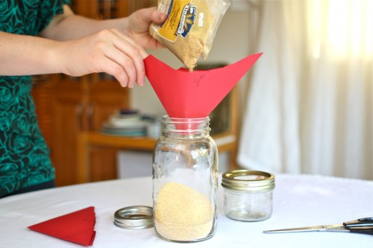
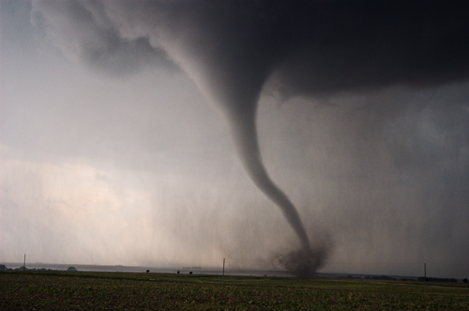
funnel
a shape that is wide at the top and narrow at the bottom
Synonym: cone
Notes:
Give student friendly definition
Use the word in other contexts

Slide 9
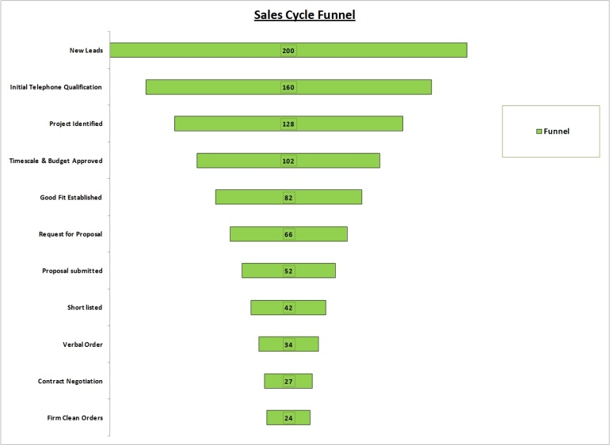
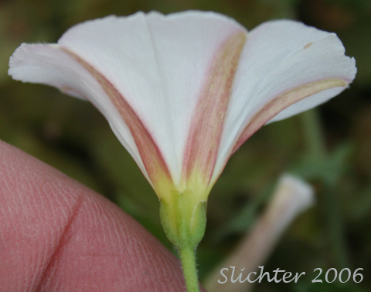
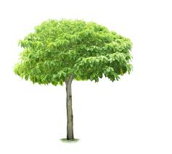
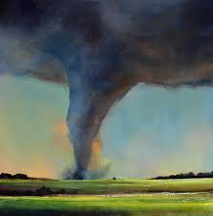
Which pictures are shaped like a funnel?
Notes:
Engage the students with the word

Slide 10
destruction
“They touch down, plow a path of destruction, and rise up into the air.”
Notes:
Contextualize the word- Find it in the text
Say the word together

Slide 11
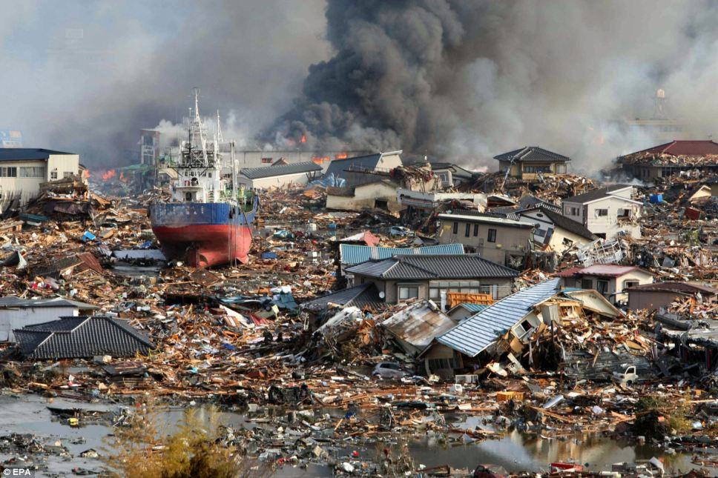
destruction
To cause something to be severely damaged
Synonym: devastation
(Click on the picture to see a video of destruction)
Notes:
Give student friendly definition
Use the word in other contexts

Slide 12
Thumbs up, Thumbs down
Tornado
Falling leaves
Hurricane
Light rain
Snow flurries
Hailstorm
Notes:
Engage the students with the word
Thumbs up if this would cause destruction. Thumbs down if not.

Slide 13
produce
“Very few thunderstorms produce tornadoes.”
“The strong thunderstorms that create tornadoes often produce hailstones as well.”
Notes:
Contextualize the word- Find it in the text
Say the word together

Slide 14
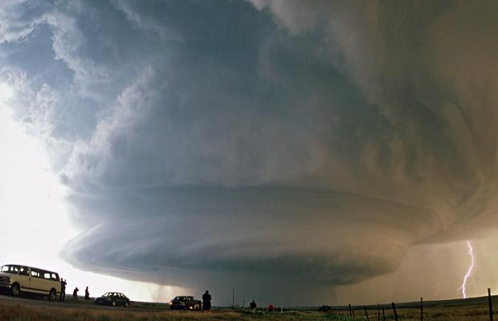
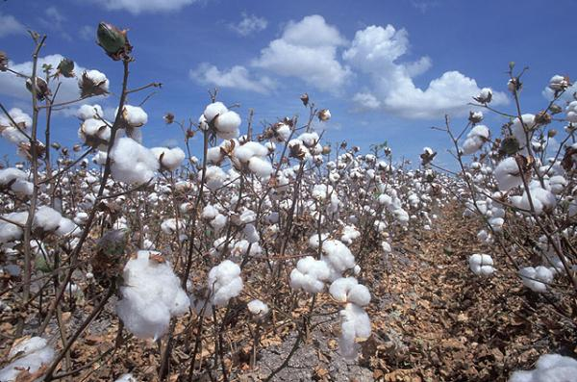
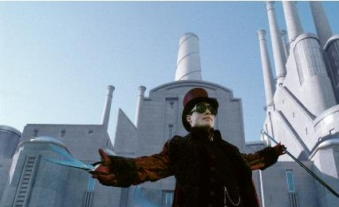
produce
To make or cause something to happen or exist
Synonym: create
Notes:
Give student friendly definition
Use the word in other contexts
Pictures: storm producing lightning, Willy Wonka and his chocolate factory producing candy, plants producing cotton

Slide 15
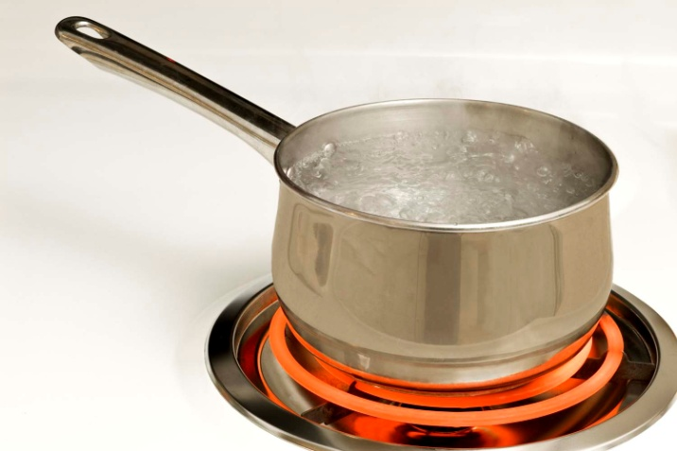
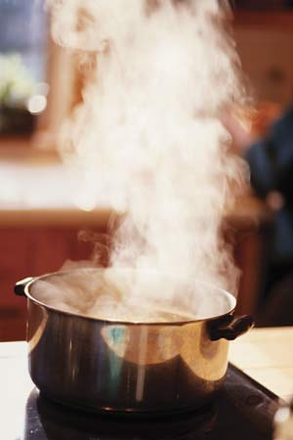
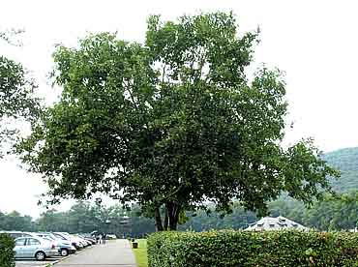
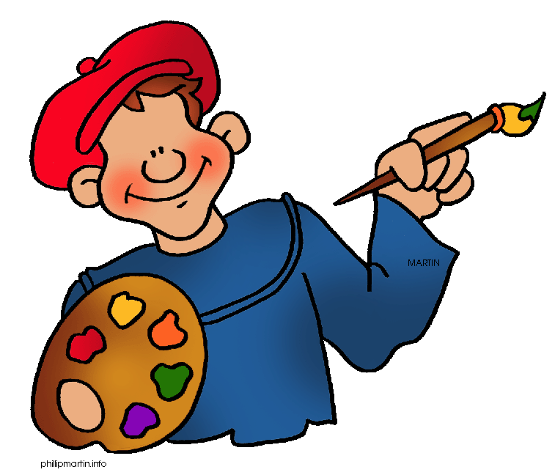
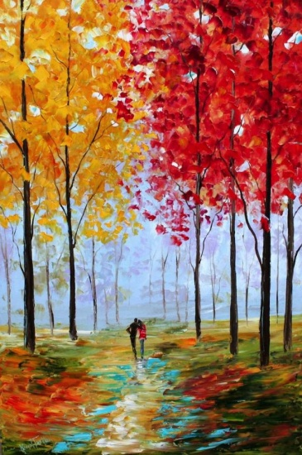
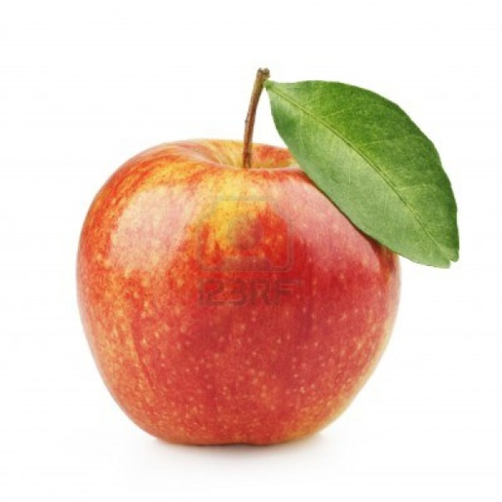
What would these things produce?
Notes:
Engage the students with the word
Boiling water produces steam, artist produces painting, tree produces fruit

Slide 16
Who can use all 3 words in a sentence?
funnel
destruction
produce
Notes:
Read all three words and see if students can use them in one sentence.

Slide 17
Draw a picture or write a sentence to show you know what these words mean.
funnel
destruction
produce
Notes:
Application-
Students need an opportunity to use the words they just learned from the text.

Slide 18
I can determine the meaning of unknown words.
Notes:
Goal-
Revisit the Goal

Slide 19
Day 3
Notes:
Wednesday

Slide 20
I can determine the meaning of unknown words.
Notes:
Goal- Students need to engage with the goal- read it, repeat it, write it, etc.

Slide 21
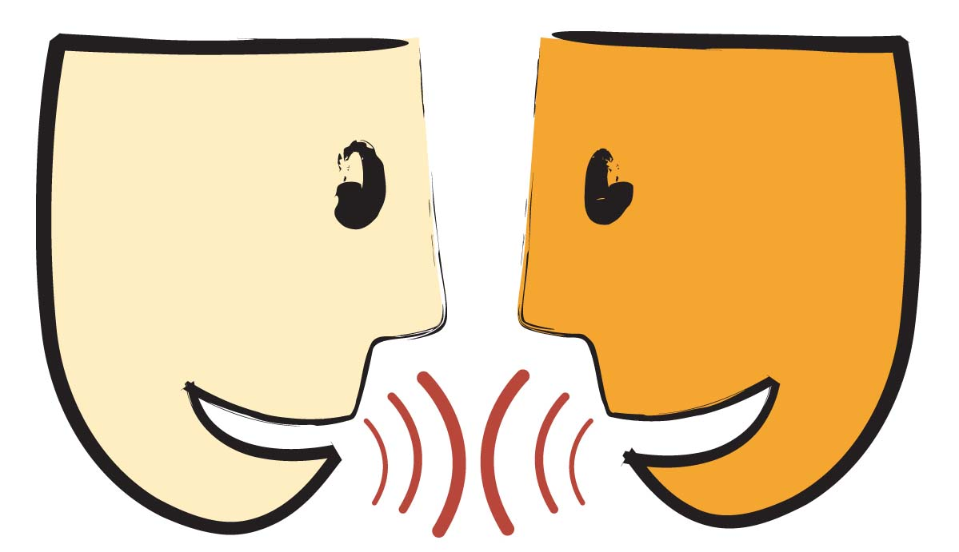
Tell your partner about a new word you learned yesterday.
Notes:
Access Prior Knowledge- (APK)
Turn and Talk
Review 3 words and definitions

Slide 22
Describe a time when…
you have seen a funnel
there has been complete destruction
you have seen something being produced
Notes:
Funnel: in the kitchen, to put oil in a car, tornado
Destruction: fire, natural disasters (tornados, hurricanes, floods, etc.)
Produce: hail, plants producing food, factories, thunderstorms producing tornados, wind producing mini-tornado

Slide 23
I can determine the meaning of unknown words.
Notes:
Goal- Students need to engage with the goal- read it, repeat it, write it, etc.

Slide 24
Day 4
Notes:
Thursday

Slide 25
I can determine the meaning of unknown words.
Notes:
Goal- Students need to engage with the goal- read it, repeat it, write it, etc.

Slide 26
Tell your partner what it means if a tornado causes destruction.
Notes:
Access Prior Knowledge- (APK)
Turn and Talk
Review 3 words and definitions

Slide 27
Making Choices
If I say something that might be shaped like a funnel, make your arms look like a funnel. If I say something that would not be shaped like a funnel, don’t do anything.
Coffee mug
Tornado
Ice cream cone
Shoe

Slide 28
Making Choices
If I say an example of destruction, say destruction. If it isn’t destruction, don’t say anything.
A home that caught on fire
A city destroyed by a tornado
Throwing away a book
A hurricane causing a flood
Walking on the grass

Slide 29
Making Choices
If I say something that could be produced by a tornado, say produced. If it wouldn’t be produced by a tornado, don’t say anything.
Rain
Hail
Sunshine
Lightning
Gravity

Slide 30
I can determine the meaning of unknown words.
Notes:
Goal- Students need to engage with the goal- read it, repeat it, write it, etc.

Slide 31
Day 5
Notes:
Friday

Slide 32
I can determine the meaning of unknown words.
Notes:
Goal- Students need to engage with the goal- read it, repeat it, write it, etc.

Slide 33
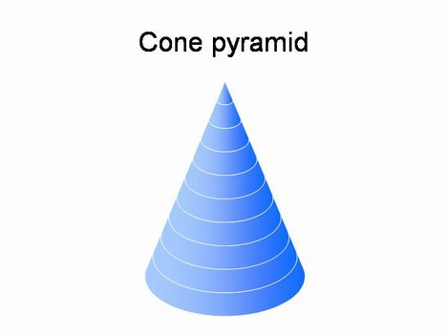
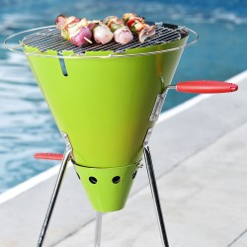
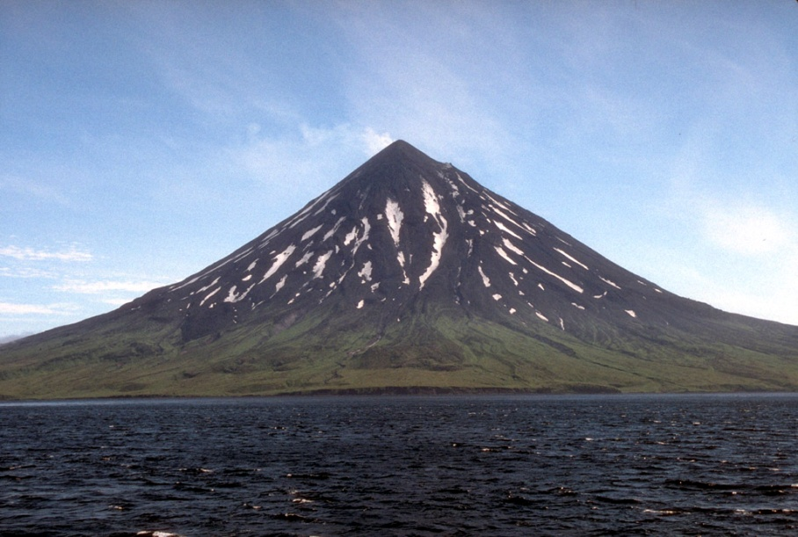
Tell your partner what all of these pictures have in common.
Notes:
Access Prior Knowledge- (APK)
Turn and Talk
Review 3 words and definitions

Slide 34
Word Association
Which word goes with completely ruined?
Which word goes with cone shape?
Which word goes with create?
funnel
destruction
produce
Notes:
Application
Word Association
Have students explain their thinking
Could have them do individually as an assessment in their notebooks or maybe after your weekly spelling test

Slide 35
I can determine the meaning of unknown words.
Notes:
Goal- Students need to engage with the goal- read it, repeat it, write it, etc.

