Slide 1
Personification
Mr. Finley
3rd-5th Grade Class
Consultant Dr. Jane E. Pollock
Grace Hill Elementary
Rogers, AR
May 11, 2011

Slide 2
Purpose of the GANAG Structure
To give students the opportunity to actively use the nine high-yield strategies:
(2) Identifying Similarities and Differences
(7) Cooperative Learning
(8) Setting Objectives and Providing Feedback
(3) Summarizing and Note Taking
(4) Reinforcing Effort and Providing Recognition
(9) Generating and Testing Hypotheses
(5) Homework and Practice
(10) Cues, Questions and Advance Organizers
(6) Nonlinguistic Representations

Slide 3
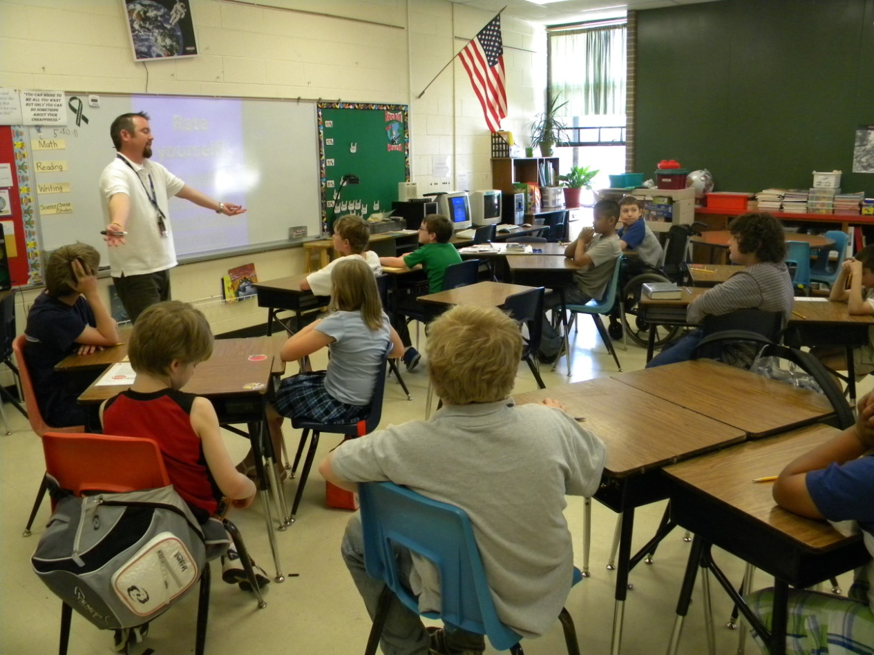
A= Access Prior Knowledge
“What is personification?”
(10) Cues, Questions and Advance Organizers

Slide 4
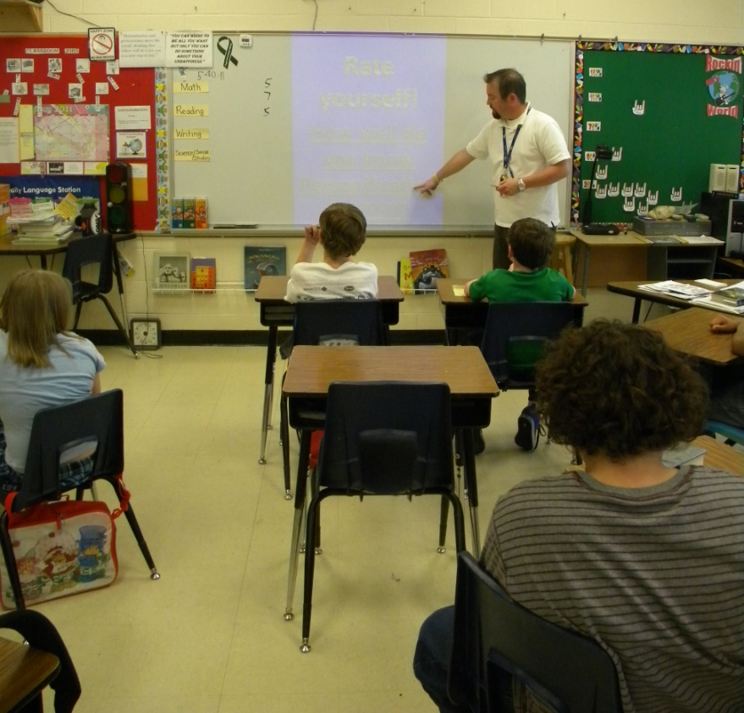
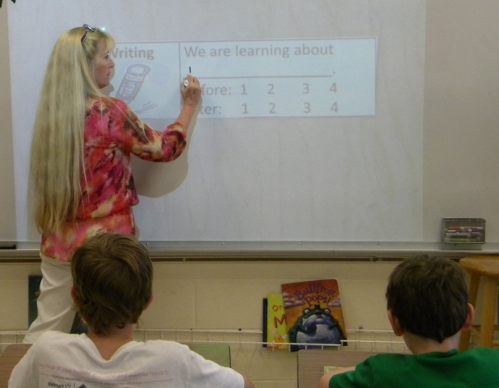
G= Goal
I can use personification in my writing.
Students were asked to score themselves.
(8) Setting Objectives and Providing Feedback

Slide 5
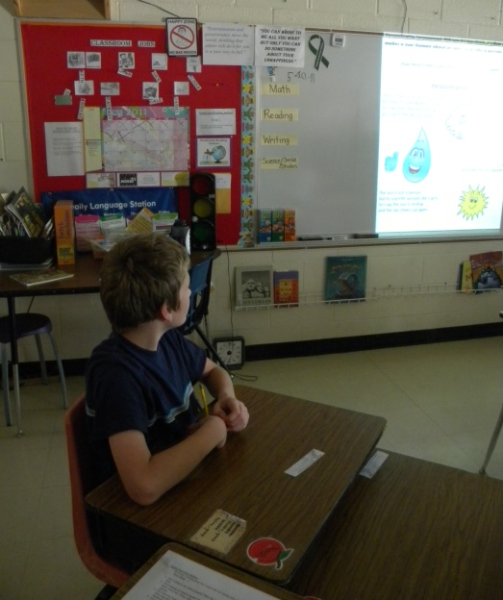
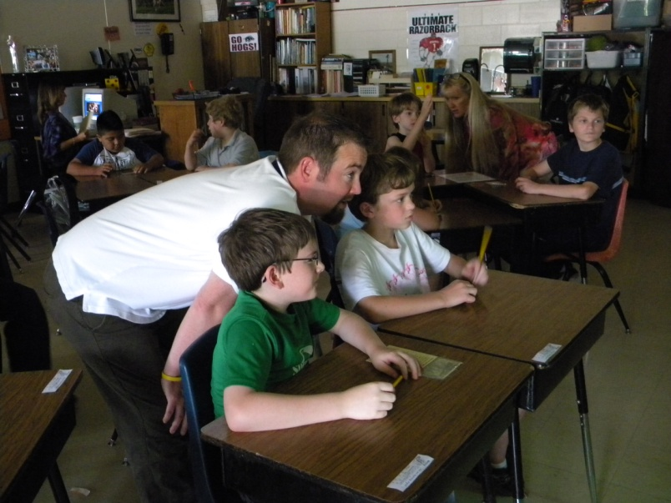
N= New Information
A student read the poem Personification aloud. Students worked in table groups to identify examples of personification within the poem.
(7) Cooperative Learning

Slide 6
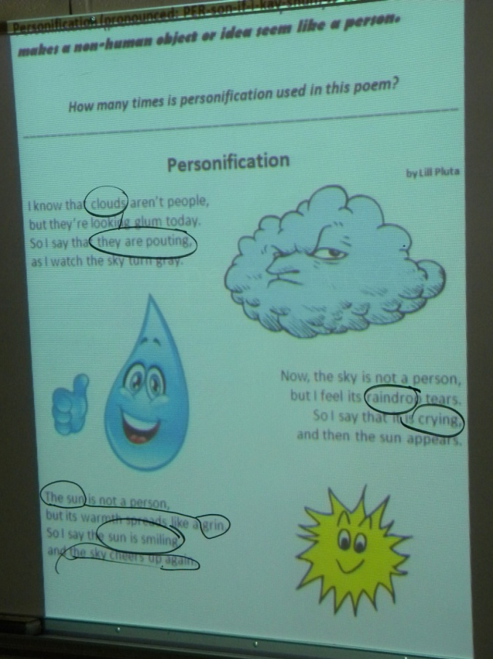
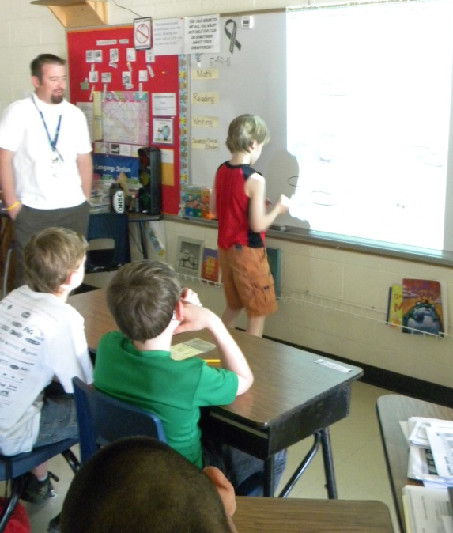
N= New Information
Examples of personification were circled.

Slide 7
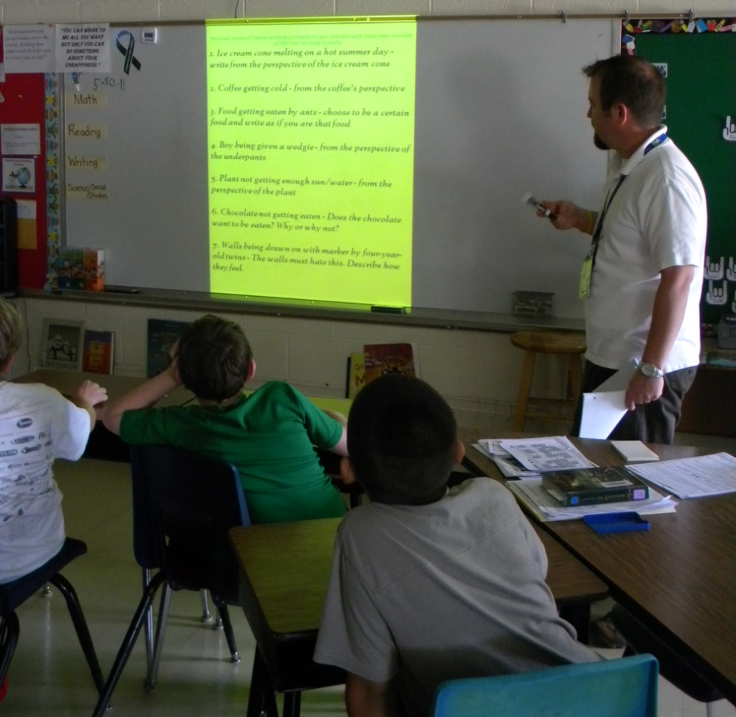
N= New Information
Students read “plain” sentences and then read the same sentences with
personification added.
(2) Identifying Similarities and Differences

Slide 8
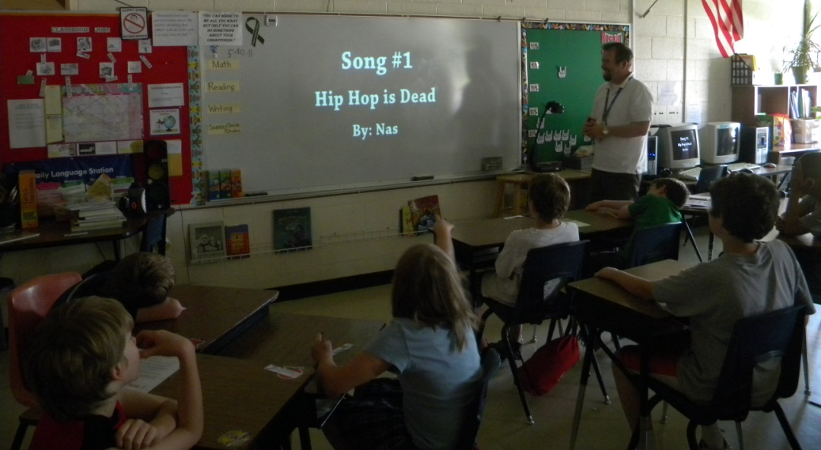
N= New Information
Mr. Finley showed a YouTube video that highlighted personification in songs.

Slide 9
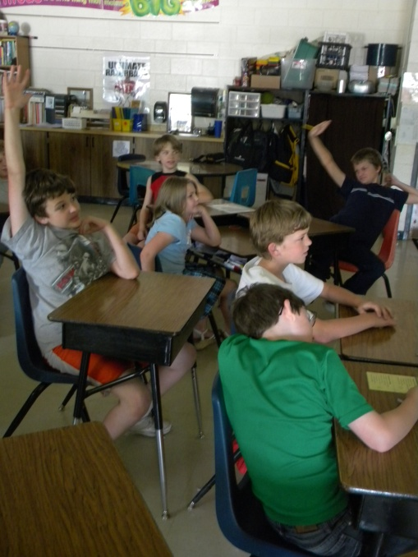
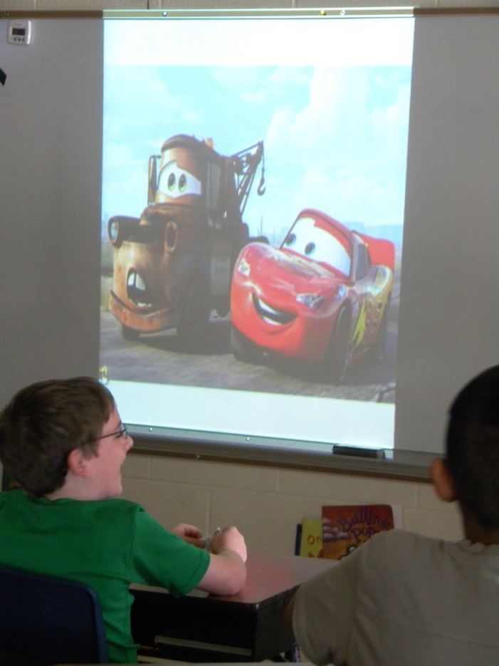
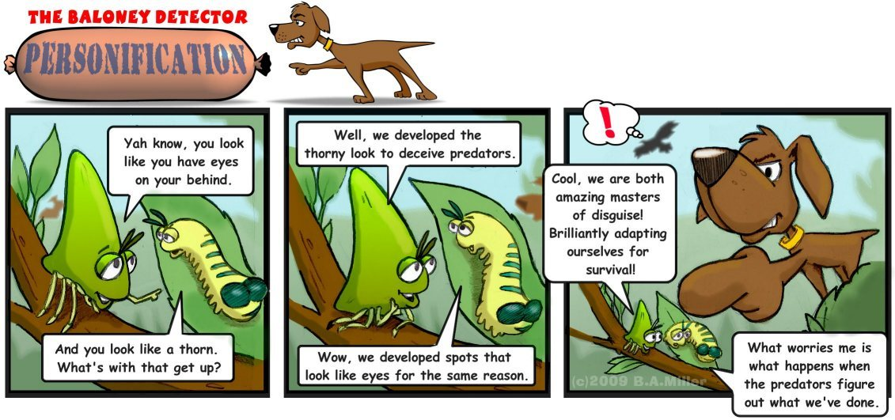
N= New Information
The class discussed personification in movies, pictures and cartoons.
(6) Nonlinguistic Representations

Slide 10
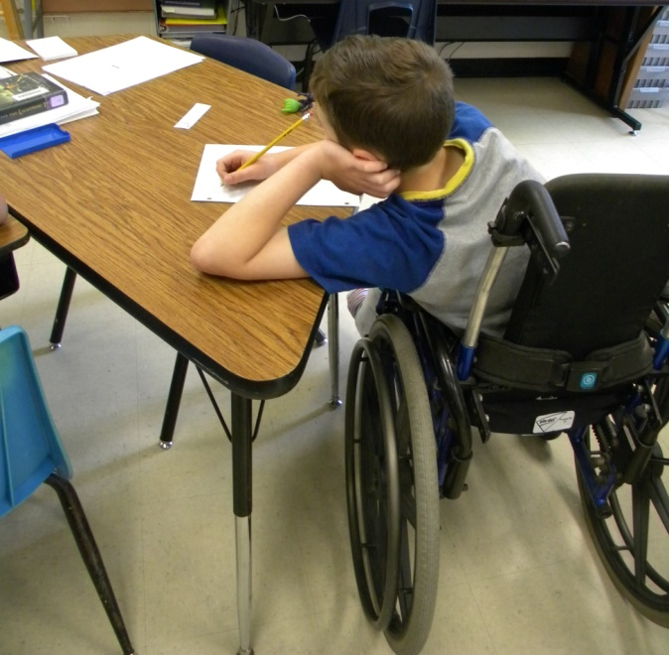
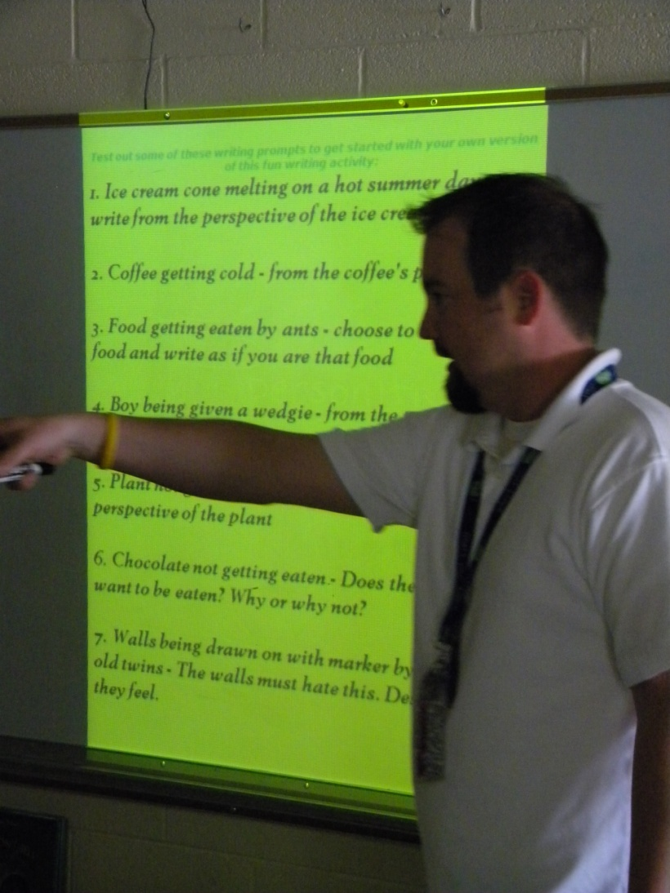
A= Apply Knowledge
Students selected a Quick Write prompt and wrote for five minutes.
(5) Homework and Practice

Slide 11
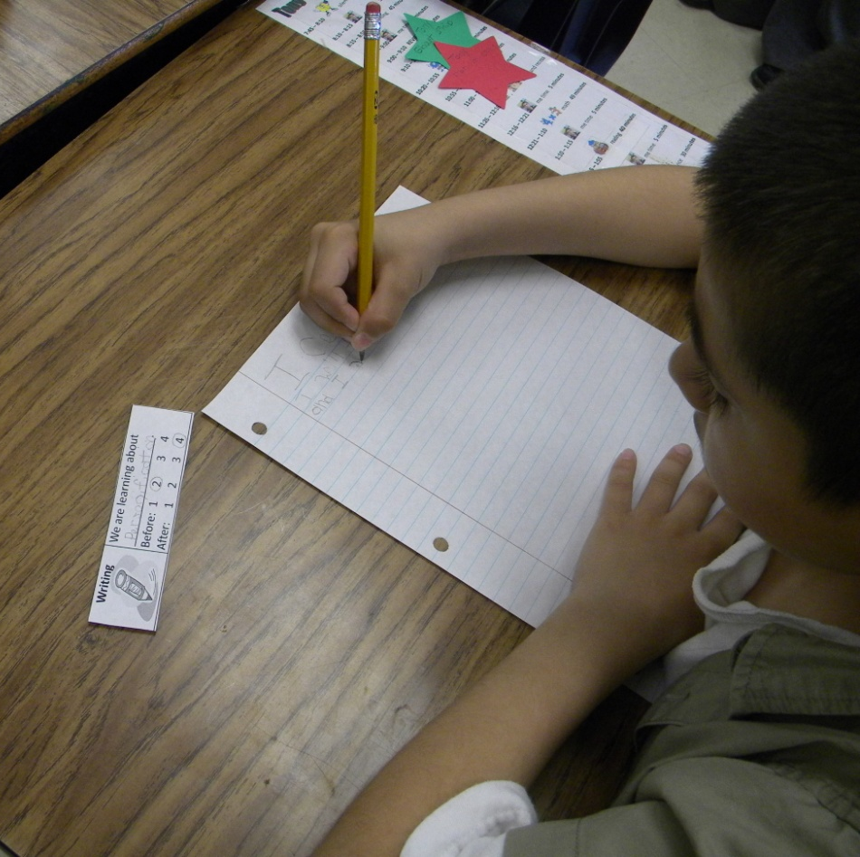
G= Generalize the Goal
Students revisited the goal and then scored themselves again.
(8) Setting Objectives and Providing Feedback

Slide 12
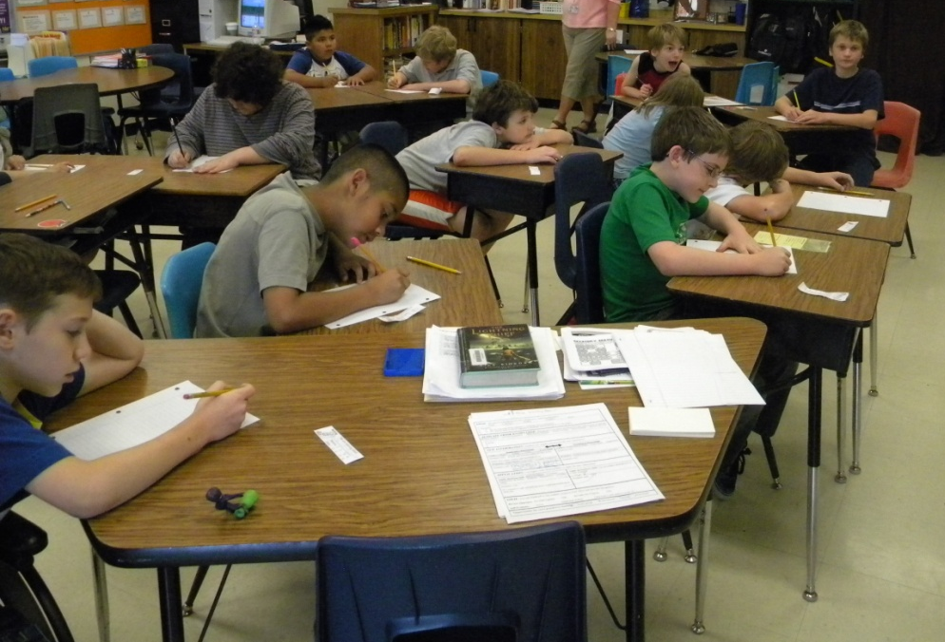
G
A
N
A
G
Student Use of the High Yield Strategies

Slide 13
Marzano, R. J., Pickering, D. J., & Pollock, J. E. (2001). Classroom instruction that works: Research-based strategies for increasing student achievement. Alexandria, VA: Association for Supervision and Curriculum Development.
Pollock, J. E. (2007). Improving student learning one teacher at a time. Alexandria, VA: Association for Supervision and Curriculum Development.
Pollock, J. E., & Ford, Sharon M. (2009). Improving student learning one principal at a time. Alexandria, VA: Association for Supervision and Curriculum Development.

