Slide 1
5th Grade
Text Talk
Unit 2

Slide 2
I can use words I learn from a text.
Notes:
Goal-
Students need to engage with the goal- read it, repeat it, write it, etc.

Slide 3
Tell your partner about a new word you learned last week.
Notes:
Access Prior Knowledge- (APK)
Turn and Talk

Slide 4
Notes:
New Information-
Read the book- provide a brief explanation of any words that may be new or unfamiliar to the students.
(You may read the book prior to this lesson)

Slide 5
craggy
Notes:
Contextualize the word- Find it in the text
Say the word together

Slide 6
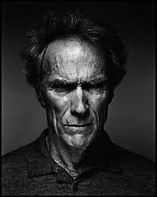
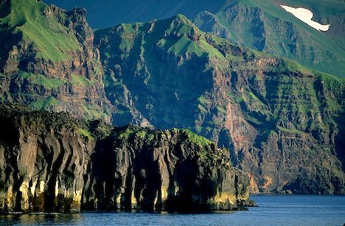
craggy
rough, rugged
Notes:
Give student friendly definition
Use the word in other contexts

Slide 7
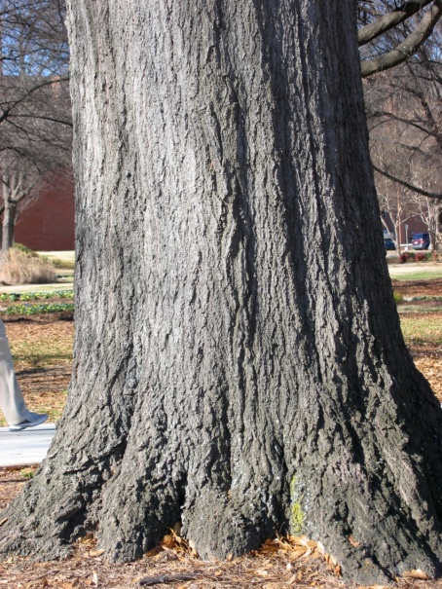
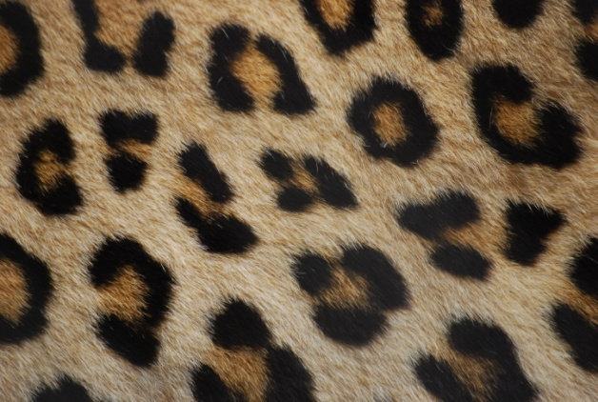
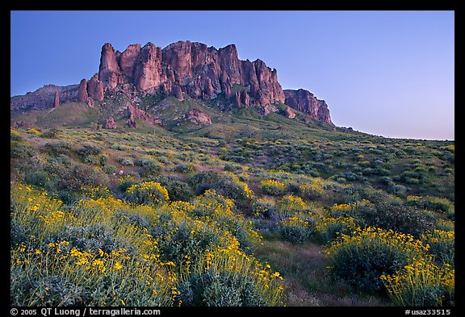
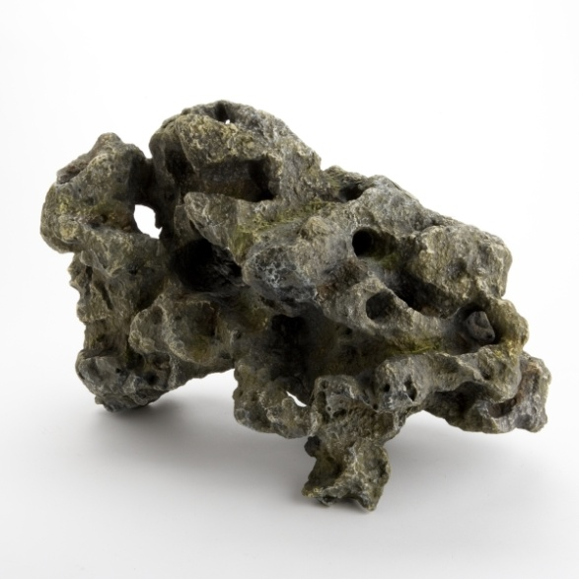
Which of these are craggy ?
Notes:
Engage the students with the word

Slide 8
colossal
Notes:
Contextualize the word- Find it in the text
Say the word together

Slide 9
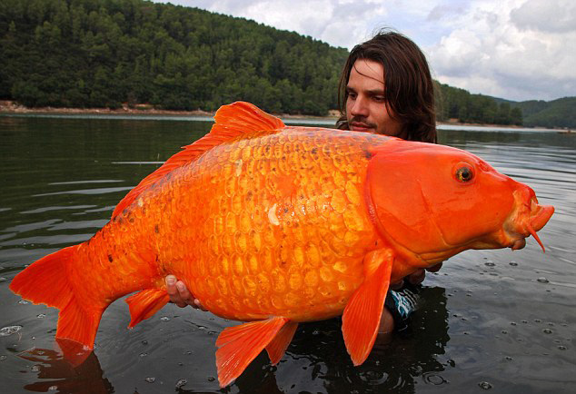
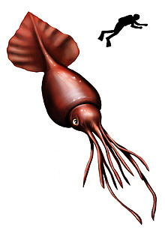
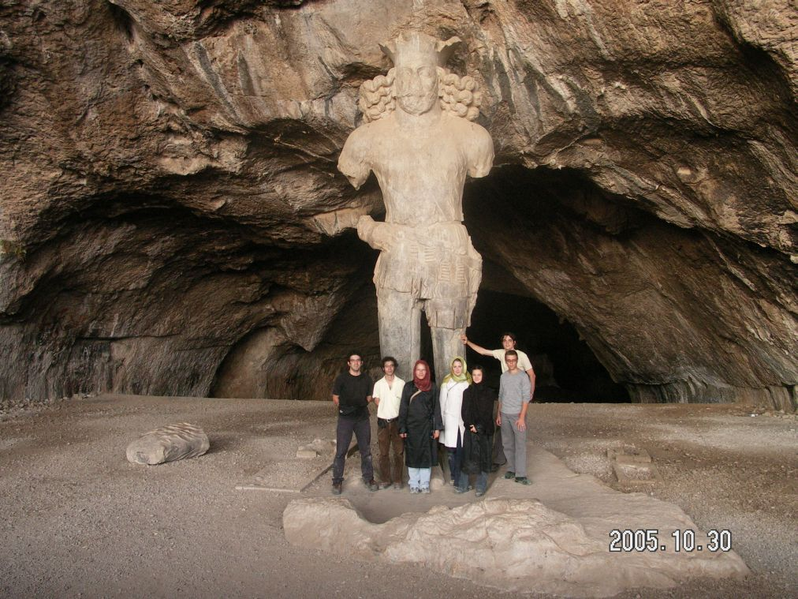
Colossal
Something massive in size
Notes:
Give student friendly definition
Use the word in other contexts

Slide 10
Describe something that is colossal.
Notes:
Engage the students with the word

Slide 11
daunting
Notes:
Contextualize the word- Find it in the text
Say the word together

Slide 12
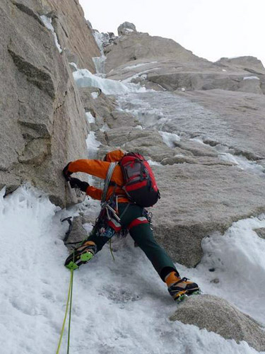
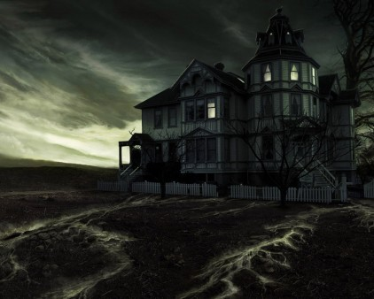
daunting
likely to discourage, intimidate or frighten
Notes:
Contextualize the word- Find it in the text
Say the word together

Slide 13
Thumbs up, Thumbs down
Which of these could be daunting?
playing soccer with professional players
playing soccer with your friends
running across the parking lot
running a marathon
a playful puppy
a snarling guard dog
Notes:
Engage the students with the word

Slide 14
Who can use all 3 words in a sentence?
craggy
colossal
daunting
Notes:
Read all three words and see if you can use them in one sentence.

Slide 15
Write a sentence to show you know what each of these words mean.
craggy
colossal
daunting
Notes:
Application-
Students need an opportunity to use the words they just learned from the text.

Slide 16
I can use words I learn from a text.
Notes:
Goal-
Revisit the Goal

