Slide 1
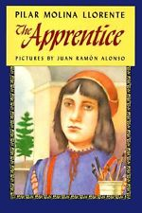
Whole Class Novel

Slide 2
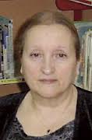
Meet the Author:
Pilar Molina Llorente
Published in Spain in 1989
Translated to English in 1993
She has written several children’s books in Spanish

Slide 3
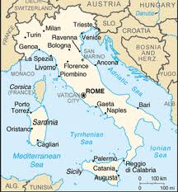
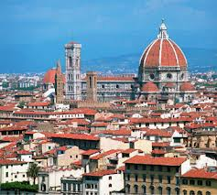
Things you need to know about this book…
The setting is in Florence, Italy during the Renaissance (15th-17th centuries)

Slide 4
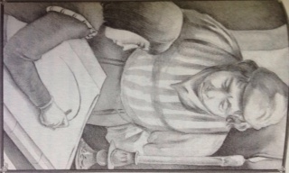
Characters you will meet…
Arduino 13 year old boy
Maestro Cosimo Master Painter
Melania Servant to Cosimo

Slide 5
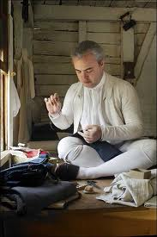
Words to Discuss…
Apprentice
Master
Tailor

Slide 6
Class Expectations…
Responsible for personal reading.
Keep up with materials.
Come to class and small groups ready to discuss your reading and notes.

