Slide 1
Comparing
Play-Doh & Silly Putty
5th Grade Unit 2

Slide 2
Goals:
I can use the steps for comparing.
I can use information from a text to help me compare.

Slide 3
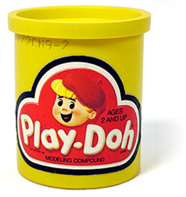
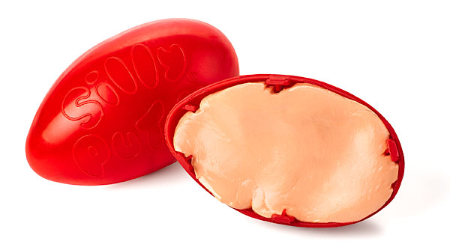
What do you know about these items?
Notes:
Access Student’s Prior Knowledge
Turn and Talk- “What do you know about these items?”

Slide 4
Steps for Comparing
I find the items to compare
I choose the features to compare the items
I tell how the items are the same or different
Notes:
New Information-
Introduce the steps for comparing
Click – for step 1

Slide 5
Steps for Comparing
I find the items to compare
I choose the features to compare the items
I tell how the items are the same or different
Item:
Who invented it?
When?
What was the original use/purpose?
Describe it.
What was the final use/purpose of the product?
Notes:
New Information-
Step 2
“we are going to use a note taking template to gather information about the features we want to compare.

Slide 6
Select a passage to read.
(1/2 the class needs to read about Play-Doh, and the other half Silly Putty)
Play-Doh pg. 102-105
Silly Putty pg. 33- 39
Notes:
New information-
Read to learn about Play-Doh & Silly Putty
Complete the note-taking template.

Slide 7
Item:
Who invented it?
When?
What was the original use/purpose?
Describe it.
What was the final use/purpose of the product?
Notes:
Students read and take notes

Slide 8
Complete Class Chart
Item: | Play-Doh | Silly Putty
Who invented it?
When?
What was the original use/purpose?
Describe it.
What was the final use/purpose of the product?
Notes:
Application-
Complete the class chart-

Slide 9
Steps for Comparing
I find the items to compare
I choose the features to compare the items
I tell how the items are the same or different
Write a paragraph about how Play-Doh and Silly Putty are the same and a paragraph about how they are different.
Notes:
Application
Have students write a paragraph about how the items are the same and a paragraph about how the items are different.

Slide 10
Goals:
I can use the steps for comparing.
I can use information from a text to help me compare.
Notes:
Revisit the goals.

