Slide 1
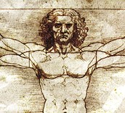
5th Grade Unit 2
Inventive Thinking
Quoting Accurately from a Text
When drawing an Inference
Mrs. Humble’s 5th Grade
Grace Hill Elementary
September 24, 2012

Slide 2
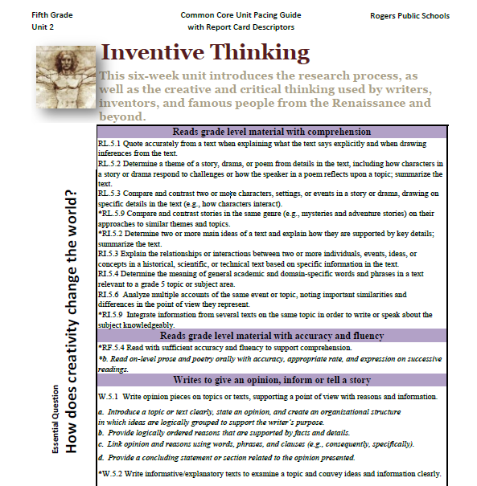
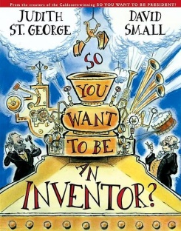
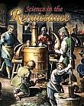
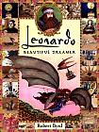
Unit Preparation:
Prior to beginning Unit 2, Mrs. Humble did the following:
Identified the standards to be taught- (she looked at the unit 2 pacing guide)
She asked herself-
“What will my students know and be able to do better at the end of this unit?”
3. She gathered and studied the resources in order to prepare the daily lessons.

Slide 3
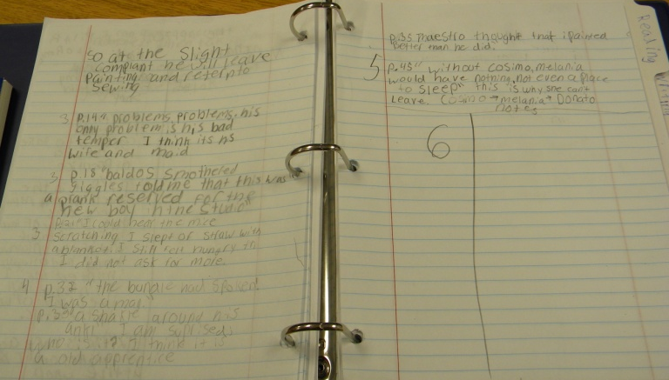
Plan Daily Lessons:
Once Mrs. Humble had the big picture for the unit, she began planning daily lessons.
This is day 6 of the unit.
The standard the class is working on is:
RL. 5.1 Quote accurately from a text when explaining what the text says explicitly and when drawing inferences from the text.
The resources she has selected for the lesson are:
Interactive notebook

Slide 4
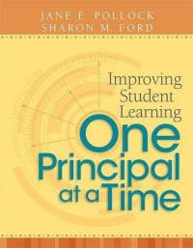
GANAG is a daily lesson structure that allows teachers to plan for student use of research based instructional strategies.
G= goal
A= access prior knowledge
N= new information
A= application
G= generalize the goal

Slide 5
The purpose of the GANAG structure:
To give students the opportunity to actively use the nine high-yield strategies:
(2) Identifying Similarities and Differences
(7) Cooperative Learning
(8) Setting Objectives and Providing Feedback
(3) Summarizing and Note Taking
(4) Reinforcing Effort and Providing Recognition
(9) Generating and Testing Hypotheses
(5) Homework and Practice
(10) Cues, Questions and Advance Organizers
(6) Nonlinguistic Representations

Slide 6
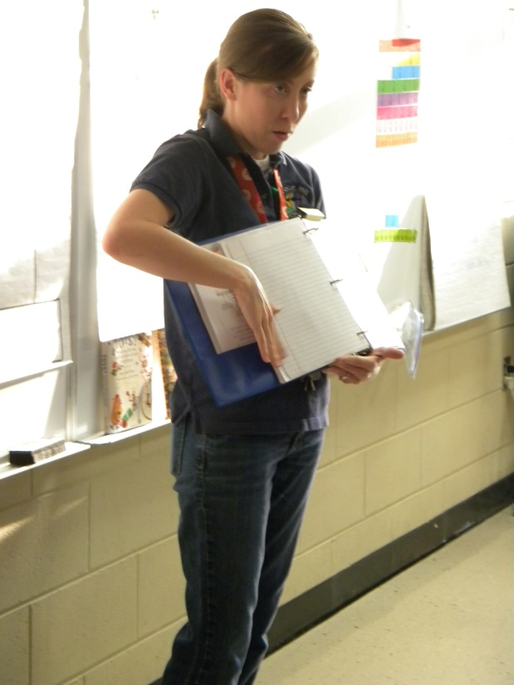
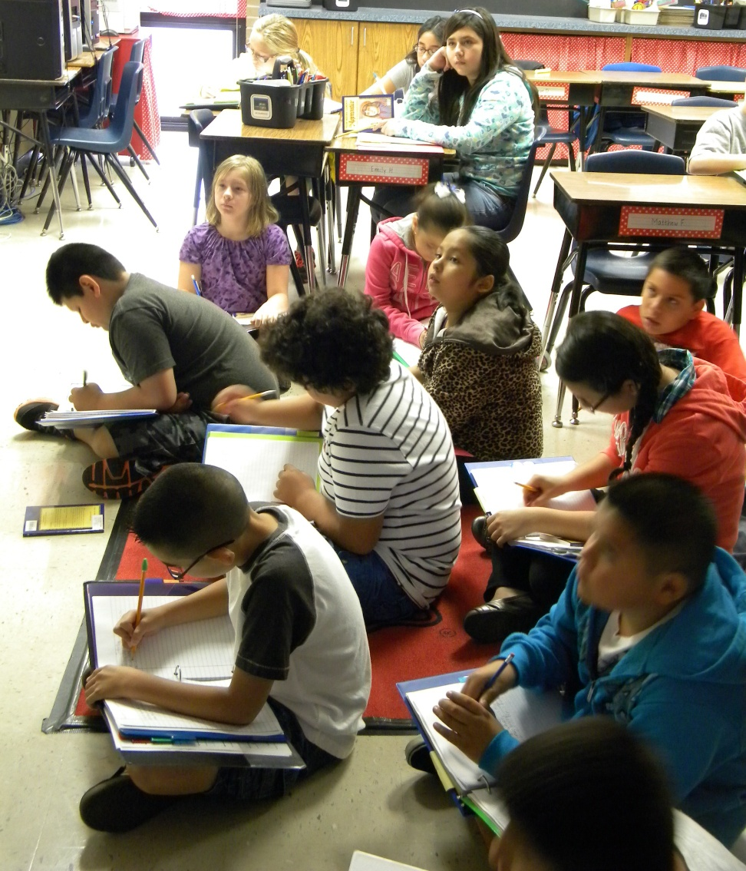
Students took out their interactive notebooks.

Slide 7
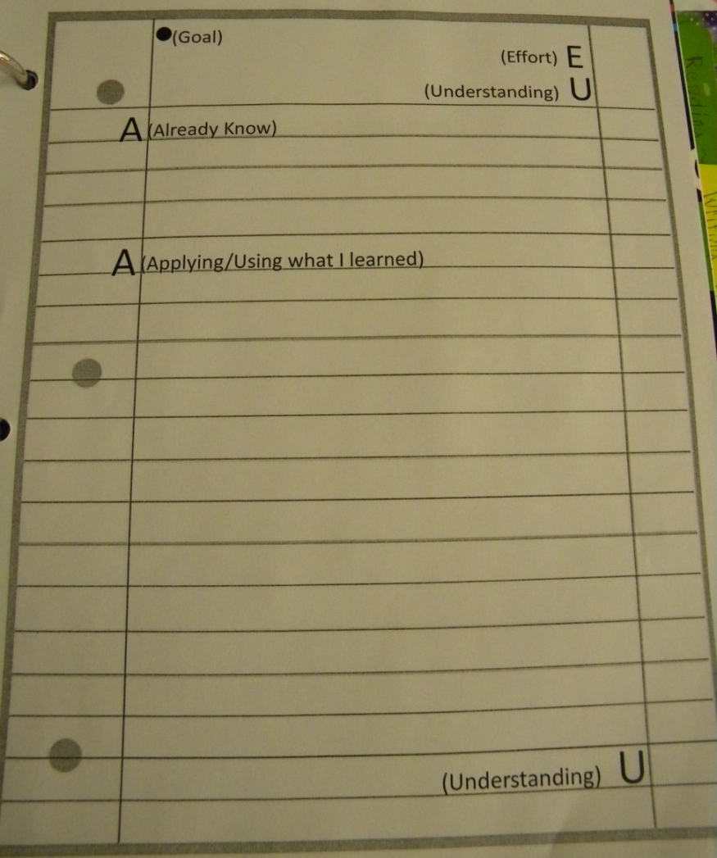
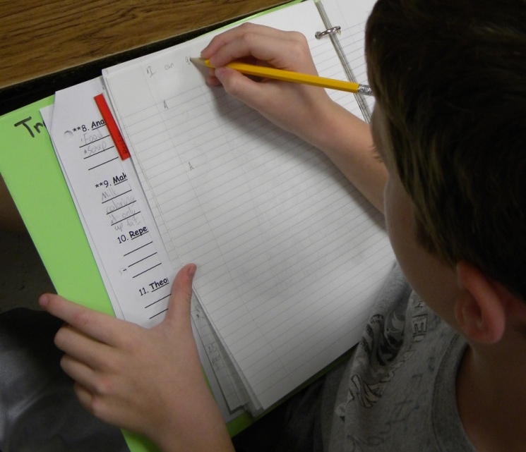
Goal
They wrote the goal at the top of the left side of the notebook.
I can quote accurately from the text to support my inferences.
They gave themselves a score for “understanding” and “effort”
(8) Setting Objectives and Providing Feedback
(4) Reinforcing Effort and Providing Recognition

Slide 8
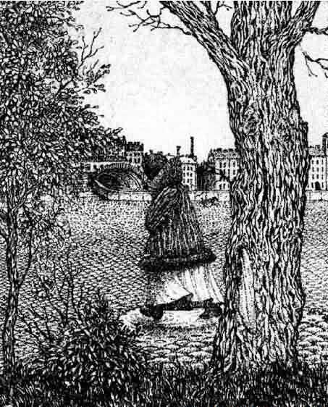
Access Prior Knowledge
The students looked at this optical illusion and discussed what they saw (and didn’t see at first).
(6) Nonlinguistic Representations

Slide 9
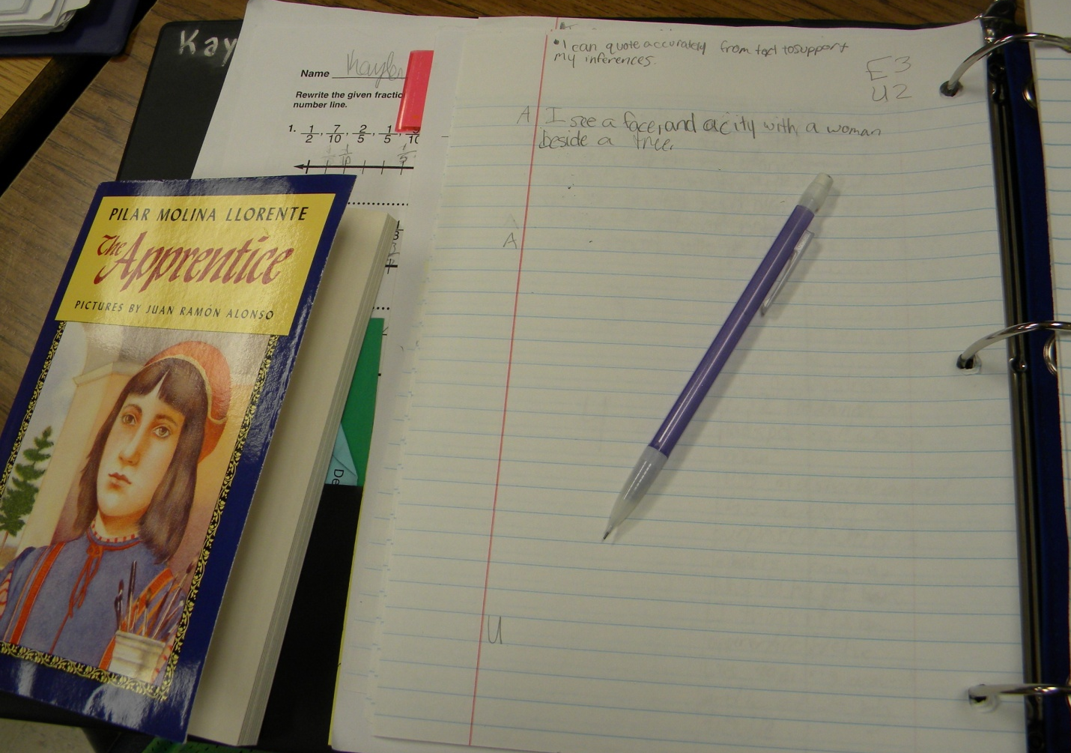
Students recorded two things they saw in the optical illusion in their notebooks (on the left side) and then created an analogy together.
Optical illusion is to a picture as inferences are to reading.
(2) Identifying Similarities and Differences

Slide 10
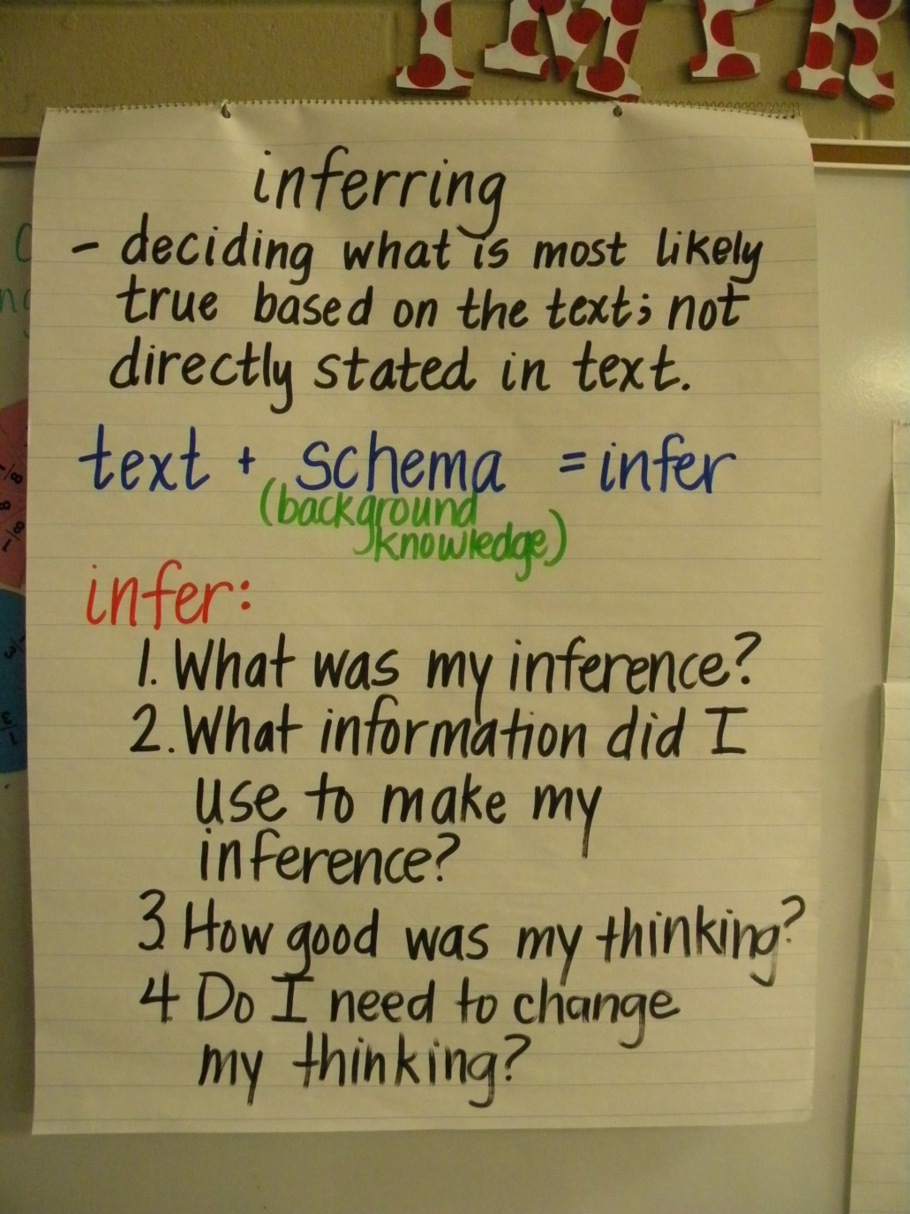
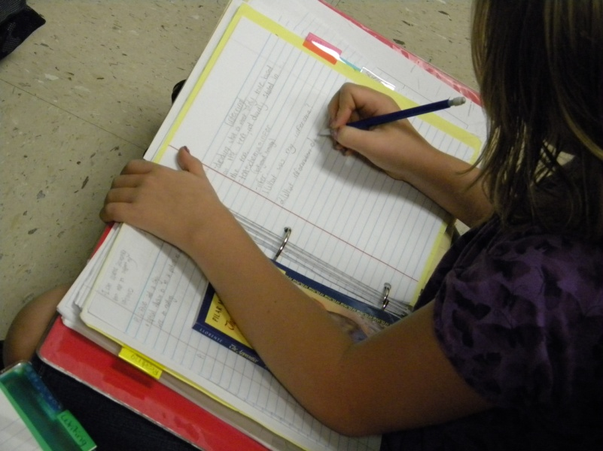
New Information
Students took notes about inferring on the right side of their notebook.
(3) Summarizing and Note Taking

Slide 11
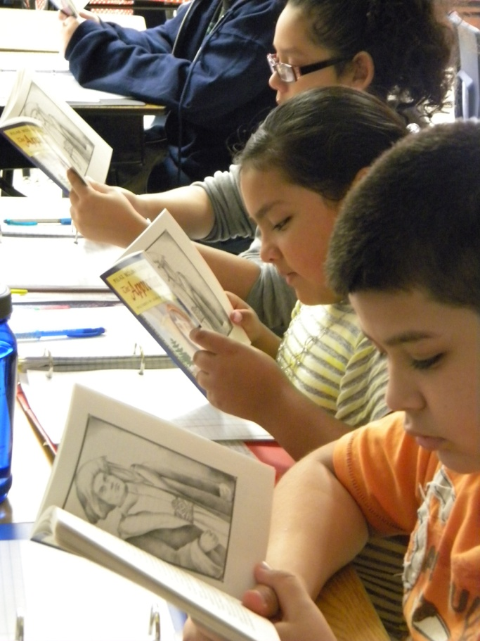
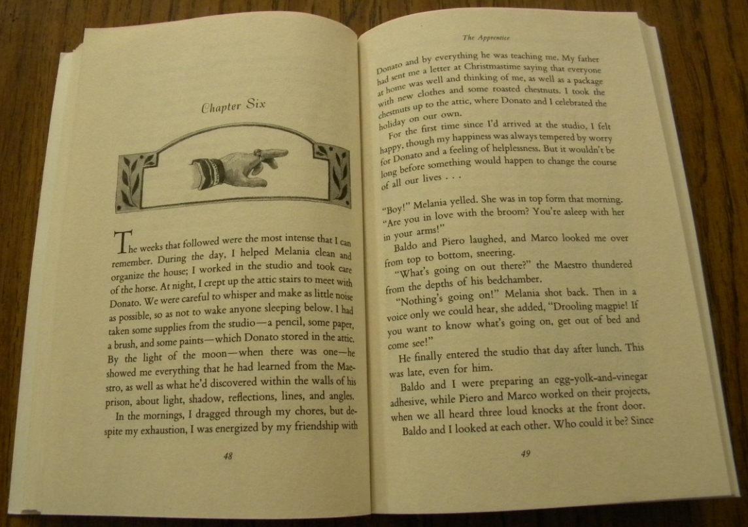
Application
Students continued reading The Apprentice.
(5) Homework and Practice

Slide 12
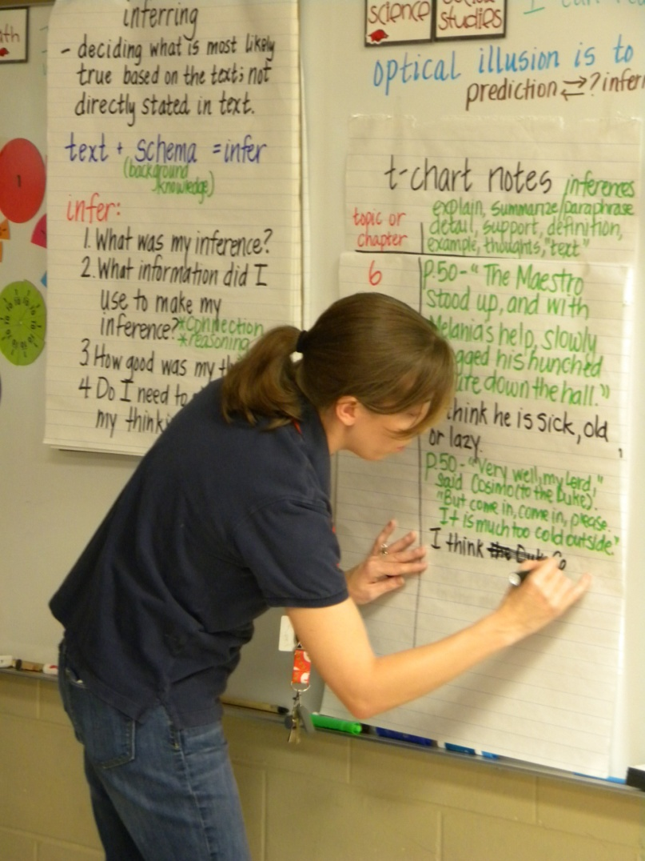
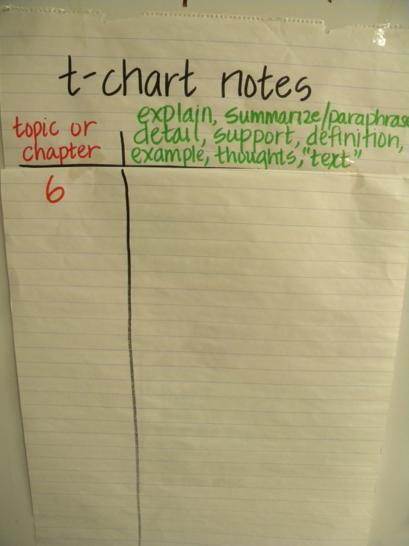
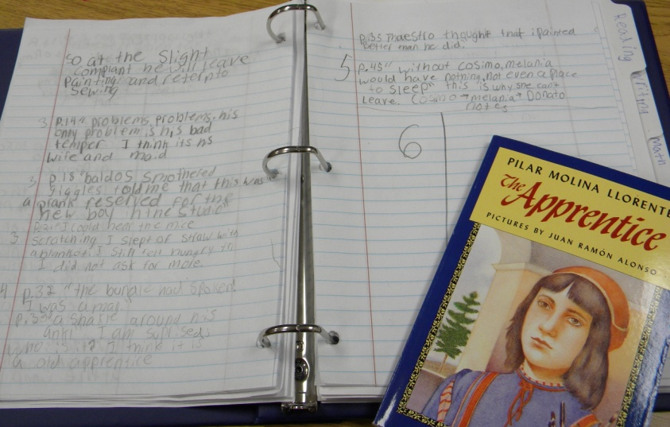
They took notes- making sure to accurately quote from the text to support their inferences.

Slide 13
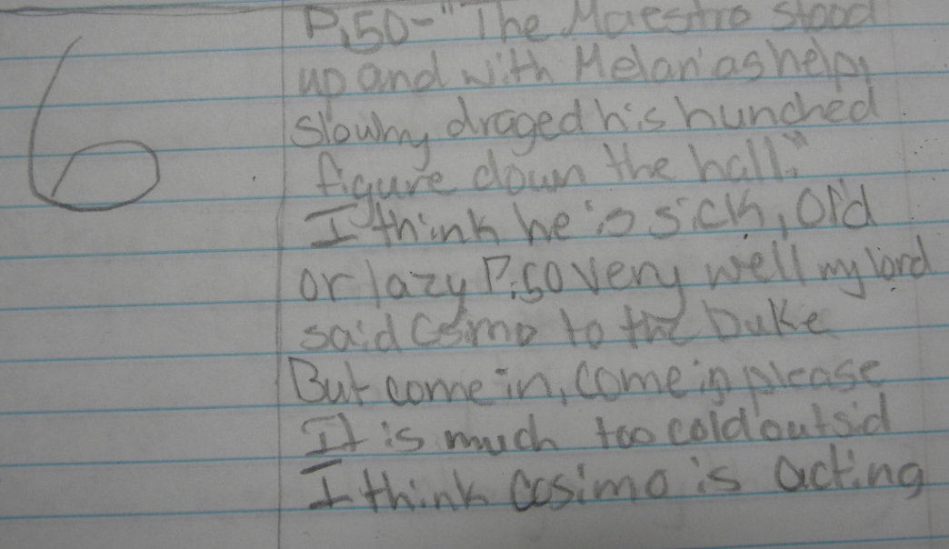
Steps for Inferring:
Mrs. Humble wanted her kids to think about their thinking so she included 4 steps to scaffold their inferring.
Pg. 50 The Maestro stood up and with Melaina’s help slowly dragged his hunched figure down the hall.
What was my inference? His is sick
What information did I use to make my inference? Personal connection
How good was my thinking? Are there other possibilities? Maybe he was old or lazy
Do I need to change my thinking? I think he was sick, old and lazy.
(9) Generating and Testing Hypotheses

Slide 14
Pg. 50 Very well, my lord," said Cosimo to the duke. “But come in, come in please. It is much too cold outside.”
What was my inference? The duke is his boss.
What information did I use to make my inference? Personal connection
How good was my thinking? Are there other possibilities? Maybe the duke is rich and Cosimo thinks he will get more money.
Do I need to change my thinking? I think Cosimo is acting this way because he (the duke) is a noble and he can pay him more.

Slide 15
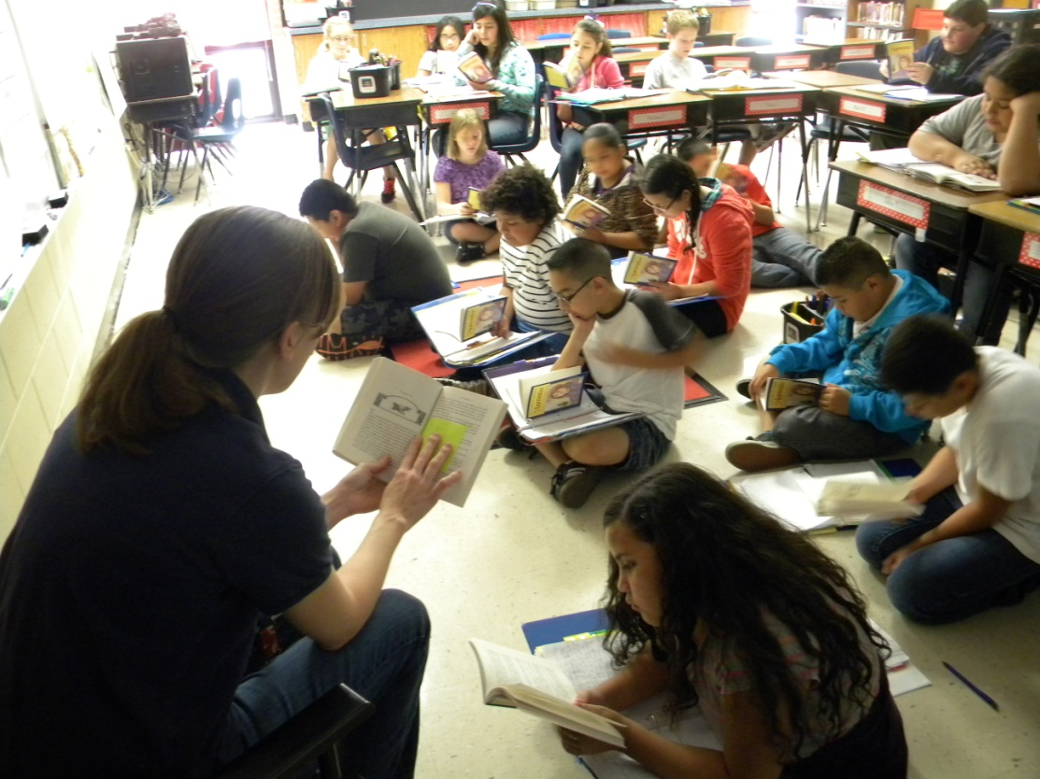
As they read they paused to discuss vocabulary.

Slide 16
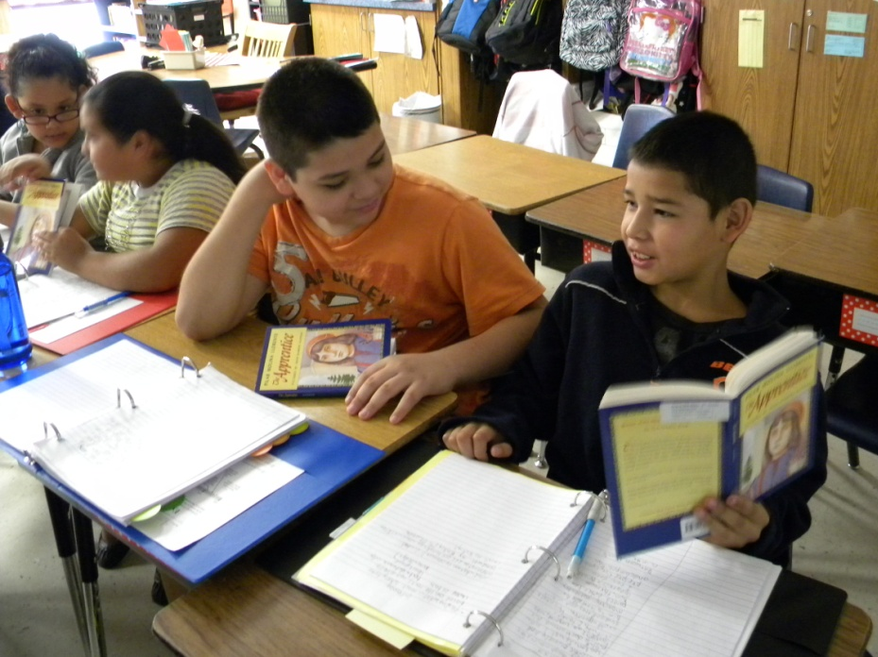
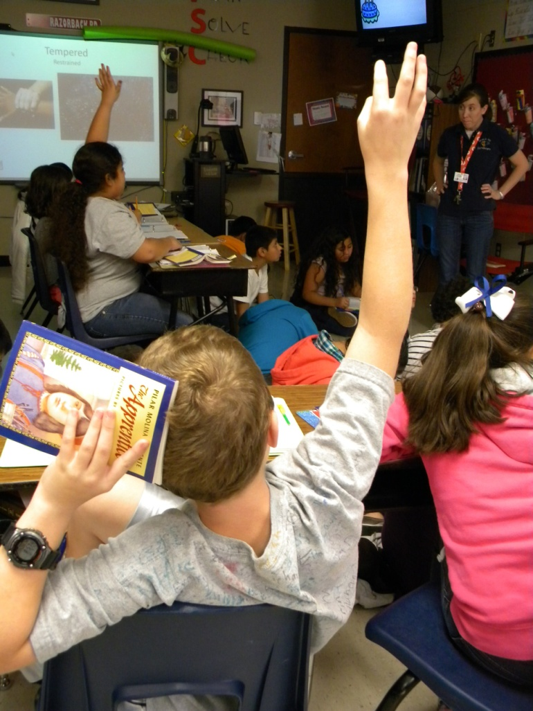
Periodically Mrs. Humble asked the students to pause and talk to their partner about the inferences they were making.
(7) Cooperative Learning

Slide 17
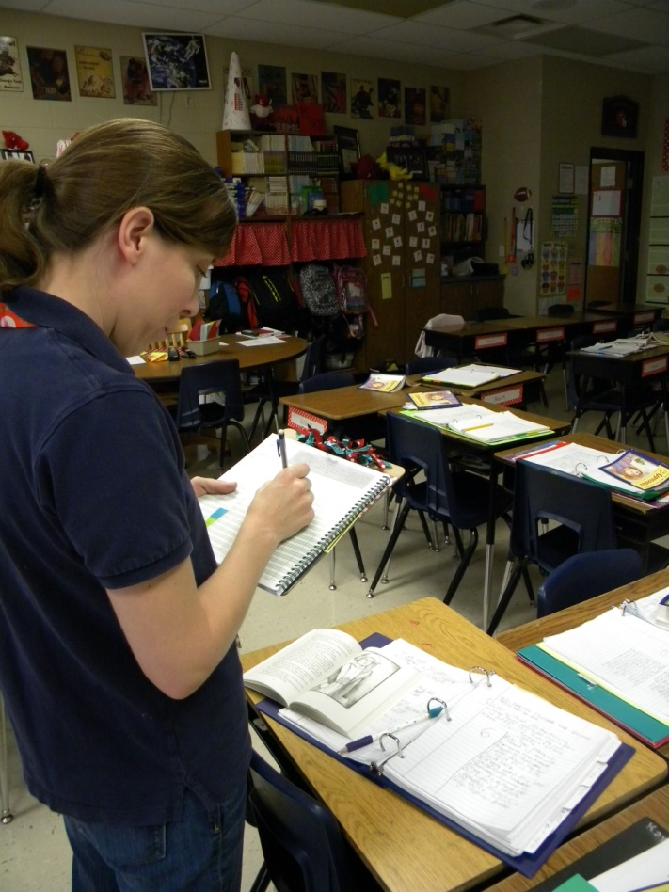
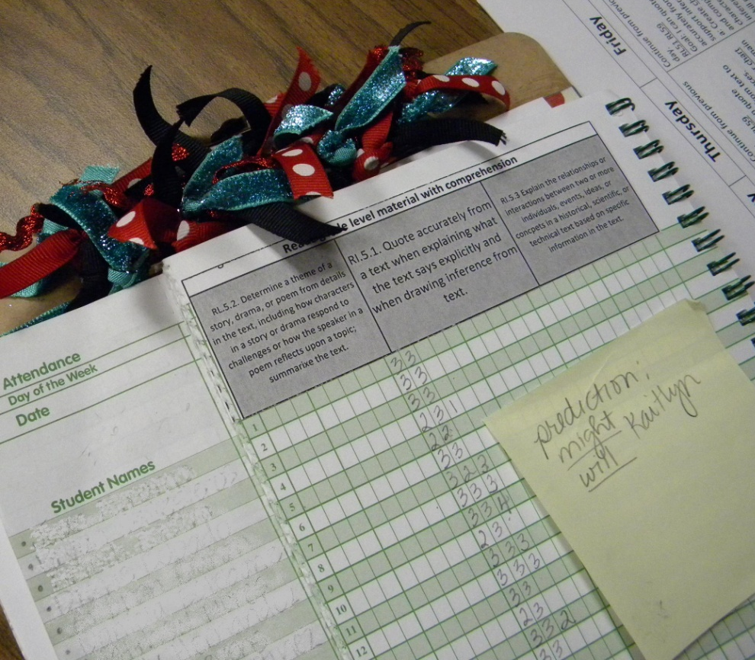
The students had to leave for their encore activity before the lesson was over. Mrs. Humble took the opportunity to walk around and score the students’ understanding of the standard.

Slide 18
When the students returned:
They finished reading chapter six and continued taking notes.
They revisited their definition for inferring to see if they needed to add anymore information.
Finally they revisited the goal of the lesson and scored their understanding at the bottom of the left hand side of their notebook.
Revisiting the Goal

Slide 19
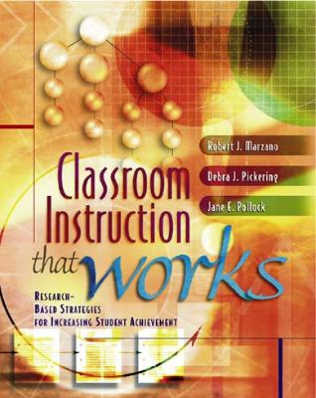
Marzano, R. J., Pickering, D. J., & Pollock, J. E. (2001). Classroom instruction that works: Research-based strategies for increasing student achievement. Alexandria, VA: Association for Supervision and Curriculum Development.
Pollock, J. E. (2007). Improving student learning one teacher at a time. Alexandria, VA: Association for Supervision and Curriculum Development.
Pollock, J. E., & Ford, Sharon M. (2009). Improving student learning one principal at a time. Alexandria, VA: Association for Supervision and Curriculum Development.

