Slide 1
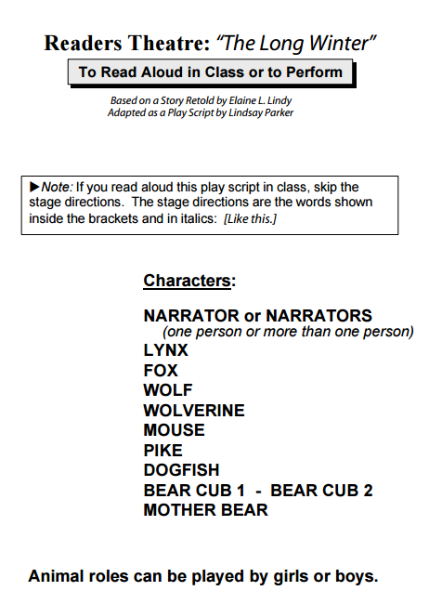
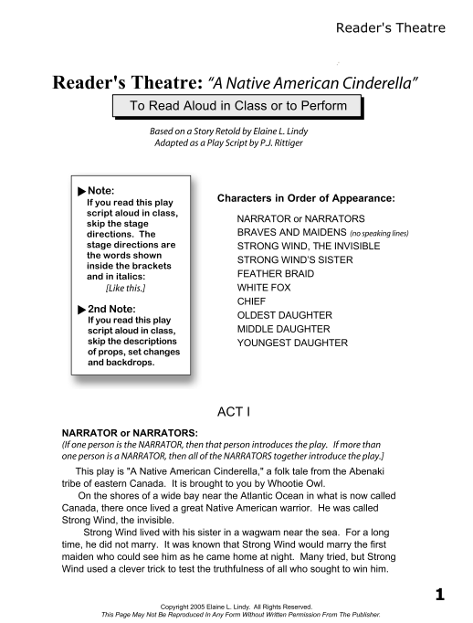
Formative Assessment
4th Grade Live Scoring Example
Susan Hensley
Elementary Curriculum Specialist
Rogers Public Schools

Slide 2
4th Grade 4th Quarter- Unit 5
Whole
Group
Text
Student
Application
Text
Monday- I can identify the structural elements of a drama. (RL.4.5)
Tuesday- I can summarize a scene from a play. (RL.4.2)
Wednesday- I can explain the differences between a play and a story. (RL.4.5)
Thursday- I can use stage descriptions to describe characters . (RL.4.7)
Friday- I can determine the theme of a play. (RL.4.2)

Slide 3
RL.5
(Analyzing the structure of a text)
Describe
The overall structure of a story
How the beginning introduces the story
How the ending concludes the action
2nd
Explain
The major difference between poems, drama and prose
Refer to structural elements
(verse, rhythm, meter, casts of characters, settings, descriptions, dialogue, stage directions)
4th
Recognize
Common types of text
Story books, Poems
K
Refer to Parts of Stories, Dramas and Poems
(Chapter, scene, and stanza)
Describe how each successive part builds on earlier sections
3rd
Explain
Major differences between books that:
Tell stories
Give information
1st
Explain
How a series of chapters, scenes, or stanzas fit together to provide the overall structure of a story, drama or poem
5th

Slide 4
I can describe the structure of a text.
RL.4.5
I can identify the structural elements of a drama.
5th Grade | 4 | Explain how a series of chapters, scenes, or stanzas fit together to create the structure of a story, drama, or poem
4th Grade | 3 | Explain the major differences between poems, drama, and prose Refer to structural elements (verse, rhythm, meter, cast of characters, settings, dialogue, stage directions)
3rd Grade | 2 | Refer to parts of stories, dramas and poems when writing or speaking about them (chapter, scene, stanza) Explain how each successive part builds on earlier sections.
2nd Grade | 1 | Describe the overall structure of a story How the beginning introduces the story How the ending concludes the action

Slide 5
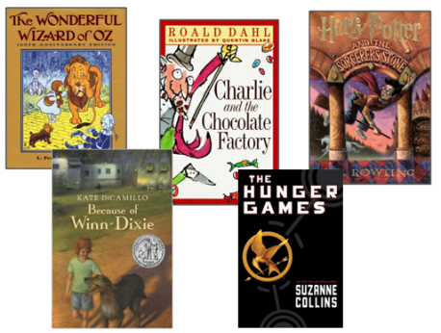
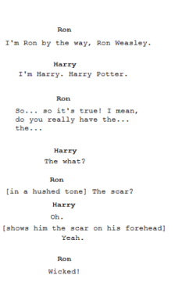
Monday (RL.4.5)
G- I can identify the structural elements of a drama.
APK- Image- book covers
Question-“What do these have in common?”
Pair- Share
N- Show script from HP movie- “Did this come from the movie or book?”
Define each of the structural elements of a drama.
Guided Practice- Identify each element in shared text (glue
script in notebook and label elements).
A- Identify an example of each element in “A Native American Cinderella” (drama).
(application in notebook) LIVE SCORE- formative assessment
G- Revisit the goal- generalize the learning- score understanding.

Slide 6
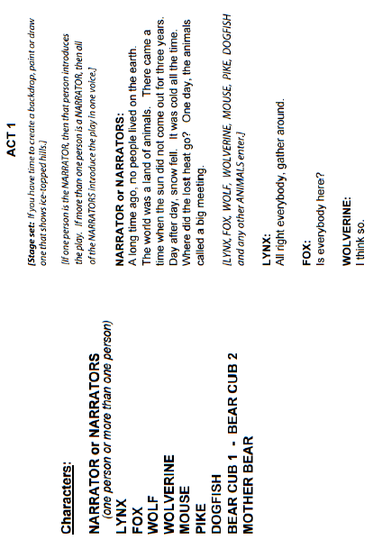
Left Side
STUDENT
Right Side
TEACHER NOTES
E= 3
U=2
Identify the structural elements of a drama.
Elements of a Drama
They are all movies.
Stage Directions
(stage left, stage right…)
Dialogue
Examples from:
A Native American Cinderella
Cast of Characters- Narrator, Braves and Maidens, Strong Wind, White Fox, Chief, Oldest Daughter
Setting- Act 1= Native American Village
Dialogue- STRONG WIND-BUT the woman I marry must be a an HONEST woman!
Stage Directions- (Turns to face STRONG WIND’S SISTER, but has his side to the audience.)
Setting
Cast of Characters
U=3

Slide 7
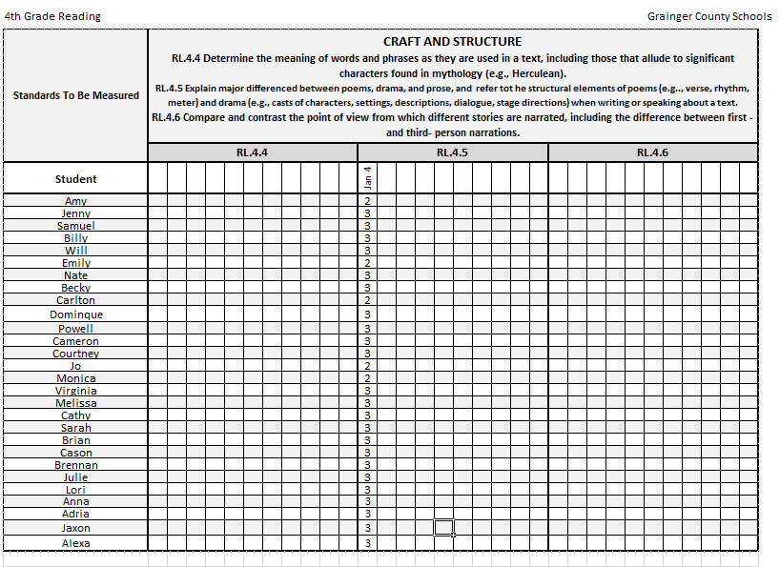
Live Formative Assessment
(Drive By)
Small Group Work
OR
Individual Feedback
1-4-15 Structural Elements of Drama

Slide 8
TEACHER
Not taking papers home to grade
I know who can identify the structural elements- whether we can go on
(Wednesday- I can explain the differences between a play and a story. (RL.4.5))
STUDENT
Students KNOW their success criteria
Timely, standards-based feedback
AFTER scoring- I can give individual or small group feedback OR have students partner up and share answers
Opportunity to self-reflect on the goal

