Slide 1
Revolutionaries from the Past
4th Grade, Unit 4
What life lessons can we learn from revolutionaries in fiction and nonfiction

Slide 2
Day 1
Your learning goal:
I can determine the meaning of the word “revolutionary”.

Slide 3

War
Questions to help your discussion:
Where have you heard this word?
Do you have a family member that has been in a war?
Why do you think people go to war?
Notes:
What do you know about this word? Use the questions on the slide to help you with your discussion. After students talk, make a chart that records student thoughts on why people go to war.

Slide 4
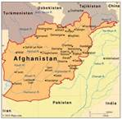
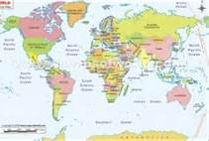
War in Afghanistan
Started: October 7th, 2001
End of the war: May 2012
This is the United States
Afghanistan is in the Middle East
Notes:
The most current war of our country has been the war in Afghanistan. How many of you have heard of this country? Do any of you know why there is a war in that country? Most wars begin because there is a need for change. There could be disagreements over land or who is controlling the land.

Slide 5
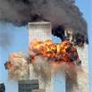
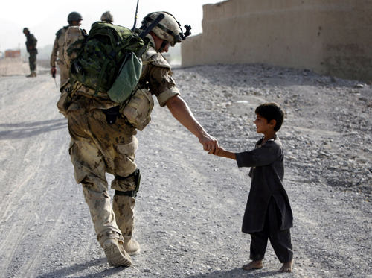
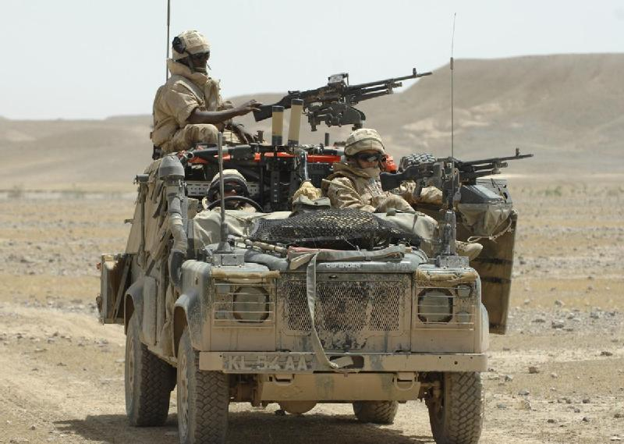
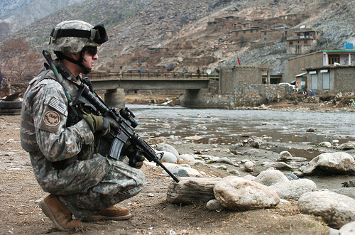
Notes:
This is the reason there was a war in Afghanistan.
The Twin Towers on September 11, 2001…
Our president said that their country had to turn in the people responsible for doing this to our country.
Their leader did not like the United States, so he attacked our country. He wanted to make change in a radical way.
The arrows are pointing to pictures of war in Afghanistain

Slide 6
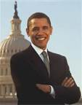
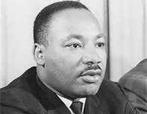
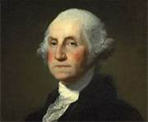
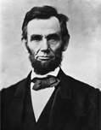
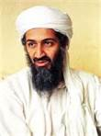
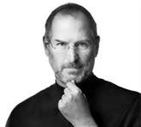
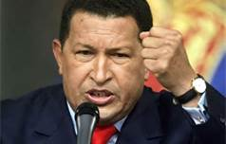
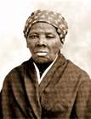
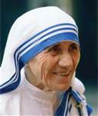
Do you know any of these faces?
Notes:
Do you know why these people are important? Talk at your tables about the faces you see… why are these people important?
Teacher note: the reason there is a picture of bin laden, is that he was the force behind 9/11, and is an example of how not all revolutionaries are good; some are and have been bad people that want negative change.

Slide 7
Notes:
Let’s look at the faces I have shown you. I am going to tell you what they have done in our American history, and you decide if their actions were for better or for worse.
Obama: our first African American President… he made a change in how our country views other African Americans in position of power.

Slide 8
Notes:
Osama Bin Laden: the man who ordered the twin towers to be destroyed. He is our example of a revolutionary that wanted change for horrible reasons and only to hurt others.

Slide 9
Notes:
MLK, was the revolutionary that started the civil rights movement and helped to make change in how African Americans were treated. (1955)

Slide 10
Notes:
Harriet Tubman: the leader of the Underground Railroad; helped to get slaves to freedom; she was a revolutionary for her time because slavery was the way of life (1849)

Slide 11
Notes:
George Washington: Our first American president; leader of the American Revolution; considered the Father of our Country (1783)

Slide 12
Now it is your turn…
How would you define “revolutionary” ?
Notes:
Have students independently define revolutionary. Give them 5 minutes to write down their definition. Once students have had time to record their answers, have students share their responses.
Record their responses on a chart

Slide 13
Revolutionary
The official definition:
sudden, complete, or marked change
of political revolution: relating to or involving a political or social revolution
stirring rebellion: causing, supporting, or advocating revolution
new and different: so new and different as to cause a major change in something
Notes:
Share this slide with the class and look at the similarities between their definitions and the one found in the dictionary.
As a revolutionary, each of these people wanted to make a change, and make a difference for their country.
Tomorrow, we will begin to meet the revolutionaries of the late 1700’s.

Slide 14
Day 1
Your learning goal:
I can determine the meaning of the word “revolutionary”.

Slide 15
Day 2
I can explain what caused the
American Revolution

Slide 16
Revolutionaries past and present
Notes:
APK: what did you learn yesterday about revolutionaries?

Slide 17
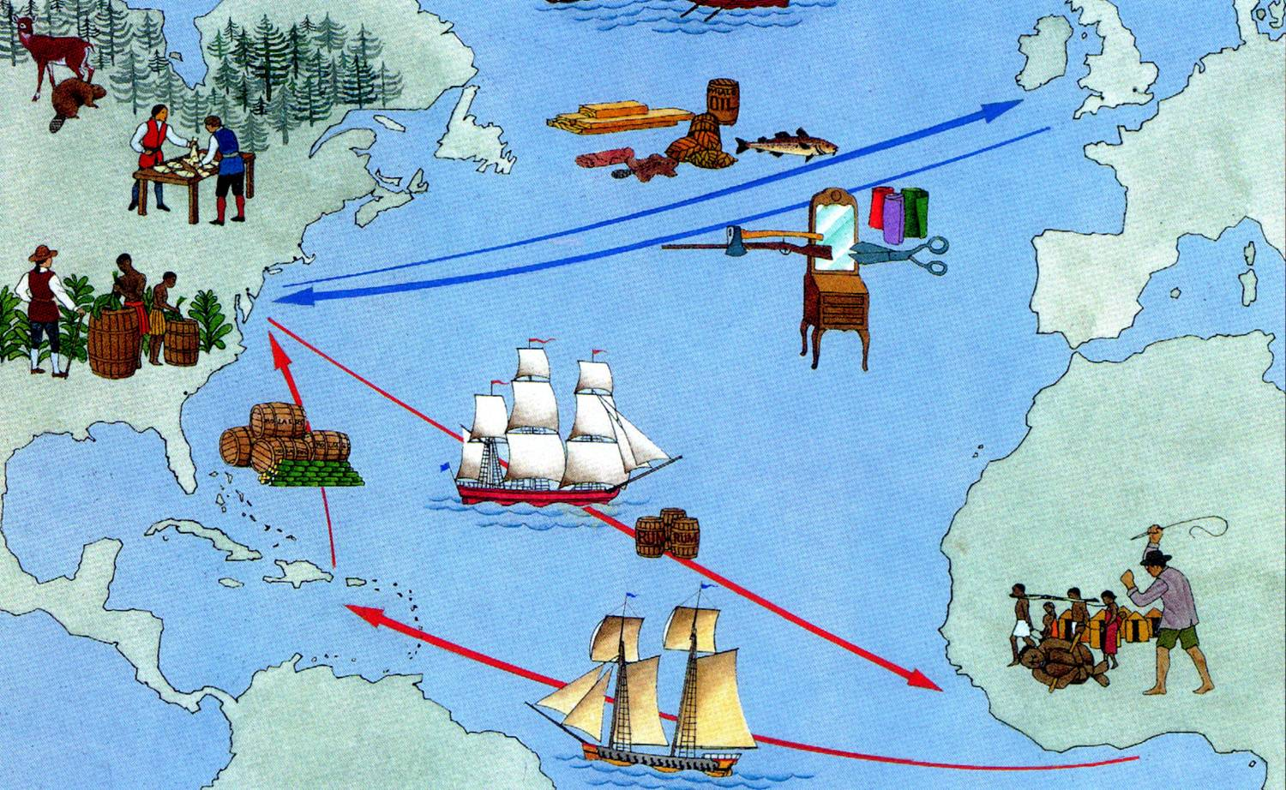
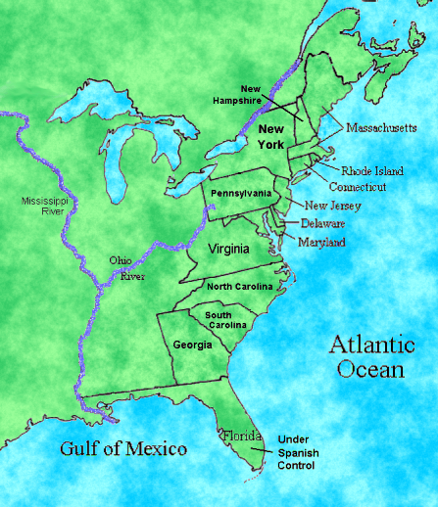
Notes:
New Knowledge: (there is a video linked to the larger map)
The colonists were getting tired of England telling them what to do. England was charging extra money for everything
Today, we are going to travel back in time and learn about revolutionaries that impacted the history of our country.
First, think back to the early grades where you learned about the pilgrims and Native Americans. Do you remember why the colonists left England to come to America?
Show the slide with the maps: the King of England wanted to control those living in the 13 colonies, even though he was an ocean away.
The colonists reached a point when they were ready for a major change; what does this remind you of from yesterday? (revolution)
We are going to watch a video that is going to introduce some amazing revolutionaries that were responsible for the American Revolution

Slide 18

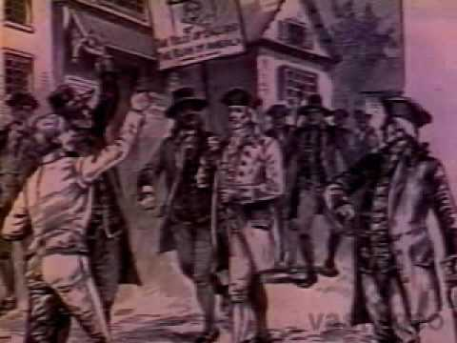
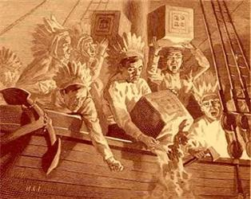
What caused the American Revolution?
Notes:
After watching the video, have students share out their thoughts about it. Have students record in their notebooks why they think the American Revolution started. What change did the colonists want?

Slide 19
Day 2
I can explain what caused the
American Revolution

Slide 20
Day 3
I can compare the difference between first and third person narrations.
Notes:
Today, we are going to focus in on one revolutionary in particular
http://www.pbs.org/ktca/liberty/chronicle.html
http://midnightride.com/ride/virtual.html the map

Slide 21
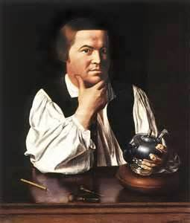
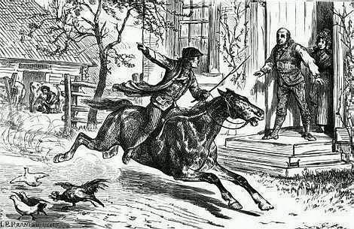
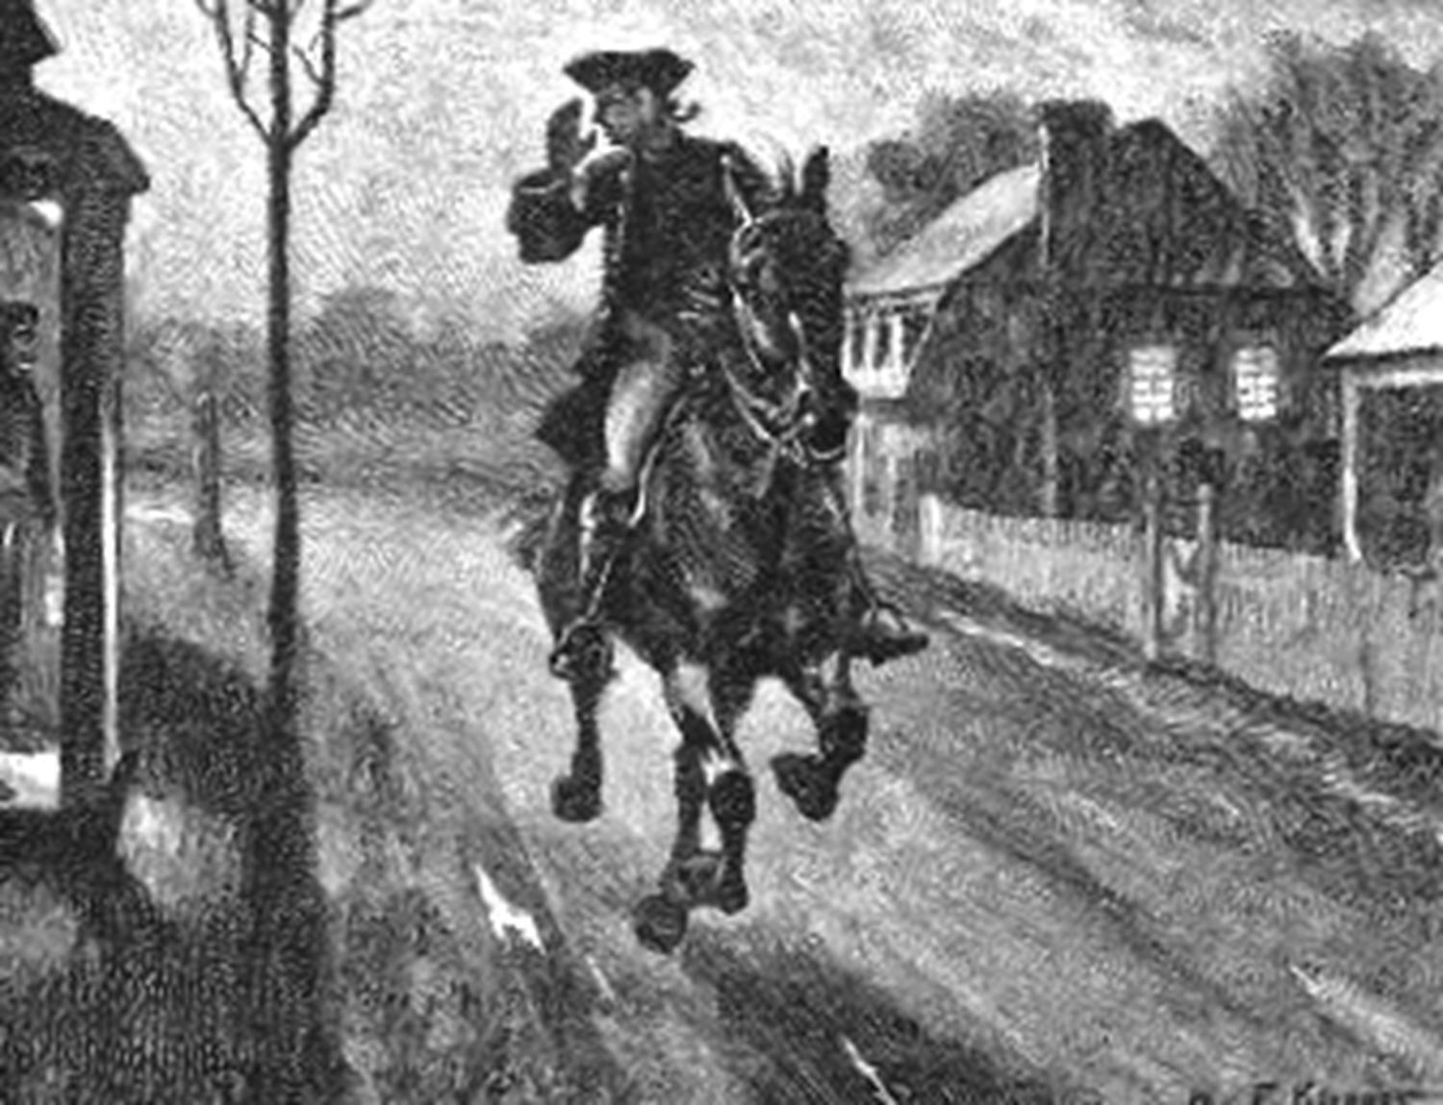
Paul Revere
April 18, 1775
Notes:
The video is hyperlinked to the far picture on the right.
This is an excellent video of a reenactment of Paul Revere’s ride. BUT, there are a few cuss words! The first one is at 5:40, 6:17 and 7:33,and 7:36. The British soldier says D---it and H---. There is a mute button on the bottom of the video that you can click on these cues. I think this is the best video of Paul’s ride, but there is a cartoon on
e at- http://www.youtube.com/watch?v=Na3pq9wqJlA
After the video, have students discuss if it was 1st person or 3rd person and why

Slide 22
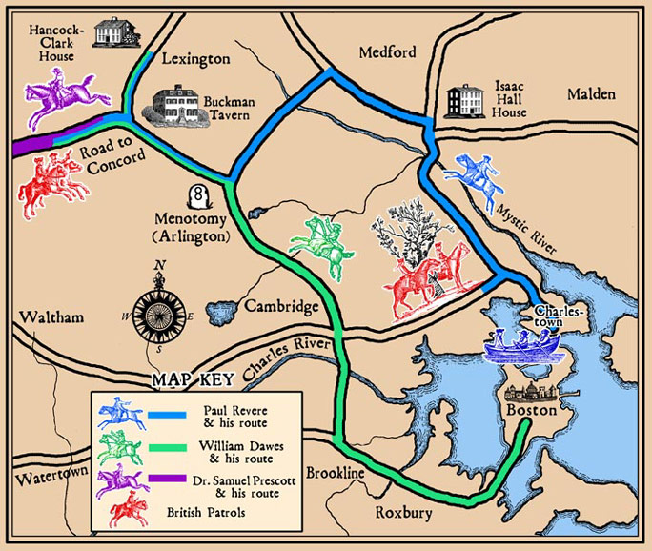
The Midnight Ride of Paul Revere
Notes:
Give students a copy of the poem, The Midnight ride of Paul Revere. Explain that Longfellow is a famous poet, and wrote this poem to give the events of the beginning of the American Revolution. Only read the first few stanzas, and then have students decide if the poem is written from 1st person or 3rd person. Why?

Slide 23
Day 3
I can compare the difference between first and third person narrations.
Notes:
Today, we are going to focus in on one revolutionary in particular
http://www.pbs.org/ktca/liberty/chronicle.html
http://midnightride.com/ride/virtual.html the map

