Slide 1
Text Talk
Westside Elementary

Slide 2
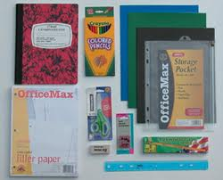
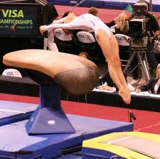
The word apparatus means tools or equipment made for a specific task.
Our town has excellent fire-fighting apparatus.
Which picture goes with apparatus? Explain why the picture goes with apparatus. .

Slide 3
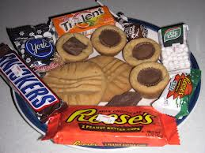
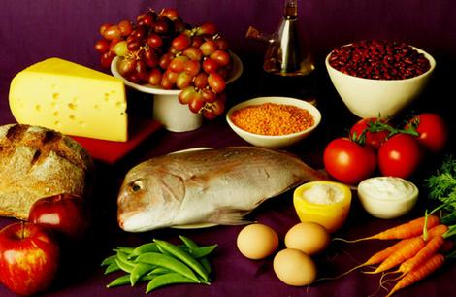
The word essential means completely necessary.
It is essential to follow the rules at school.
Choose the picture that shows foods that are essential for good health. Explain your answer.

Slide 4
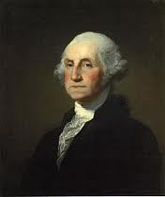
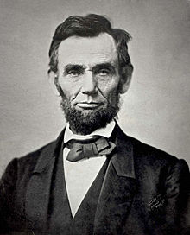
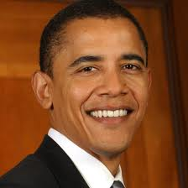
The word prestigious means highly respected or esteemed.
She was given a prestigious award for her acts of kindness.
Choose a person below that you consider to be prestigious. Explain why you think they are prestigious.

