Slide 1
Comparing
Hurricanes and Tornadoes
4th Grade Unit 2

Slide 2
Goal:
I can use the steps for comparing.
I can use information from a text to compare.
Notes:
Students need to engage with the goals- read, repeat, write, etc….

Slide 3
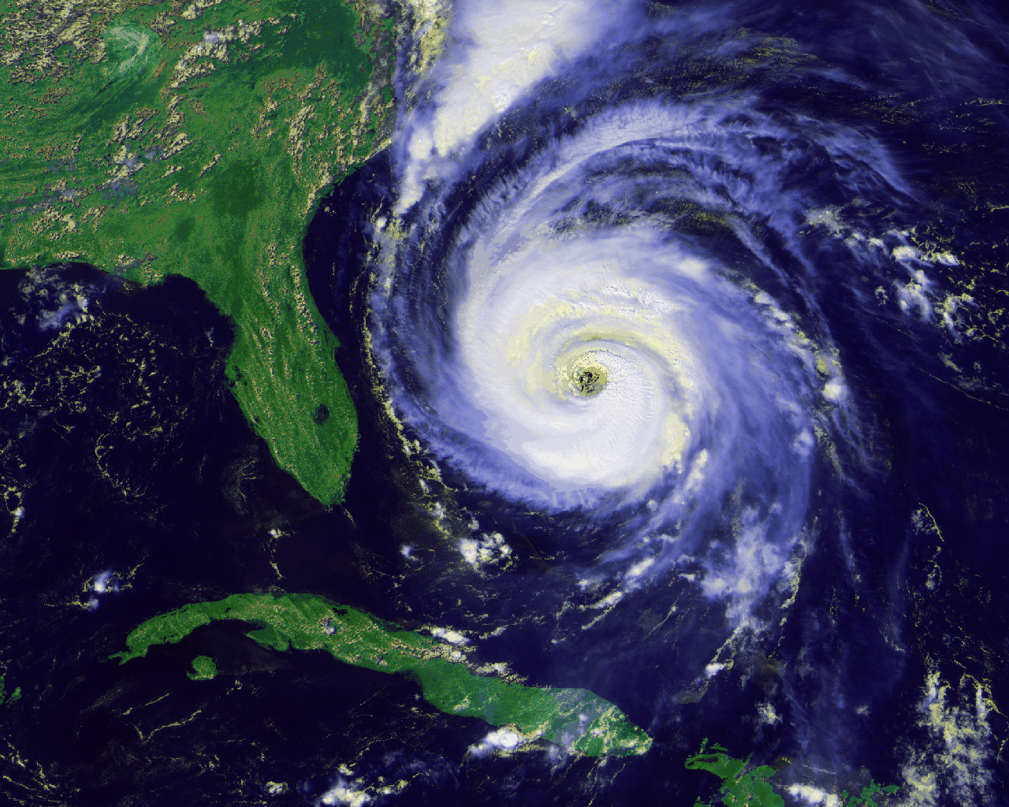
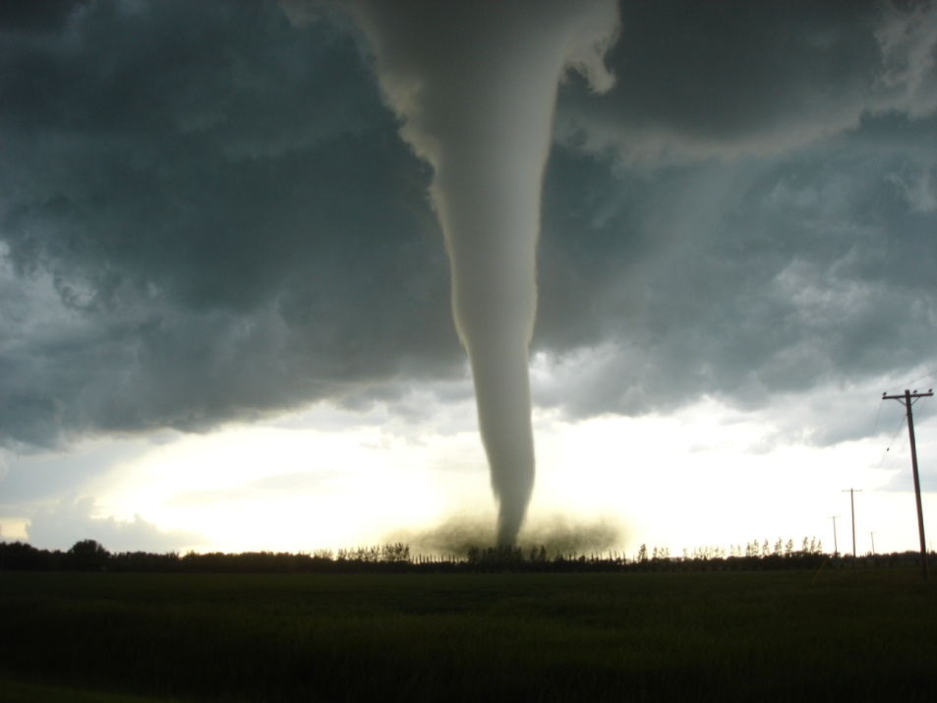
What do you know about these?
Notes:
Access Student’s Prior Knowledge
Turn and Talk- “What do you know about these?”

Slide 4
Steps for Comparing
I find the items to compare
I choose the features to compare the items
I tell how the items are the same or different
Notes:
New Information-
Introduce the steps for comparing

Slide 5
Steps for Comparing
I find the items to compare
I choose the features to compare the items
I tell how the items are the same or different
Notes:
New Information
Step 1

Slide 6
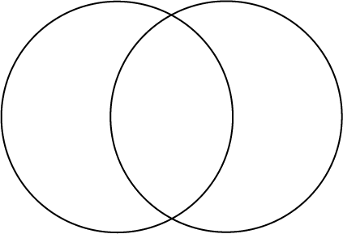
Steps for Comparing
I find the items to compare
I choose the features to compare the items
I tell how the items are the same or different
Type of storm
Wind speed
Damage
Season
Notes:
New Information
Step 2

Slide 7
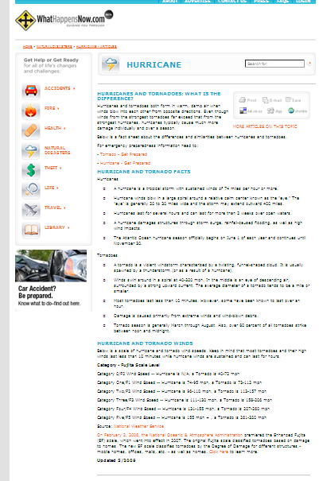
Read about Hurricanes and Tornadoes
Complete the Graphic Organizer
Type of storm
Wind speed
Damage
Season
http://www.whathappensnow.com/articles_show.cfm?id=171&cat=4&sub=4
Notes:
Application
Read and annotate- model highlighting, underlining, circling, jotting notes
Complete the graphic organizer

Slide 8
Steps for Comparing
I find the items to compare
I choose the features to compare the items
I tell how the items are the same or different
Write a paragraph about how hurricanes and tornadoes are the same and a paragraph about how they are different.
Notes:
Application
Have students write a paragraph about how the items are the same and a paragraph about how the items are different.

Slide 9
Goal:
I can use the steps for comparing.
I can use information from a text to compare.
Notes:
Revisit the Goal

